Slide 1
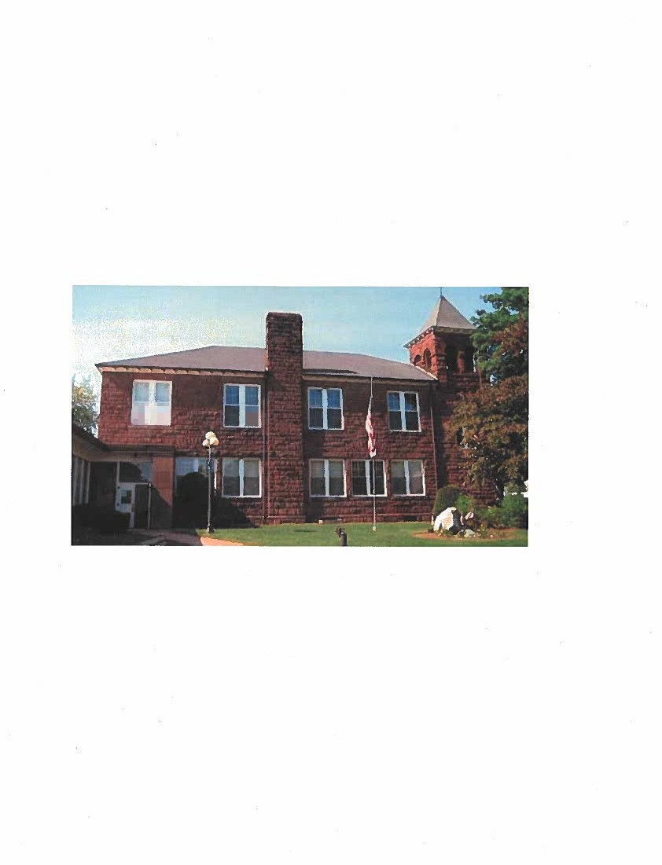




Slide 2



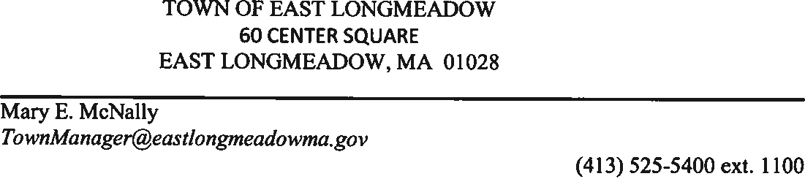
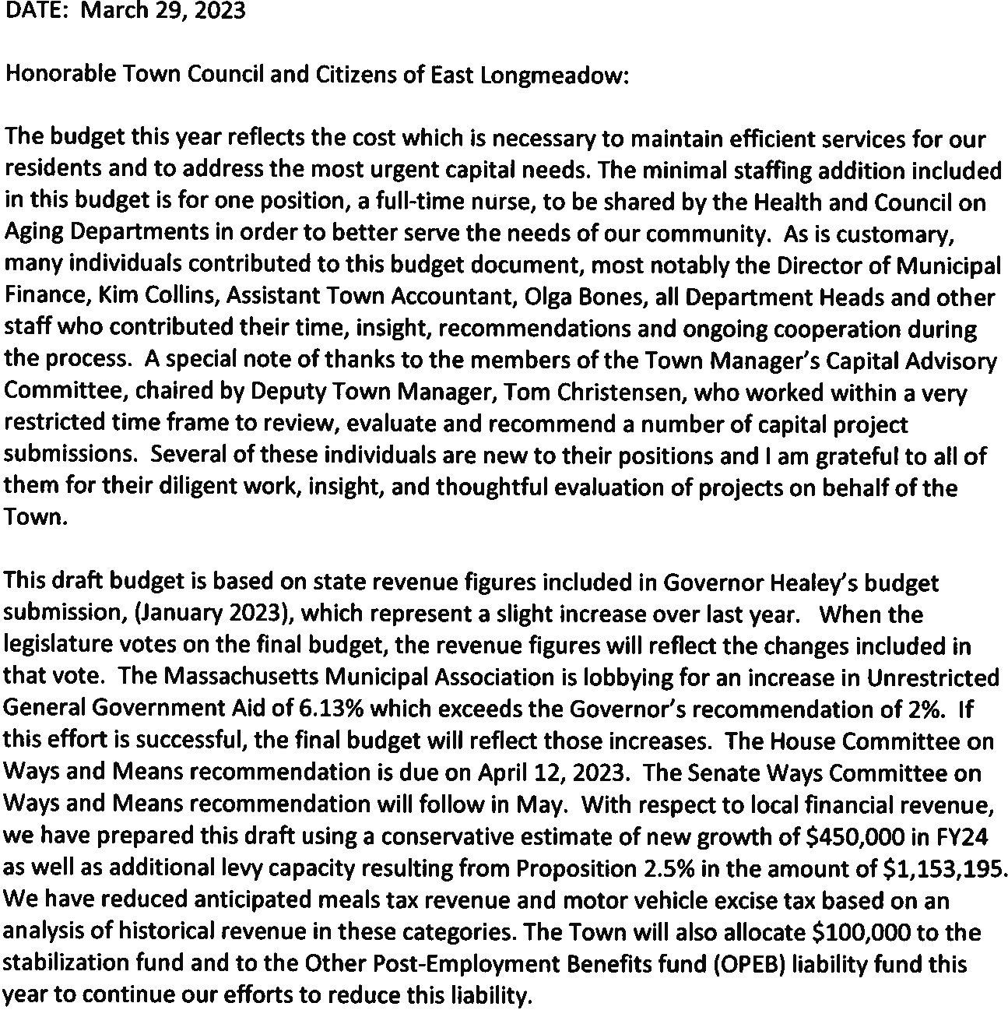

Slide 3

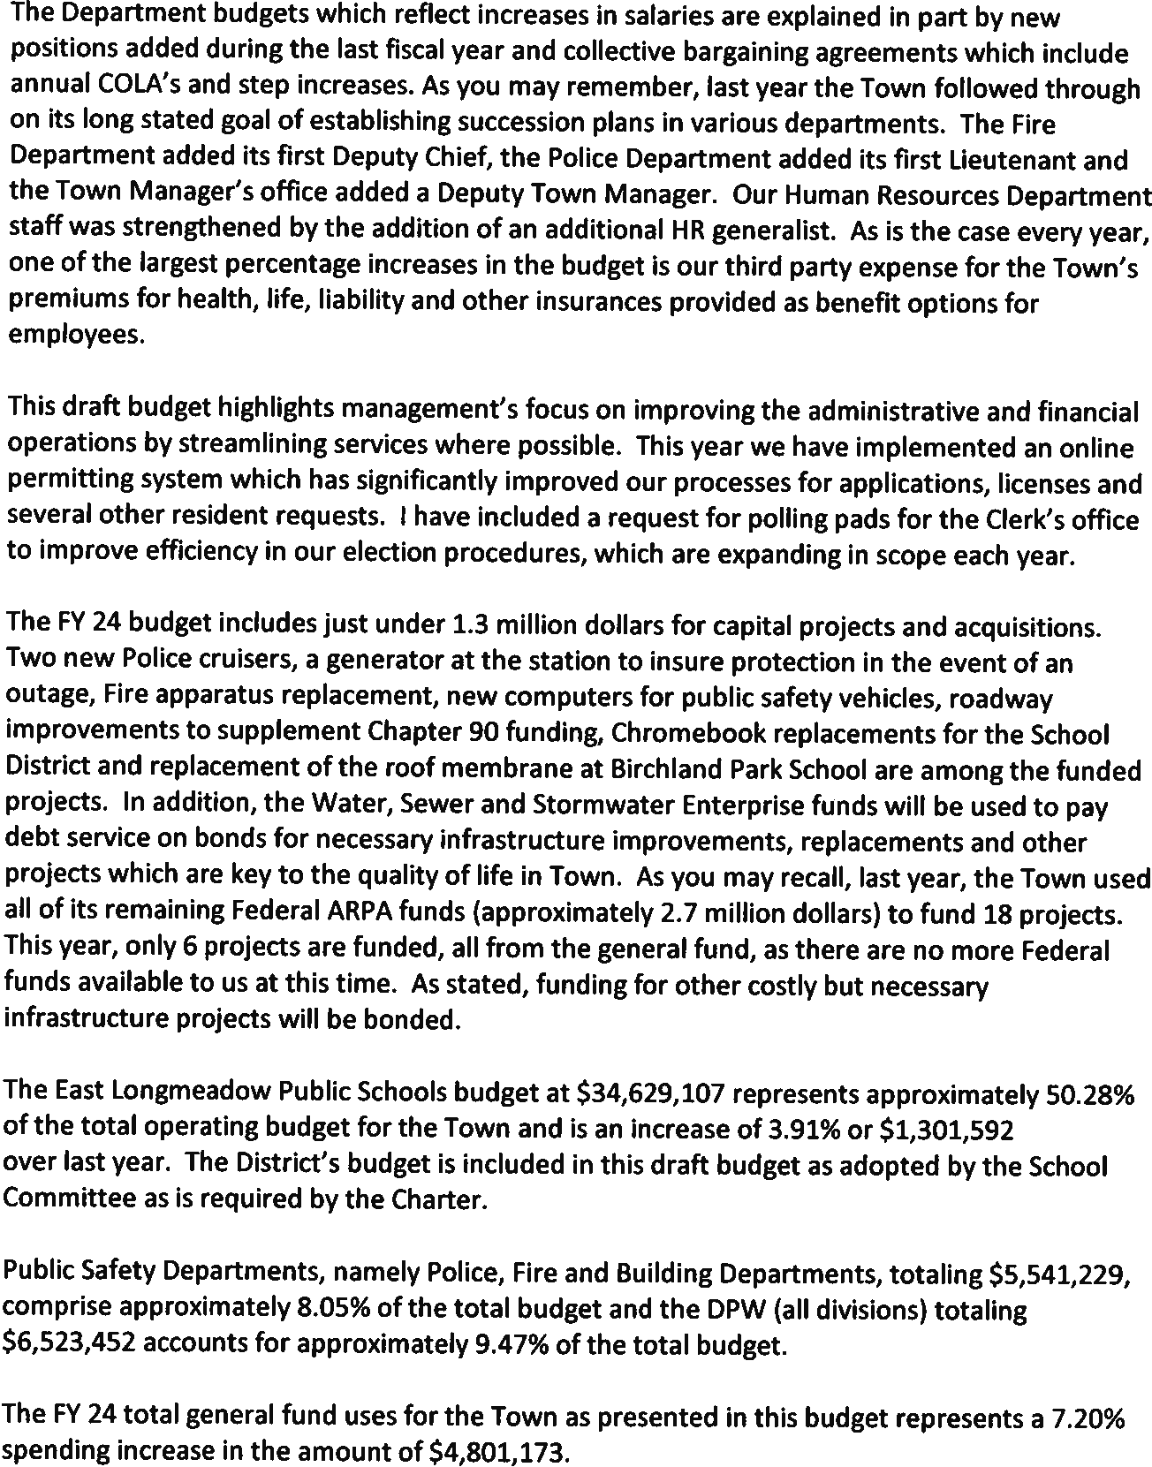

Slide 4

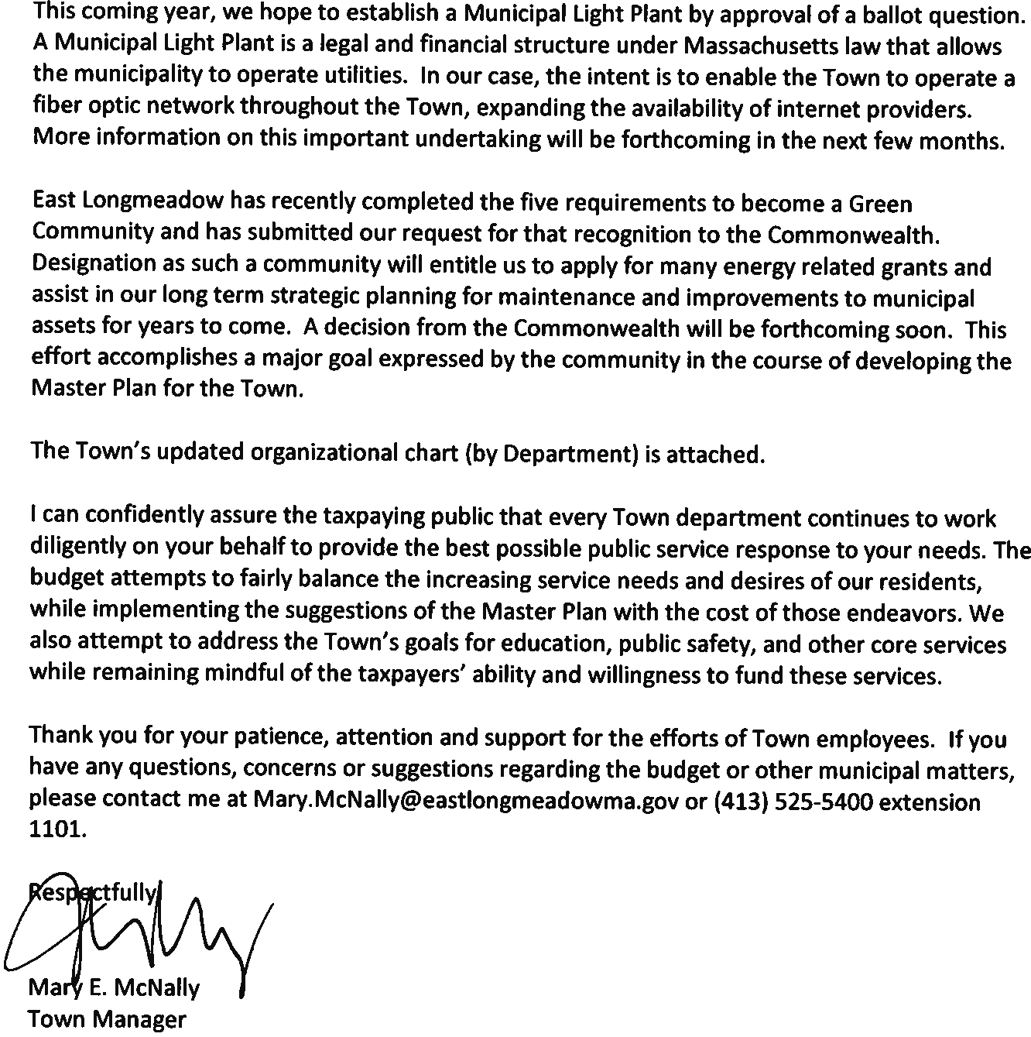

Slide 5

MUNICIPAL FINANCE TERMINOLOGY
Thefollowing terms arefrequently used in this report
Ahatement: A reduction of a real or personal property tax, motor vehicle excise, a fee, charge, or special assessment imposed by a governmental unit and granted only on application of the person seeking the abatement and only by the committing governmental unit.
Appropriation: An authorization granted by a town meeting to expend money and incur obligations for specific public purposes. An appropriation is usually limited in amount and as to the time period within which it may be expended.
Available Funds: Balances in the various fund types that represent non-recurring revenue sources. As a matter of sound practice, they are frequently appropriated to meet unforeseen expenses, for capital expenditures or other onetime costs. Examples of available funds include free cash, stabilization funds, overlay surplus and enterprise retained earnings.
Budget:A plan for allocating resourcestosupport services, purposes, and functions overaspecificperiodoftime.
Cherry Sheet: Named for the cherry colored paper on which they were originally printed, the Cherry Sheet is the official notification to cities, towns and regional school districts of the next fiscal year's state aid and assessments. The aid is in the form of distributions, which provide funds based on formulas and reimbursements for costs incurred during a prior period for certain programs or services.
Cherry Sheet Assessments: Estimates of annual charges to cover the cost of certain state and county programs.
Debt Service: The repayment cost, usually stated in annual terms and based on an amortization schedule, of the principal and interest on any particular bond issue.
Enterprise Funds: An enterprise fund, authorized by MGL Ch. 44§53F 1/2 is a separate accounting and financial reporting mechanism for municipal services for which a fee is charged in exchange for goods or services. It allows a community to demonstrate to the public the portion of total costs of a service that is recovered through user charges and the portion that is subsidized by the tax levy, if any. With an enterprise fund, all costs of service delivery - direct, indirect, and capital costs - are identified. Enterprise accounting also enables communities to reserve the "surplus" or net assets unrestricted (retained earnings) generated by the operation ofthe enterprise rather than closing it out of the general fund at year-end.
Estimated Receipts: A term that typically refers to the anticipated local revenues listed on page three of the Tax Recapitulation Sheet (Recap Sheet). Projections of local revenues are often based on the previous year's receipts and represent funding sources necessary to support a community's annual budget.
Fiscal Year: Since 1974, the Commonwealth and municipalities have operated on a budget cycle that begins July I and ends June 30. The designation of the fiscal year is that of the calendar year in which the fiscal year ends. For example, the 2021 fiscal year is July I, 2020 to June 30, 2021.
Free Cash (Also Budgetary Fund Balance): Remaining, unrestricted funds from operations of the previous fiscal year including unexpended free cash from the previous year, actual receipts in excess of revenue estimates shown on the tax recapitulation sheet, and unspent amounts in budget line-items. Unpaid property taxes and certain deficits reduce the amount than can be certified as free cash. The calculation of free cash is based on the balance sheet as of June 30, which is submitted by the community's auditor, accountant, or comptroller. Important - free cash is not available for appropriation until certified by the Director of Accounts of the Commonwealth of Massachusetts.
General Fund: The fund used to account for most financial resources and activities governed by the normal town meeting/city council appropriation process.

Slide 6

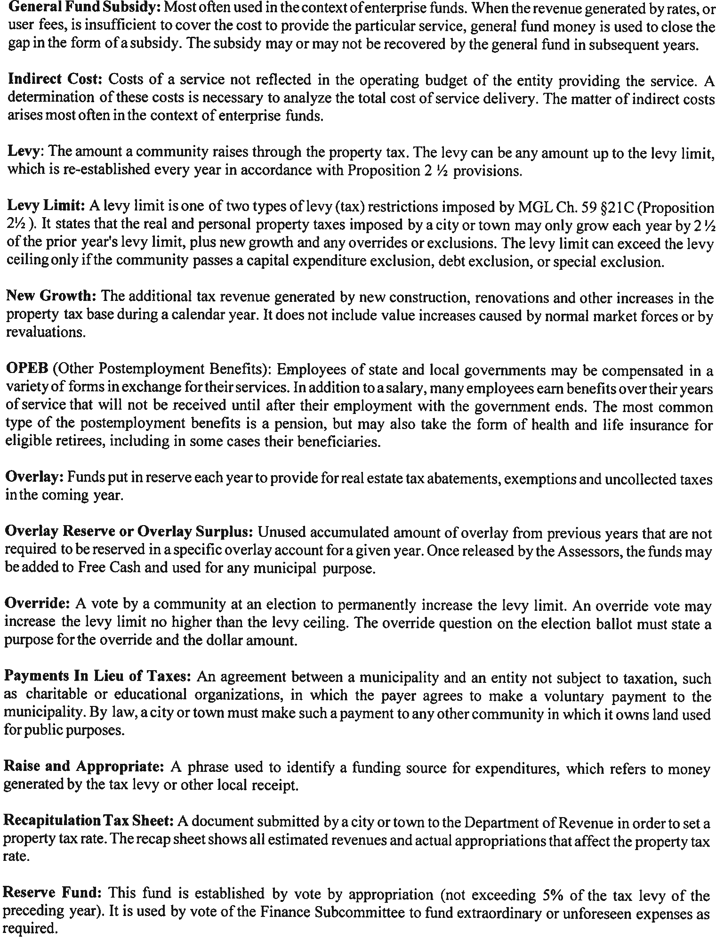

Slide 7

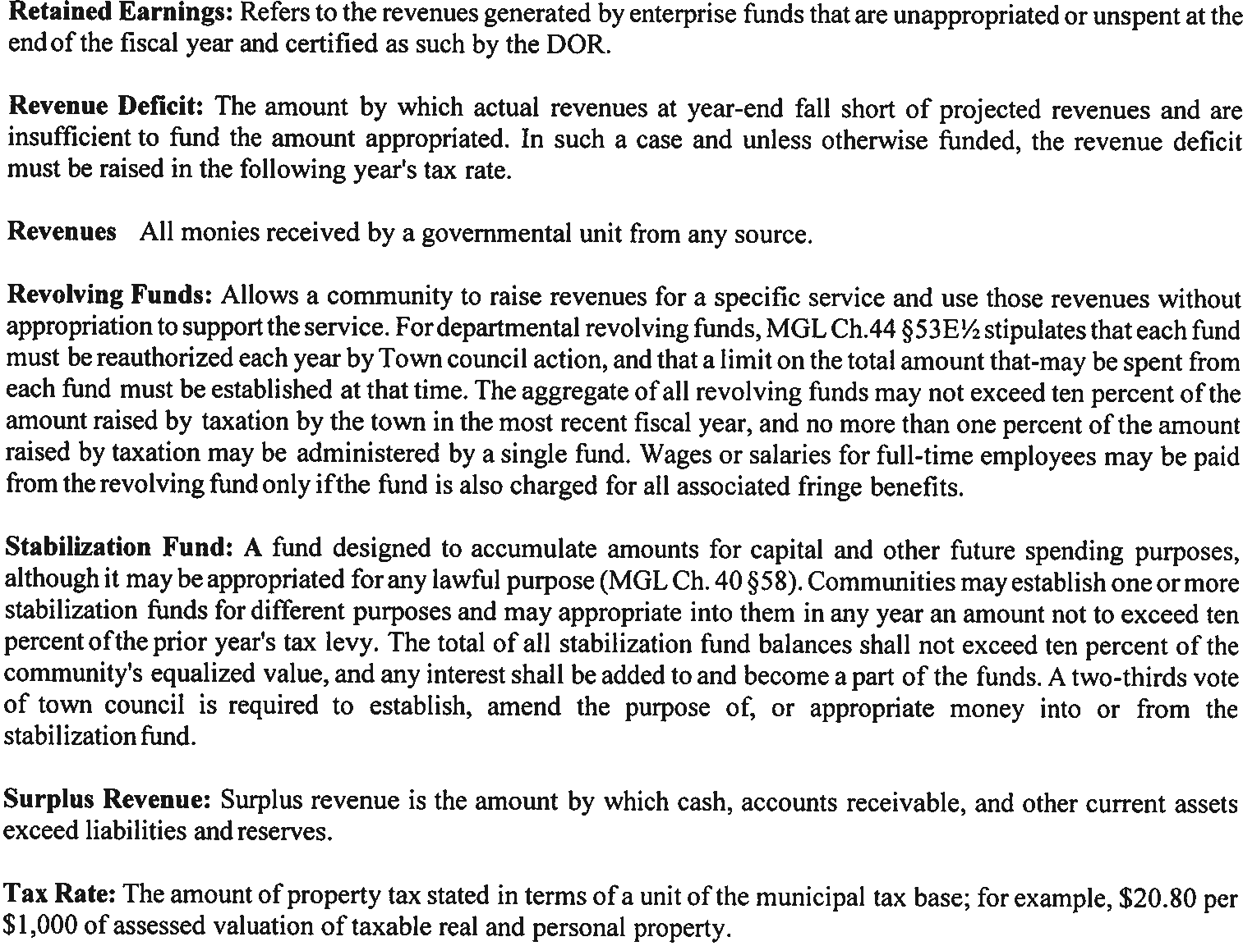

Slide 8

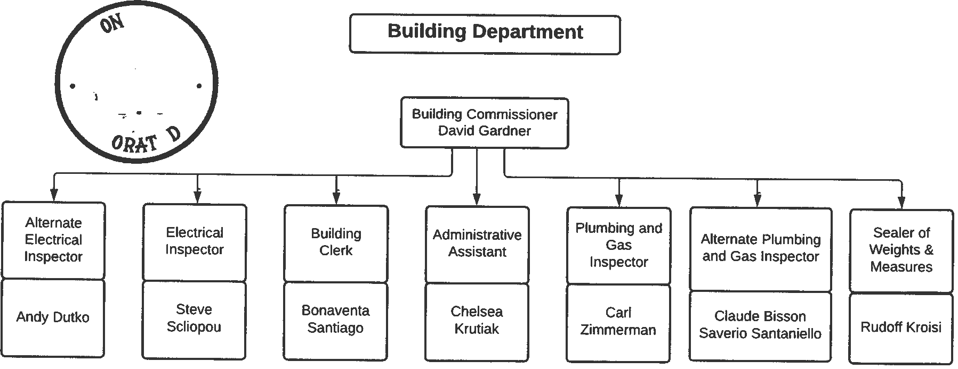


Slide 9

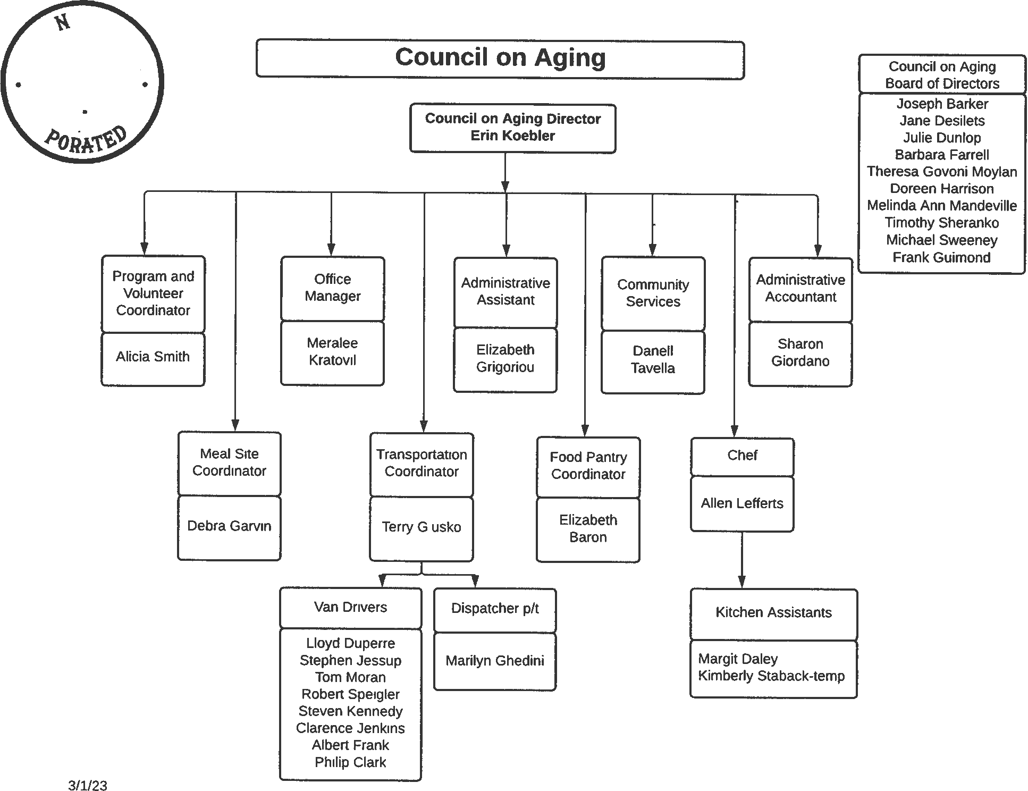


Slide 10


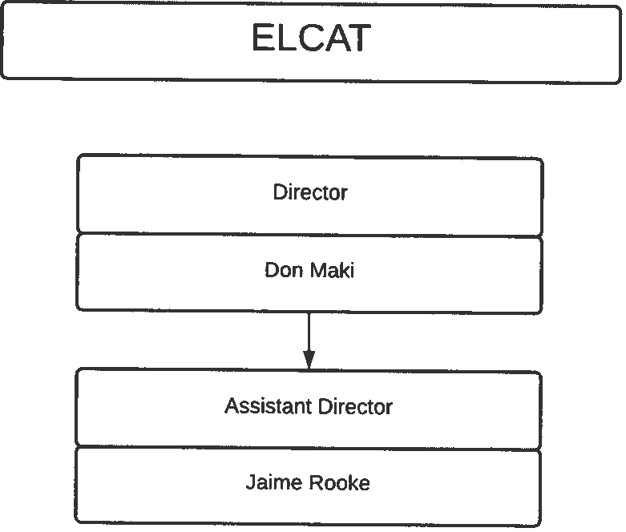



Slide 11

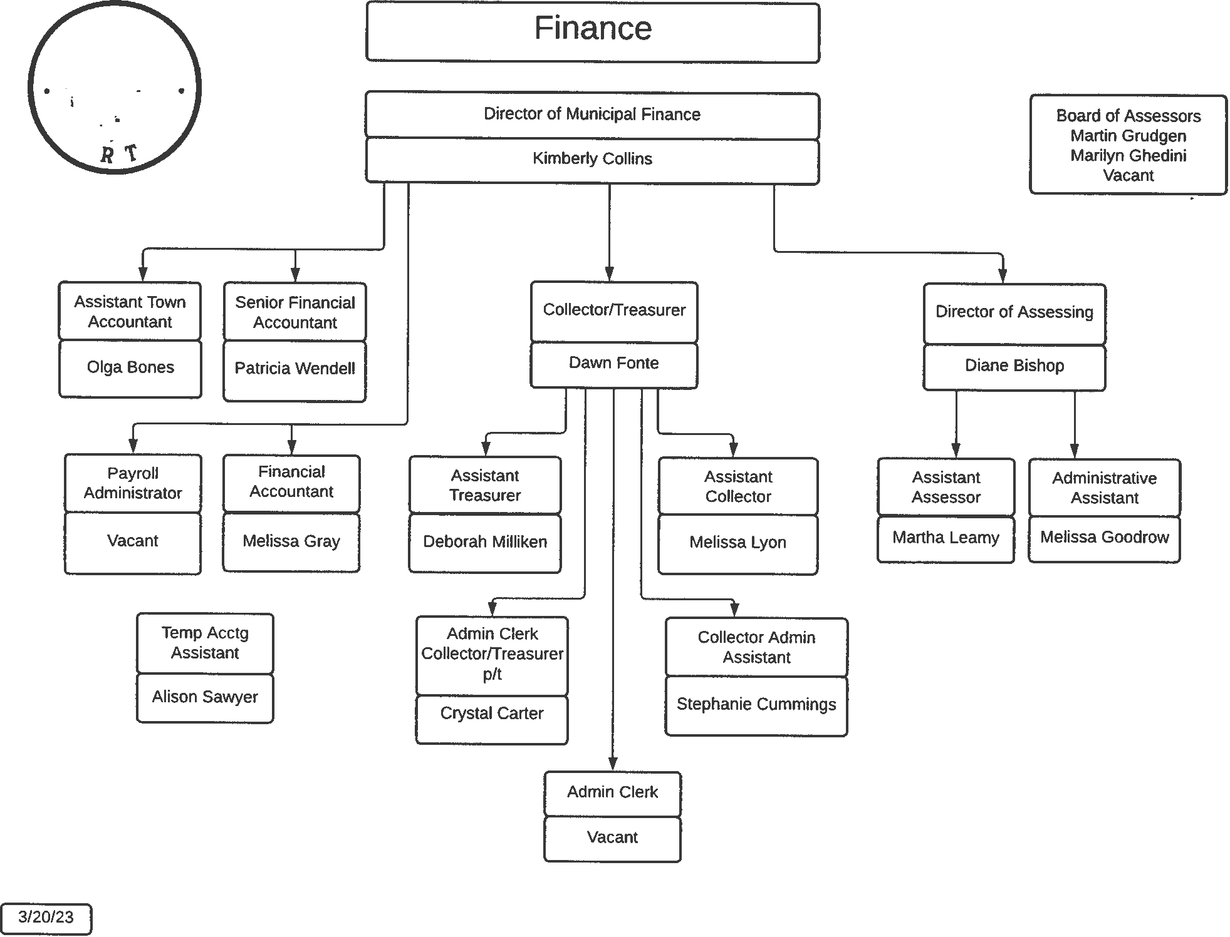


Slide 12

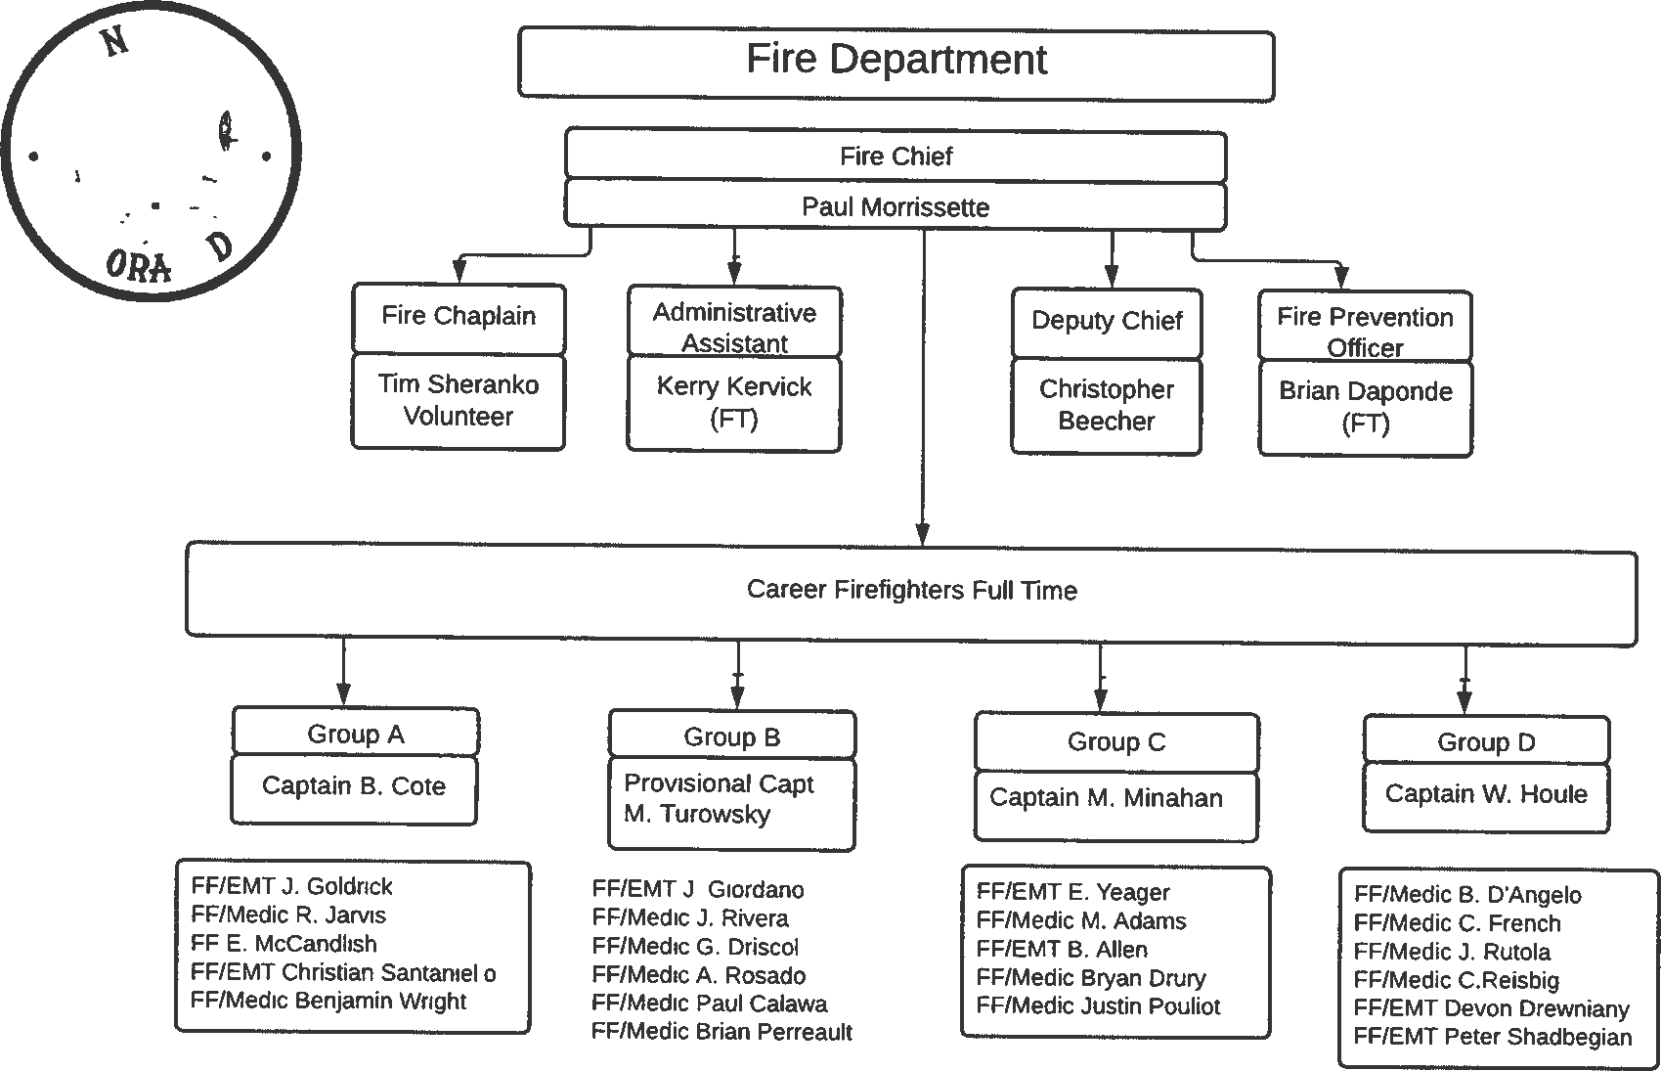


Slide 13

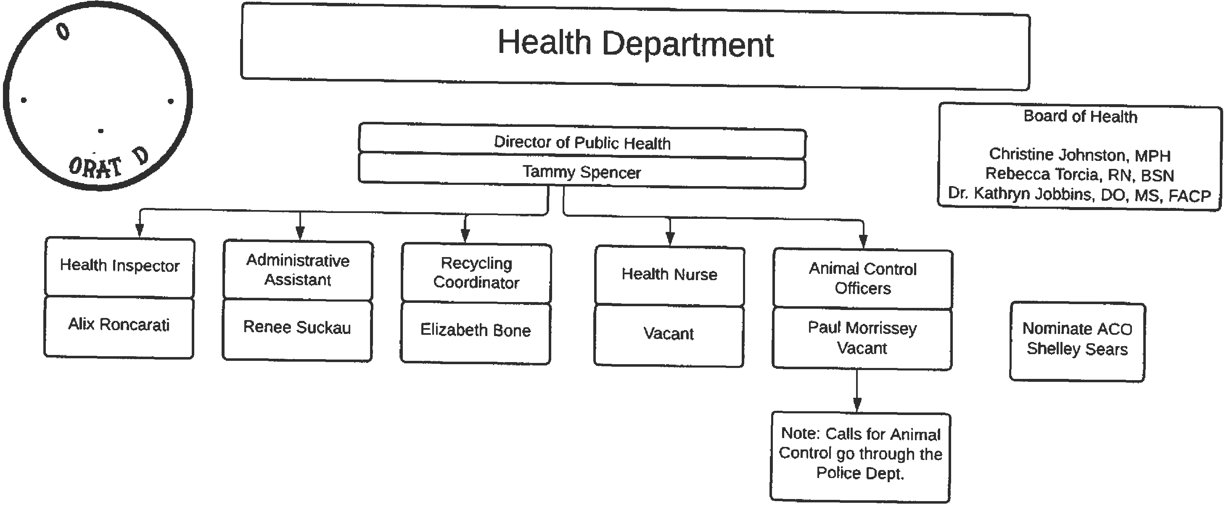



Slide 14

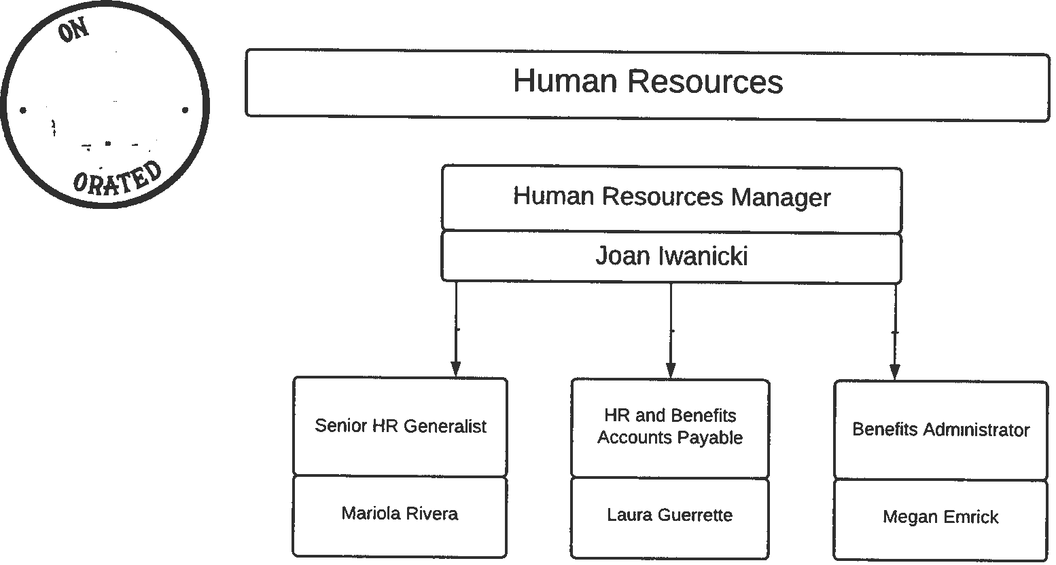


Slide 15

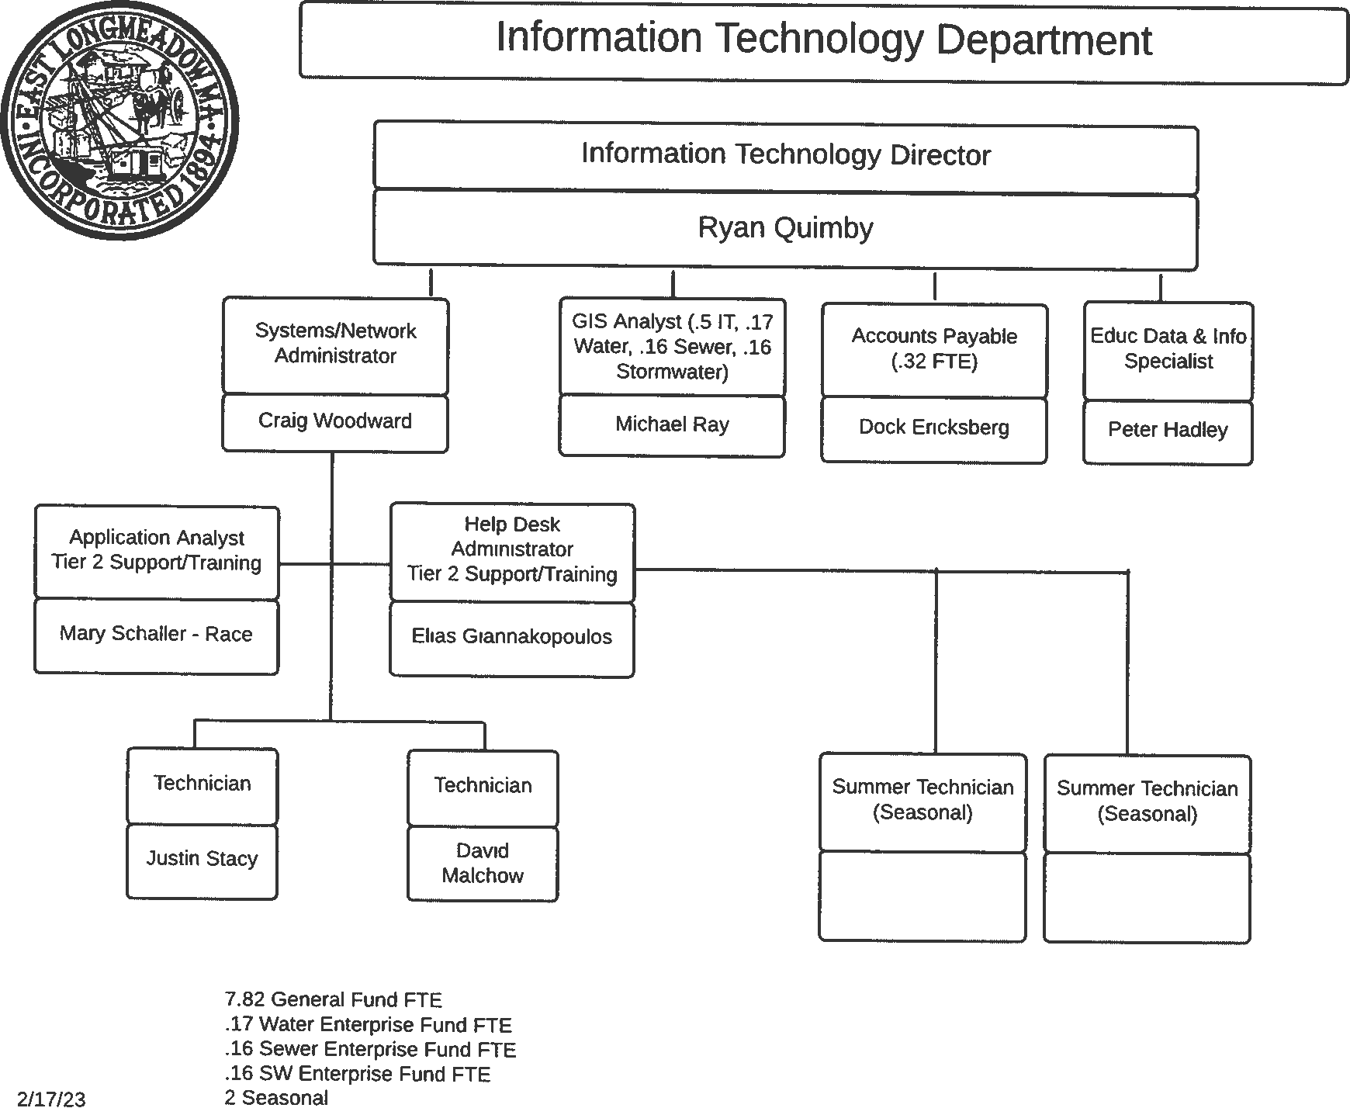


Slide 16

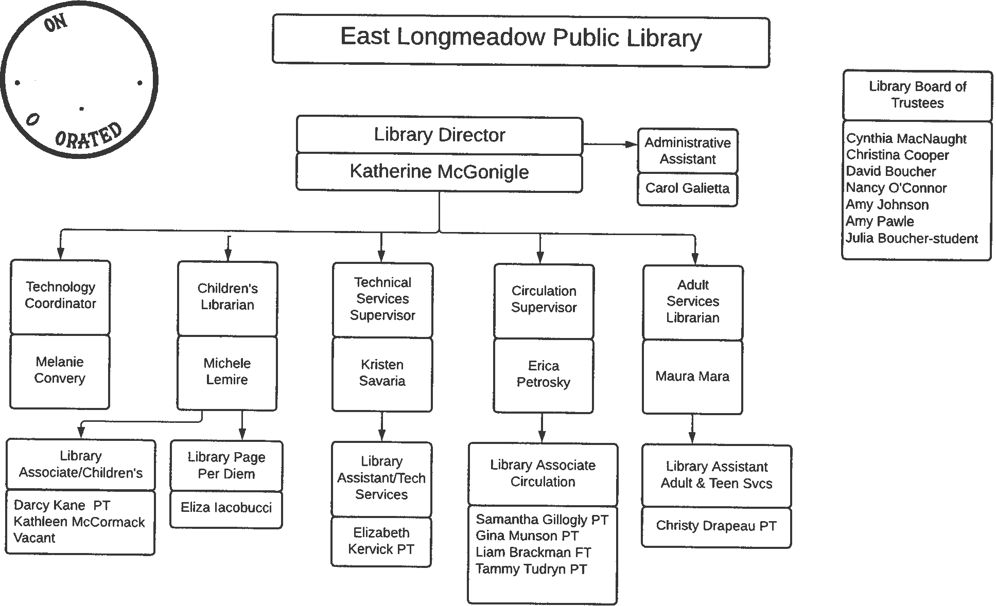


Slide 17


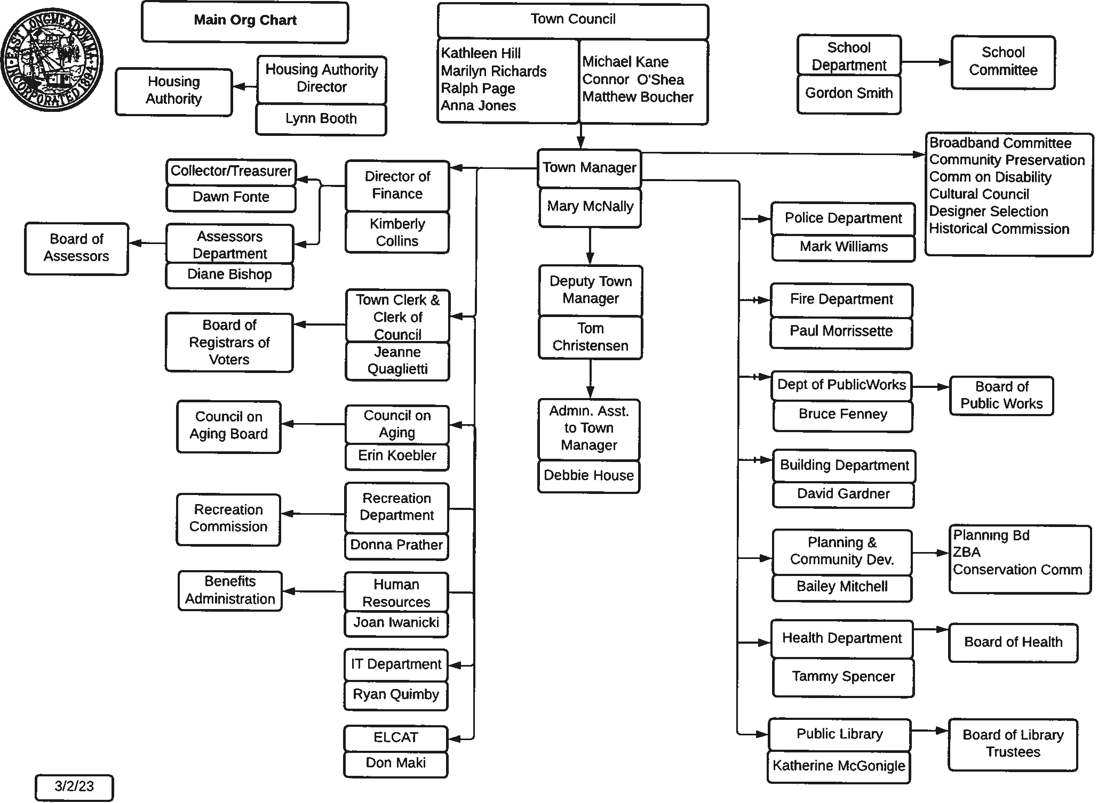

Slide 18

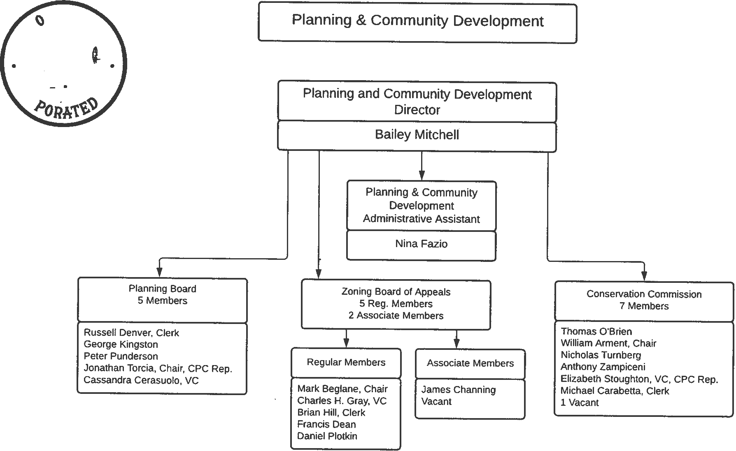


Slide 19
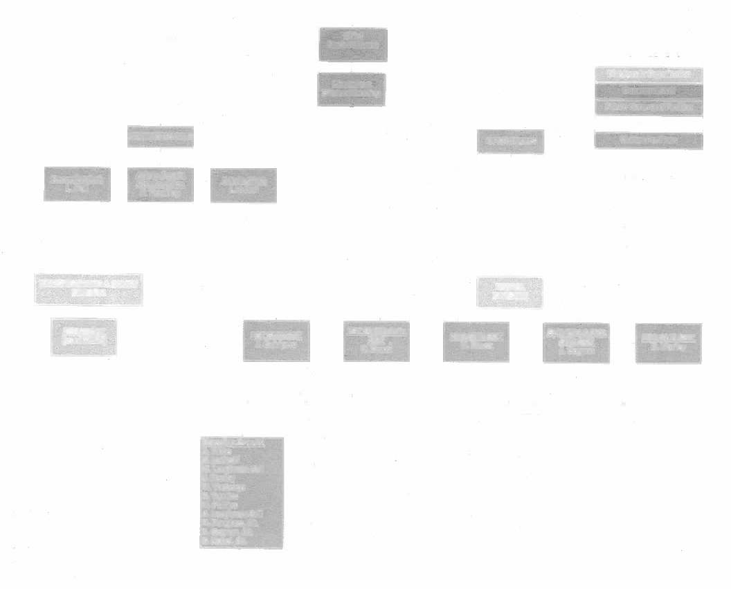
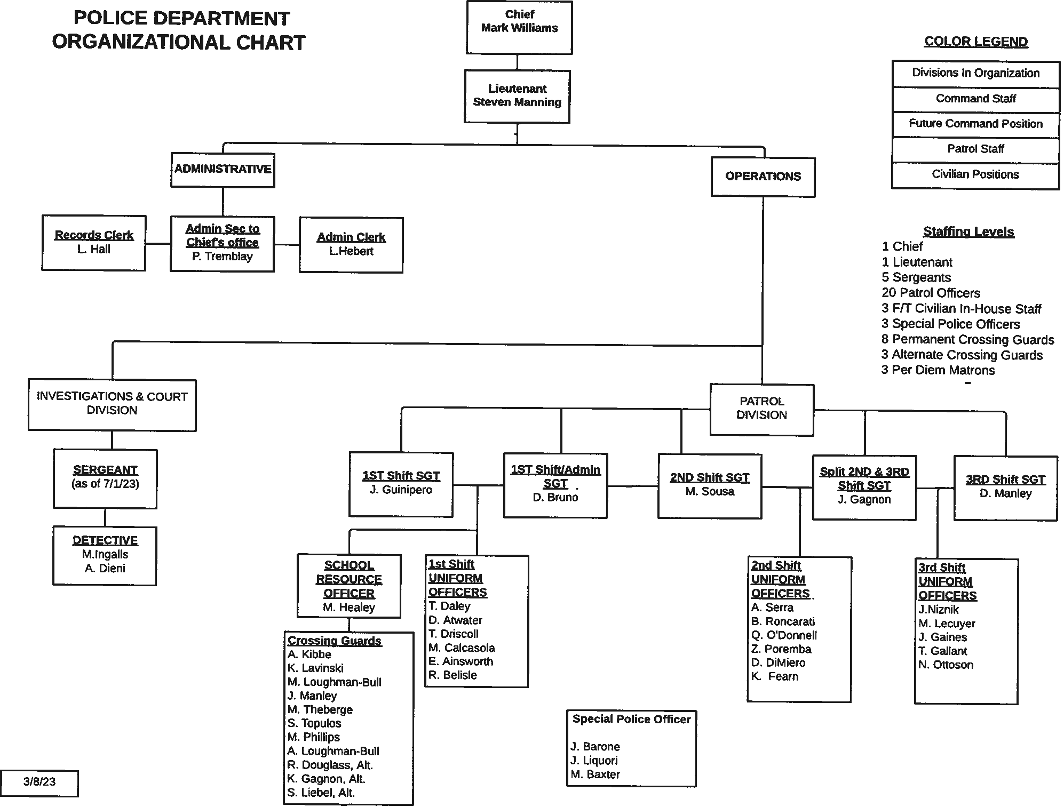

Slide 20

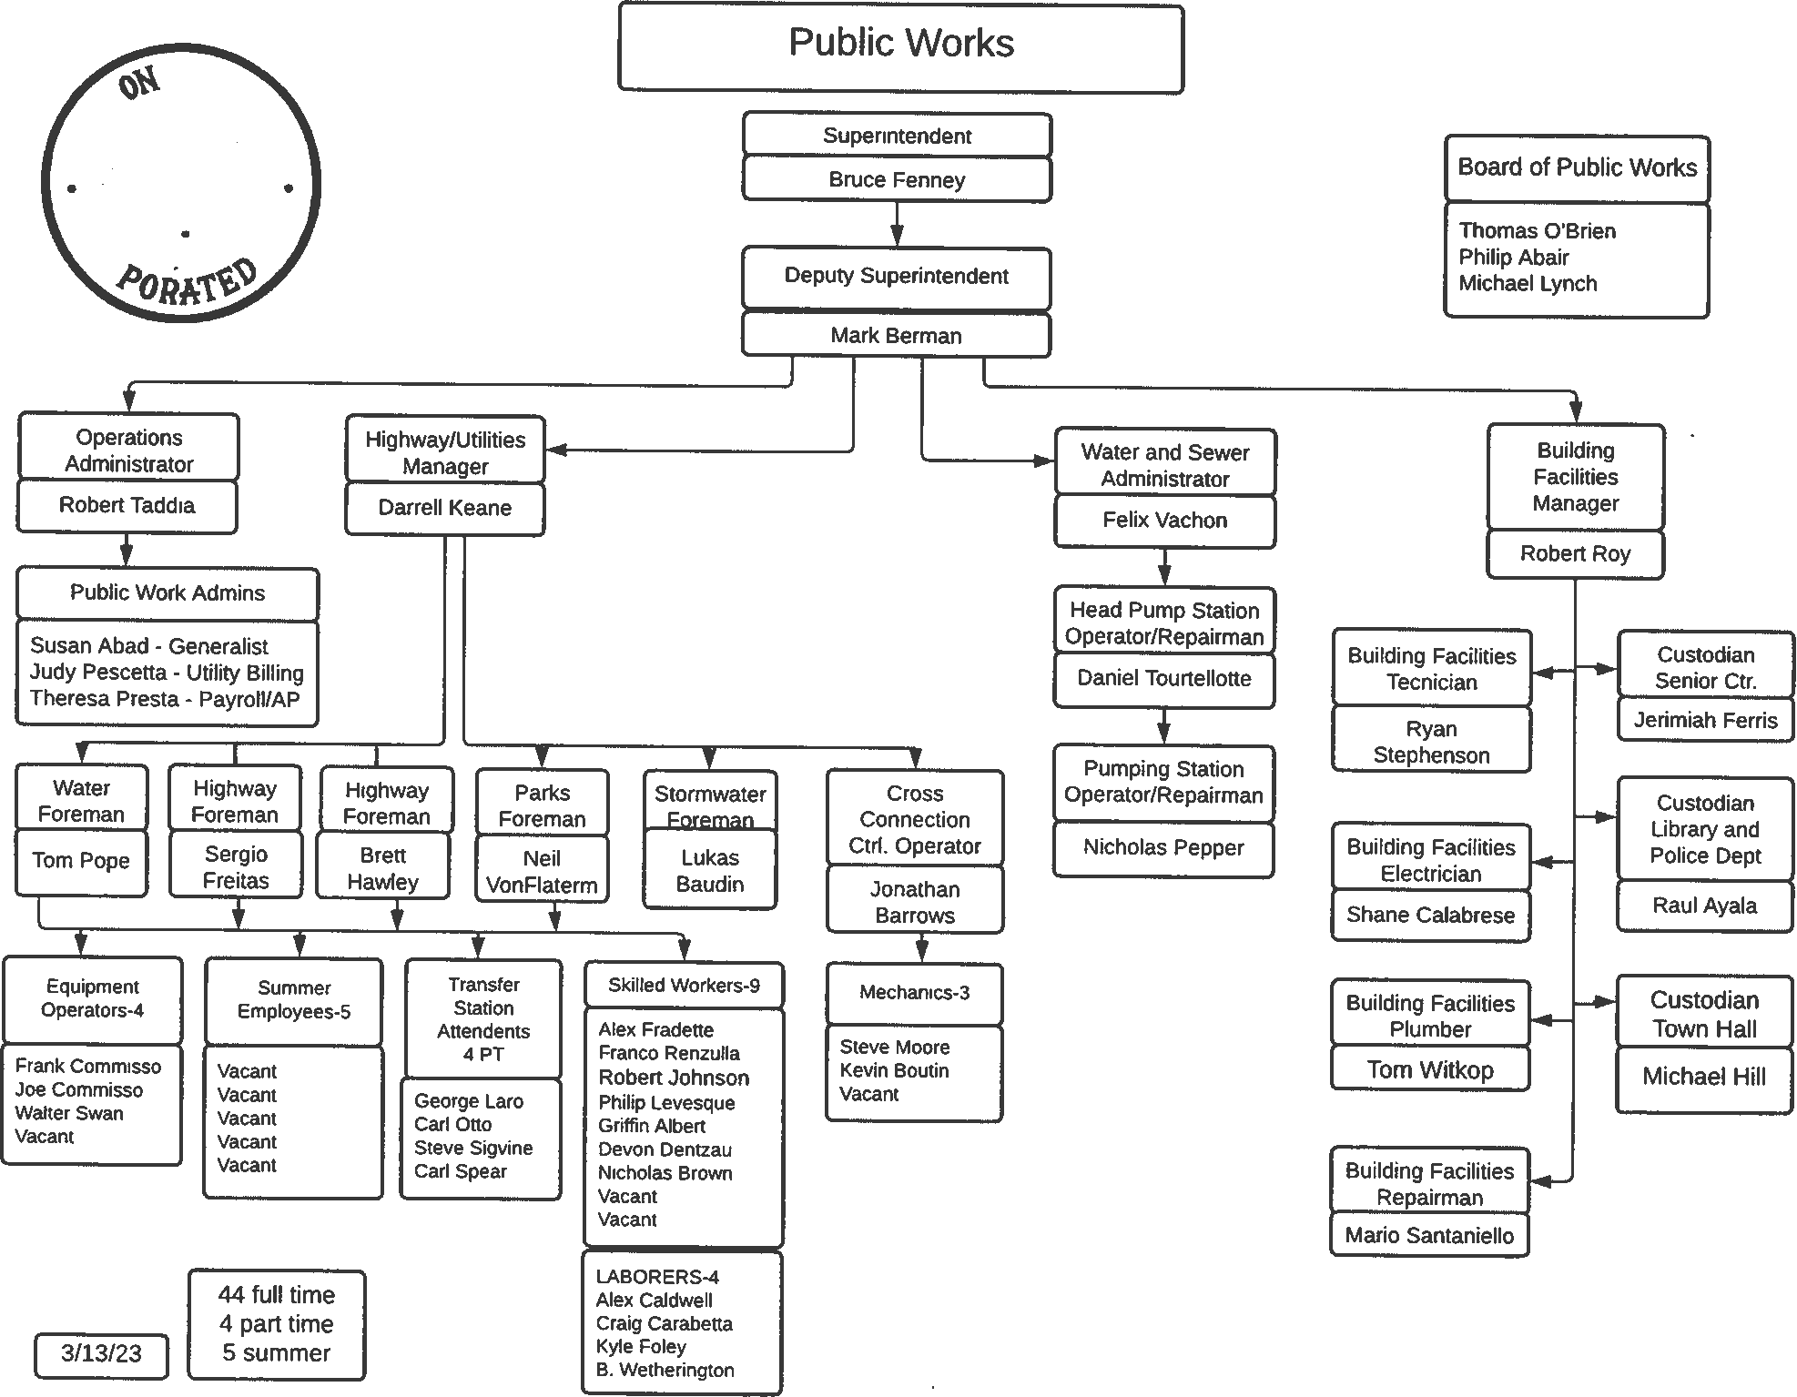

Slide 21


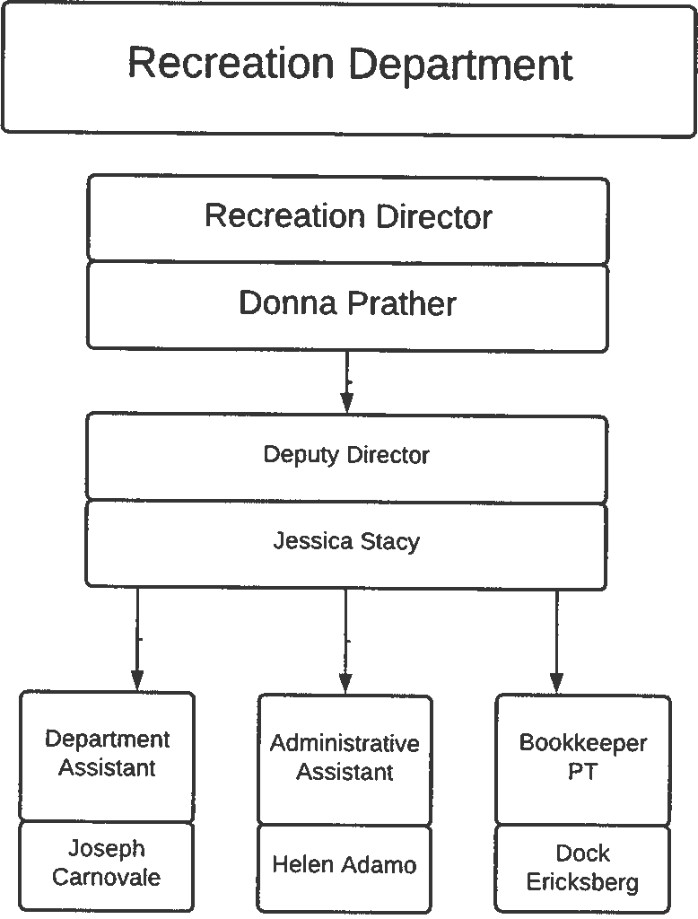
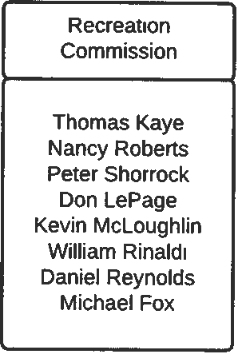




Slide 22

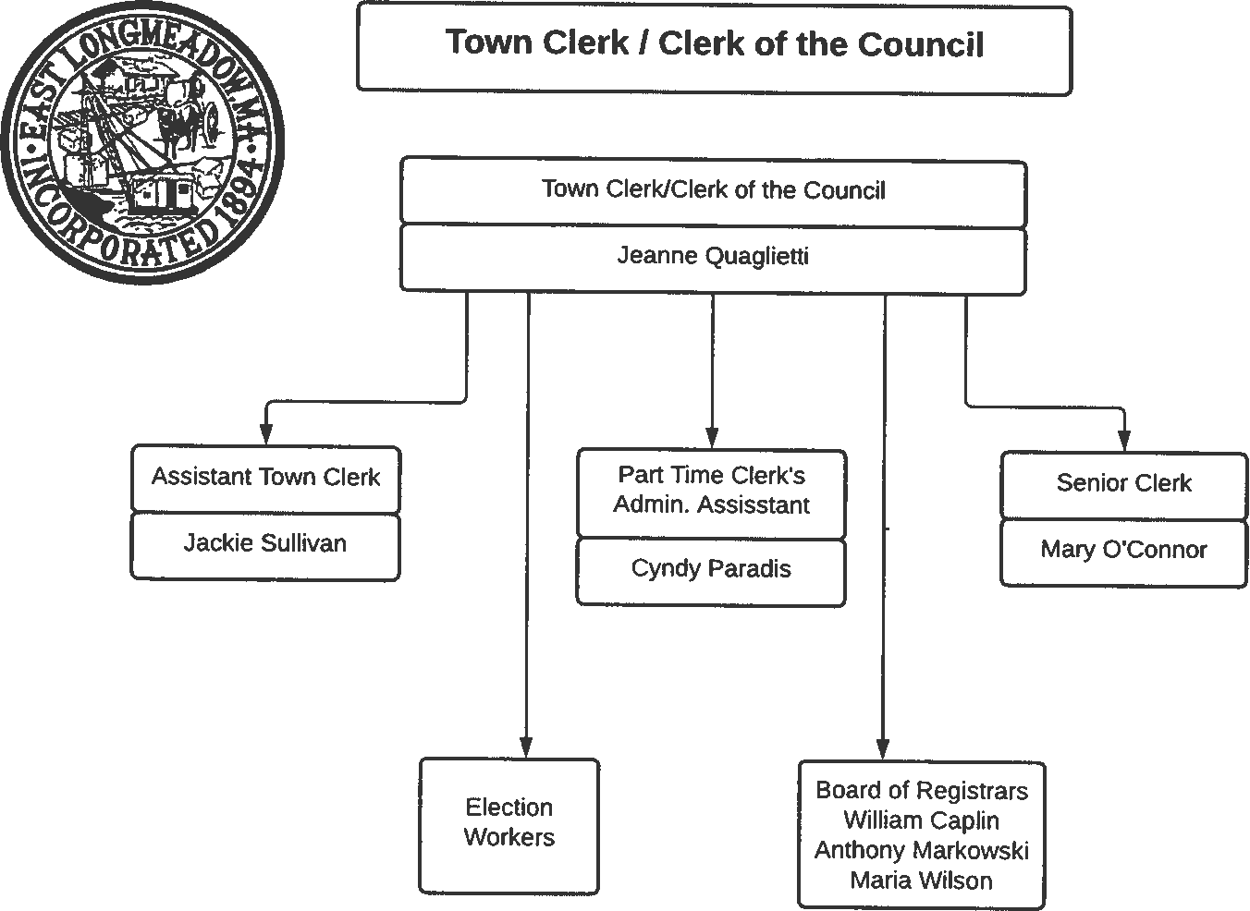
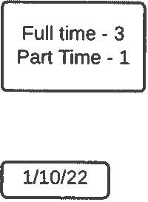

Slide 23
EAST LONGMEADOW
RECAP SUMMARY
 |  |  |  |  |  |  | 2.23.23 GOV | 2.23.23 GOV
 |  | 2019 | 2020 | 2021 | 2022 | 2023 | 2024 - DEPT Level 1 | 2024 - TM Level 2 | 2024 - TC Level 3
 |  | ACTUAL | ACTUAL | ACTUAL | ACTUAL | ACTUAL | ESTIMATED | ESTIMATED | ESTIMATED
Levy
Prior yr levy limit |  | 41,170,794 | 42,778,627 | 44,321,186 | 46,127,811 | 47,811,490 | 49,637,135 | 49,637,135
Add: 2.5% |  | 1,029,270 | 1,069,466 | 1,108,030 | 1,153,195 | 1,195,287 | 1,240,928 | 1,240,928
Amended Growth - PY |  | 9,120 | - | - | 1,815 | - | - | - |  | Kimberly Collins: 537,426 based on 5 year average 450K per Assessor
New Growth |  | 569,443 | 473,094 | 698,595 | 528,669 | 630,358 | 500,000 | 450,000
Levy Limit |  | 42,778,627 | 44,321,186 | 46,127,811 | 47,811,490 | 49,637,135 | 51,378,063 | 51,328,063
Add: Debt Exclusion |  | 692,306 | 626,125 | 554,948 | 282,904 | 151,936 | 68,463 | 68,463
Max Allowable Levy |  | 43,470,933 | 44,947,311 | 46,682,759 | 48,094,394 | 49,789,071 | 51,446,526 | 51,396,526
Actual Levy |  | 40,996,992 | 42,832,763 | 44,736,486 | 45,380,748 | 47,087,092 | 49,421,046 | 49,750,464
Excess Levy Capacity |  | 2,473,941 | 2,114,549 | 1,946,273 | 2,713,646 | 2,701,979 | 2,025,481 | 1,646,062
 |  |  |  |  |  |  |  |  |  | Kimberly Collins: 5 year average
Increase in Valuations |  |  | 3% | 3% | 5% | 10% | 5% | 5%
Valuations |  | 1,994,987,436 | 2,055,314,900 | 2,124,239,600 | 2,236,606,600 | 2,452,452,700 | 2,575,075,335 | 2,575,075,335
Growth Added Value |  | 27,194,028 | 23,021,600 | 33,521,810 | 25,103,000 | 31,067,400 | 27,981,568 | 27,981,568
Tax Rate | 20.94 | 20.55 | 20.84 | 21.06 | 20.29 | 19.20 | 19.19 | 19.32
LEVY CEILING
Levy Ceiling |  | 49,874,686 | 51,382,873 | 53,105,990 | 55,915,165 | 61,311,318 | 64,376,883 | 64,376,883
Override Capacity |  | 7,096,059 | 7,061,686 | 6,978,179 | 8,103,675 | 11,674,183 | 12,998,820 | 13,048,820
Revenue
Max Allowable Levy |  | 43,470,933 | 44,947,311 | 46,682,759 | 48,094,394 | 49,789,071 | 51,446,526 | 51,396,526
Local Receipts |  | 4,420,379 | 4,507,718 | 4,261,112 | 4,409,425 | 4,479,302 | 4,578,791 | 4,377,626
 |  |  |  |  |  |  |  |  |  | Kimberly Collins: Reduced based on historical actuals
CPA - Transfer of debt service |  |  |  |  |  |  | 88,160 | 88,160
State Receipts |  | 12,941,060 | 13,902,637 | 13,940,660 | 14,086,475 | 15,140,825 | 17,276,677 | 17,276,677
MSBA |  | 668,807 | 668,807 | 668,807 | - | - | - | -
Enterprise/RRA Budgets: Detail Below |  | 5,393,769 | 6,319,268 | 6,118,554 | 6,439,821 | 6,471,214 | 6,337,506 | 6,337,506
CPA |  | 359,680 | 388,880 | 465,781 | 451,726 | 977,475 | 300,000 | 300,000
Free Cash Motions |  | 3,300,324 | 2,261,473 | 507,197 | 8,333 | 1,374,061 | - | -
Other Available Funds: Detail Below |  | 580,792 | 915,709 | 1,552,660 | 2,053,521 | 2,246,991 | 2,291,754 | 2,291,754
Total Revenues |  | 71,135,744 | 73,911,803 | 74,197,530 | 75,543,694 | 80,478,939 | 82,319,414 | 82,068,249
4/4/2023 FY24 Budget ‐ Level 2 ‐ TM
Page 1 of 31

Slide 24
EAST LONGMEADOW
RECAP SUMMARY
 |  |  |  |  |  |  | 2.23.23 GOV | 2.23.23 GOV
 |  | 2019 | 2020 | 2021 | 2022 | 2023 | 2024 - DEPT Level 1 | 2024 - TM Level 2 | 2024 - TC Level 3
 |  | ACTUAL | ACTUAL | ACTUAL | ACTUAL | ACTUAL | ESTIMATED | ESTIMATED | ESTIMATED
Expenses
General Fund Budget |  | 57,385,262 | 60,079,330 | 61,873,658 | 61,910,111 | 65,356,368 | 68,811,512 | 68,889,765
Capital Plan |  | 744,494 | 1,049,635 | 1,009,940 | 1,055,117 | - | 1,258,796 | 1,258,796 |  | Kimberly Collins: Includes 3.9% increase
Stabilization - special article |  | 100,000 | 43,287 | - | 50,000 | 100,000 | 50,000 | 100,000
OPEB - special article |  | 100,000 | - | - | 50,000 | 100,000 | 100,000 | 100,000
Compensated Absences - special article |  | 75,000 | 75,000 | 75,000 | 50,000 | 50,000 | 50,000 | 50,000
Enterprise/Rec.Res. for Approp Budgets:
Water |  | 2,845,933 | 3,157,166 | 3,278,000 | 3,367,958 | 3,412,796 | 3,360,824 | 3,360,824
Sewer |  | 2,318,436 | 2,641,527 | 2,314,100 | 2,440,500 | 2,540,168 | 2,389,177 | 2,389,177
ELCAT |  | 229,400 | 231,500 | 215,600 | 319,850 | 216,500 | 216,250 | 216,250
Stormwater |  | - | 289,075 | 310,854 | 311,513 | 301,750 | 371,255 | 371,255
CPA |  | 359,680 | 388,880 | 465,781 | 451,726 | 977,475 | 300,000 | 300,000
Free Cash Motions |  | 3,300,324 | 2,261,473 | 507,197 | 8,333 | 1,374,061 | - | -
Other Available Funds:
Ambulance - Leases |  | - | - | 135,160 | 135,774 | 320,221 | 183,733 | 183,733
Ambulance - Budget |  | - | 218,185 | 575,997 | 1,126,089 | 1,350,631 | 1,530,848 | 1,530,848
Grants |  | - | - | 260,000 | 211,939 | - | - | -
CH90 |  | 580,792 | 697,524 | 581,503 | 579,719 | 576,139 | 577,173 | 577,173
Cherry Sheet Offsets |  | 31,312 | 33,600 | 33,767 | 127,518 | 168,285 | 168,285 | 168,285
Govt Assessments |  | 421,621 | 456,988 | 460,661 | 448,729 | 626,081 | 626,081 | 626,081
Overlay Allowance |  | 169,549 | 174,085 | 154,039 | 185,173 | 306,484 | 300,000 | 300,000
Total Expenses (Amount to be Raised) |  | 68,661,803 | 71,797,255 | 72,251,257 | 72,830,048 | 77,776,960 | 80,293,933 | 80,422,186
Surplus/Shortfall |  | 2,473,941 | 2,114,549 | 1,946,273 | 2,713,646 | 2,701,979 | 2,025,481 | 1,646,062 | -
 |  | 2,473,941 | 2,114,549 | 1,946,273 | 2,713,646 | 2,701,980 | 2,025,481 | 1,646,062 | -
 |  | (0) | (1) | (0) | 0 | (1) | 0 | 0 | -
4/4/2023 FY24 Budget ‐ Level 2 ‐ TM
Page 2 of 31

Slide 25
EAST LONGMEADOW
RECAP SUMMARY
 |  |  |  |  |  |  | 2.23.23 GOV | 2.23.23 GOV
 |  | 2019 | 2020 | 2021 | 2022 | 2023 | 2024 - DEPT Level 1 | 2024 - TM Level 2 | 2024 - TC Level 3
 |  | ACTUAL | ACTUAL | ACTUAL | ACTUAL | ACTUAL | ESTIMATED | ESTIMATED | ESTIMATED
RESERVES:
Certified July 1 of FY | 7/1/2018 | 7/1/2019 | 7/1/2020 | 7/1/2021 | 7/1/2022 | % of: | FY23 Budgets | Obligation
STABILIZATION | 2,488,277 | 2,884,710 | 3,038,763 | 3,410,928 | 3,429,488 | 5.2%
OPEB | 5,632,044 | 7,993,747 | 7,921,750 | 10,028,542 | 10,298,572 | 14.7% | Kimberly Collins: | 70,081,952
FREE CASH COMPENSATED ABSENCES RESERVE | 2,891,781 100,000 | 1,688,773 186,621 | 1,613,308 274,878 | 5,635,532 376,469 | 6,812,589 412,048 | 10.4% 58.7% | Includes Enterprise Funds | 701,979
PENSION RESERVE | 144,001 | 159,087 | 165,142 | 185,367 | 183,746 | 0.4% |  | 41,175,560
CPA | 1,172,580 | 1,360,343 | 1,511,630 | 1,747,054 | 1,513,896
Enterprise Funds - Retained Earnings:
WATER SERVICES | 24,577 | 1,006,373 | 1,494,300 | 1,844,038 | 1,572,104 | 46.1% | 3,412,796
SEWER SERVICES | 633,194 | 376,002 | 620,248 | 642,856 | 614,789 | 24.2% | 2,540,168
ELCAT | 386,239 | 373,463 | 462,296 | 517,749 | 573,302 | 87.6% | 216,500
STORMWATER | ‐ | ‐ | 42,033 | 119,470 | 189,627 | 62.8% | 301,750
4/4/2023 FY24 Budget ‐ Level 2 ‐ TM
Page 3 of 31

Slide 26
RESERVES ‐ FY23 ACTIVITY
Free Cash Certified 7.1.22 |  |  | $ 6,812,589.00
Municipal Broadband | 11/10/2022 | FY23 | $ 35,000.00
Increase Town Manager's budget by $150,000 from free cash | 12/13/2022 | FY23 | $ 150,000.00
Purchase of Building | 12/13/2022 | FY23 | $ 2,400,000.00
Rec Dept New scheduling system | 12/13/2022 | FY23 | $ 5,980.00
Prior Year Bills‐DPW and IT | 12/13/2022 | FY23 | $ 46,632.99
$210,000 from free cash to DPW School and Town utilities | 2/14/2023 | FY23 | $ 210,000.00
$15,303 from free cash for diff in price for Van#47 | 2/14/2023 | FY23 | $ 15,303.00
Veterans' District Assessment overage | 3/20/2023 | FY23 | $ 9,321.00
Allen St Landfill ‐ Post closure work | 3/20/2023 | FY23 | $ 14,600.00
Firearm and Evidence Lockers ‐ Police Dept | 3/20/2023 | FY23 | $ 24,222.41
Furniture and Renovations ‐ Police Dept | 3/20/2023 | FY23 | $ 13,121.00
FEMA Fire Truck Grant ‐ 5% Town Match | 3/20/2023 | FY23 | $ 37,619.05
FEMA Fire Truck Grant ‐ Town Portion | 3/20/2023 | FY23 | $ 183,711.00
Total Votes |  |  | $ 3,145,510.45
Remaining |  |  | $ 3,667,078.55
 |  | $ 473,877.40 | Gen Fund Budget Adj
4/4/2023 FY24 Budget ‐ Level 2 ‐ TM
Page 4 of 31

Slide 27
RESERVES ‐ FY23 ACTIVITY
Enterprise Fund ‐ Water Certified 7.1.22 |  |  | $ 1,572,104.00
SRF Loan | 2/14/2023 | FY23 | $ 250,000.00
25% Tighe & Bond Design Fee ‐ Chestnut Street Pump | 3/20/2023 | FY23 | $ 41,700.00
Total Votes |  |  | $ 291,700.00
Remaining |  |  | $ 1,280,404.00
Enterprise Fund ‐ Sewer
Certified 7.1.22
$
614,789.00
Total Votes
$
‐
Remaining
$
614,789.00
4/4/2023 FY24 Budget ‐ Level 2 ‐ TM
Page 5 of 31

Slide 28
RESERVES ‐ FY23 ACTIVITY
Enterprise Fund ‐ ELCAT
Certified 7.1.22
$
573,302.00
Total Votes | $ | ‐
Remaining | $ 573,302.00
Enterprise Fund ‐ Stormwater Certified 7.1.22 | $ 189,627.00
Total Votes | $ ‐
Remaining | $ 189,627.00
4/4/2023 FY24 Budget ‐ Level 2 ‐ TM
Page 6 of 31

Slide 29
Town of East Longmeadow
FY2024 BUDGET PROJECTION WITH HISTORICAL COMPARISON
ACCOUNTS | FOR: | 2020 ACTUALS | 2021 ACTUALS | 2022 ACTUALS | 2023 ACTUALS |  | 2023 ORIGINAL BUDGET | 2023 REVISED BUDGET | 2024 PROJECTION LEVEL 1 ‐ DEPT | 2024 PROJECTION LEVEL 2 ‐ MGR | DOLLAR CHANGE
TOWN | DEPARTMENTS
TOTAL | TOWN COUNCIL | 47,569.68 | 41,754.86 | 48,363.73 |  | 27,682.95 | 41,600.00 | 41,600.00 | 44,460.00 | 44,460.00 | 2,860.00
TOTAL | TOWN MANAGER | 246,576.30 | 206,412.58 | 225,411.35 |  | 245,062.54 | 205,802.00 | 355,801.74 | 331,951.74 | 331,951.74 | (23,850.00)
TOTAL | RESERVE FUND TRANSFER | ‐ | ‐ | ‐ |  | ‐ | 112,000.00 | 112,000.00 | 112,000.00 | 112,000.00 | ‐
TOTAL | ACCOUNTING | 282,137.50 | 289,484.71 | 371,643.30 |  | 287,936.71 | 462,732.09 | 462,732.09 | 475,161.83 | 475,161.83 | 12,429.74
TOTAL | ASSESSORS | 222,212.11 | 181,817.03 | 168,105.58 |  | 175,586.33 | 301,778.00 | 301,778.42 | 308,354.11 | 308,354.11 | 6,575.69
TOTAL | TREASURER/COLLECTOR | 306,097.79 | 310,521.92 | 333,067.82 |  | 263,441.04 | 402,241.32 | 402,241.32 | 412,112.36 | 416,922.70 | 14,681.38
TOTAL | LEGAL SERVICES | 216,345.44 | 88,128.02 | 123,945.85 |  | 102,833.26 | 172,401.85 | 172,401.85 | 171,000.00 | 171,000.00 | (1,401.85)
TOTAL | HUMAN RESOURCES | 110,624.00 | 195,695.19 | 215,553.74 |  | 197,254.48 | 294,383.00 | 294,383.00 | 306,548.44 | 305,548.44 | 11,165.44
TOTAL | INFORMATION TECHNOLOGY | 855,842.63 | 874,771.90 | 1,008,554.24 |  | 882,836.97 | 1,075,597.00 | 1,082,776.19 | 1,221,770.00 | 1,221,770.00 | 138,993.81
TOTAL | TOWN/COUNCIL CLERK | 211,259.76 | 226,619.76 | 253,724.33 |  | 179,784.86 | 244,215.99 | 244,215.99 | 249,218.92 | 249,218.92 | 5,002.93
TOTAL | ELECTIONS | 15,852.56 | 38,662.31 | 16,899.02 |  | 27,004.88 | 56,830.00 | 56,830.00 | 82,440.00 | 73,565.00 | 16,735.00
TOTAL | PLANNING/ZONING/CONSER | 133,294.16 | 107,833.59 | 104,365.78 |  | 98,176.00 | 148,026.31 | 148,026.31 | 149,885.11 | 149,885.11 | 1,858.80
TOTAL | POLICE DEPARTMENT | 2,837,491.32 | 2,914,306.30 | 3,005,799.67 |  | 2,386,939.56 | 3,303,055.23 | 3,340,398.64 | 3,492,014.69 | 3,495,414.69 | 155,016.05
TOTAL | FIRE DEPARTMENT | 1,776,675.82 | 1,701,952.86 | 1,612,851.33 |  | 1,188,946.33 | 1,654,005.77 | 1,654,005.77 | 1,693,566.30 | 1,693,566.30 | 39,560.53
TOTAL | BUILDING INSPECTOR | 212,610.64 | 241,409.20 | 248,800.90 |  | 170,166.85 | 262,065.26 | 262,065.26 | 261,644.00 | 261,644.00 | (421.26)
4/4/2023 FY24 Budget ‐ Level 2 ‐ TM
Page 7 of 31

Slide 30
Town of East Longmeadow
FY2024 BUDGET PROJECTION WITH HISTORICAL COMPARISON
ACCOUNTS FOR: |  | 2020 ACTUALS | 2021 ACTUALS | 2022 ACTUALS | 2023 ACTUALS | 2023 ORIGINAL BUDGET | 2023 REVISED BUDGET | 2024 PROJECTION LEVEL 1 ‐ DEPT | 2024 PROJECTION LEVEL 2 ‐ MGR | DOLLAR CHANGE
TOTAL | East Longmeadow Dispatch | 192,164.86 | 127,976.25 | ‐ | ‐ | 148,963.00 | 148,963.00 | 90,604.50 | 90,604.50 | (58,358.50)
TOTAL | HIGHWAY | 1,546,912.60 | 1,529,274.78 | 1,401,631.50 | 963,618.00 | 1,896,878.00 | 1,746,878.26 | 1,936,039.51 | 2,005,712.31 | 258,834.05
TOTAL | BUILDING FACILITIES | 749,947.75 | 741,960.54 | 777,318.87 | 631,944.01 | 891,105.65 | 891,105.65 | 960,102.64 | 960,102.64 | 68,996.99
TOTAL | SNOW & ICE | 235,417.80 | 272,776.88 | 323,149.91 | 245,530.40 | 148,172.00 | 148,172.00 | 148,172.00 | 148,172.00 | ‐
TOTAL | TOWN & SCHOOL UTILITIE | 1,101,715.69 | 939,069.68 | 975,399.70 | 1,085,060.05 | 1,319,100.00 | 1,718,554.07 | 1,770,480.00 | 1,770,480.00 | 51,925.93
TOTAL | TRASH COLLECTION/DISPO | 930,385.18 | 968,330.25 | 946,660.31 | 1,343,819.77 | 1,377,098.50 | 1,377,098.50 | 1,508,609.30 | 1,508,609.30 | 131,510.80
TOTAL | WASTE COLLECTION/DISPO | 80,510.09 | 88,737.07 | 89,626.66 | 51,723.49 | 108,212.00 | 108,212.00 | 130,376.00 | 130,376.00 | 22,164.00
TOTAL | HEALTH DEPARTMENT | 270,385.69 | 266,354.22 | 267,779.65 | 232,691.99 | 332,675.56 | 347,275.56 | 391,189.73 | 321,516.93 | (25,758.63)
TOTAL | COUNCIL ON AGING | 334,001.24 | 276,844.68 | 314,812.69 | 256,579.12 | 355,668.23 | 355,668.23 | 400,957.78 | 400,957.78 | 45,289.55
TOTAL | VETERANS SERVICES | 116,911.29 | 93,125.24 | 119,237.03 | 134,973.62 | 152,416.00 | 161,737.00 | 152,717.00 | 171,028.00 | 9,291.00
TOTAL | PUBLIC LIBRARY | 749,601.60 | 728,730.48 | 809,943.23 | 657,643.68 | 871,555.84 | 871,555.84 | 892,714.12 | 909,750.59 | 38,194.75
TOTAL | RECREATION DEPARTMENT | 219,889.29 | 175,134.01 | 231,808.96 | 170,946.67 | 296,538.00 | 302,518.20 | 307,722.50 | 307,722.50 | 5,204.30
TOTAL | CELEBRATION/CULT/HISTO | 24,741.23 | 943.82 | 28,096.48 | 27,440.30 | 27,125.00 | 27,125.00 | 26,975.00 | 26,975.00 | (150.00)
TOTAL | RETIREMENT OF DEBT | 2,359,351.20 | 2,260,525.57 | 1,372,645.12 | 1,152,548.58 | 1,311,092.00 | 1,311,092.00 | 1,207,660.90 | 1,207,660.90 | (103,431.10)
TOTAL | INTEREST ON LONG TERM | 429,187.33 | 334,313.86 | 322,158.05 | 275,255.97 | 364,491.74 | 364,491.74 | 278,652.17 | 278,652.17 | (85,839.57)
TOTAL | INTEREST ON SHORT TERM | ‐ | 1,875.00 | 25,194.42 | 11,182.85 | 50,000.00 | 50,000.00 | 50,000.00 | 50,000.00 | ‐
4/4/2023 FY24 Budget ‐ Level 2 ‐ TM
Page 8 of 31

Slide 31
Town of East Longmeadow
FY2024 BUDGET PROJECTION WITH HISTORICAL COMPARISON
ACCOUNTS FOR: | 2020 ACTUALS | 2021 ACTUALS | 2022 ACTUALS | 2023 ACTUALS | 2023 ORIGINAL BUDGET | 2023 REVISED BUDGET | 2024 PROJECTION LEVEL 1 ‐ DEPT | 2024 PROJECTION LEVEL 2 ‐ MGR | DOLLAR CHANGE
TOTAL EMPLOYEE BENEFITS | 505,537.46 | 530,893.91 | 536,457.90 | 403,232.06 | 583,704.30 | 583,703.39 | 595,325.00 | 595,325.00 | 11,621.61
TOTAL WORKERS' COMPENSATION | 248,263.64 | 332,579.16 | 252,012.55 | 208,179.19 | 228,033.00 | 228,033.00 | 241,714.98 | 241,714.98 | 13,681.98
TOTAL HEALTH INSURANCE | 6,110,816.88 | 6,277,446.92 | 6,526,940.56 | 8,113,234.97 | 8,019,159.88 | 8,019,159.88 | 8,372,154.00 | 8,372,154.00 | 352,994.12
TOTAL LIABILITY INSURANCE | 281,082.39 | 325,722.15 | 432,351.51 | 406,214.51 | 400,226.00 | 400,226.00 | 487,371.00 | 487,371.00 | 87,145.00
TOTAL RETIREMENT CONTRIBUTIO | 3,351,681.15 | 3,880,837.46 | 4,060,222.38 | 4,406,977.93 | 4,406,977.93 | 4,406,977.93 | 4,919,962.54 | 4,962,309.64 | 555,331.71
TOTAL PVPC ASSESSMENT | 2,600.25 | 2,665.17 | 2,731.66 | 2,926.41 | 2,926.41 | 2,926.41 | 2,926.41 | 2,999.63 | 73.22
GRAND TOTAL TOWN | 27,315,694.32 | 27,575,487.33 | 27,553,265.78 | 27,015,376.33 | 32,028,852.86 | 32,502,730.24 | 34,184,554.58 | 34,260,657.71 | 1,757,927.47
ACCOUNTS FOR: | 2020 | 2021 | 2022 | 2023 | 2023 | 2023 | 2024 PROJECTION | 2024 PROJECTION | DOLLAR
 | ACTUALS | ACTUALS | ACTUALS | ACTUALS | ORIGINAL BUDGET | REVISED BUDGET | LEVEL 1 ‐ DEPT | LEVEL 2 ‐ MGR | CHANGE
SCHOOL DEPARTMENTS
PROFESSIONAL SALARIE | 21,349,273.07 | 21,271,452.76 | 21,650,209.60 | 22,324,724.94 | 23,065,028.00 | 23,065,028.00 | 23,601,098.00 | 23,601,098.00 | 536,070.00
CLERICAL SALARIES | 914,217.51 | 910,668.69 | 1,000,611.38 | 963,835.88 | 979,704.00 | 979,704.00 | 998,882.00 | 998,882.00 | 19,178.00
OTHER SALARIES | 3,479,193.48 | 3,257,260.37 | 3,528,494.91 | 3,391,620.80 | 3,839,397.30 | 3,839,397.30 | 4,260,637.00 | 4,260,637.00 | 421,239.70
CONTRACTED SERVICES | 2,617,471.42 | 2,492,439.54 | 2,407,217.68 | 2,840,801.59 | 3,041,501.70 | 3,041,501.70 | 2,979,319.00 | 2,979,319.00 | (62,182.70)
SUPPLIES/MATERIALS | 436,702.79 | 518,960.02 | 710,055.51 | 333,011.27 | 592,264.79 | 592,264.79 | 667,260.00 | 667,260.00 | 74,995.21
4/4/2023 FY24 Budget ‐ Level 2 ‐ TM
Page 9 of 31

Slide 32
Town of East Longmeadow
FY2024 BUDGET PROJECTION WITH HISTORICAL COMPARISON
ACCOUNTS FOR: | 2020 ACTUALS | 2021 ACTUALS | 2022 ACTUALS | 2023 ACTUALS | 2023 ORIGINAL BUDGET | 2023 REVISED BUDGET | 2024 PROJECTION LEVEL 1 ‐ DEPT | 2024 PROJECTION LEVEL 2 ‐ MGR | DOLLAR CHANGE
OTHER EXPENSES | 2,363,444.03 | 2,283,569.05 | 1,923,654.12 | 1,725,722.79 | 1,801,119.21 | 1,801,119.21 | 2,111,261.00 | 2,111,261.00 | 310,141.79
nonsalary | 2,980.00 | 3,000.00 | 3,000.00 | (3,000.00) | ‐ | ‐ | ‐ | ‐ | ‐
TOTAL SCHOOL | 31,163,282.30 | 30,737,350.43 | 31,223,243.20 | 31,576,717.27 | 33,319,015.00 | 33,319,015.00 | 34,618,457.00 | 34,618,457.00 | 1,299,442.00
TOTAL SCHOOL COMMITTEE | 8,499.84 | 8,499.84 | 8,499.84 | 5,666.23 | 8,500.00 | 8,500.00 | 8,500.00 | 10,650.00 | 2,150.00
GRAND TOTAL SCHOOL | 31,171,782.14 | 30,745,850.27 | 31,231,743.04 | 31,582,383.50 | 33,327,515.00 | 33,327,515.00 | 34,626,957.00 | 34,629,107.00 | 1,301,592.00
TOTAL GENERAL FUND BUDGET | 58,487,476.46 | 58,321,337.60 | 58,785,008.82 | 58,597,759.83 | 65,356,367.86 | 65,830,245.24 | 68,811,511.58 | 68,889,764.71 | 3,059,519.47
CAPITAL PROJECTS |  |  |  |  | ‐ | ‐ | 1,258,796.00 | 1,258,796.00 | 1,258,796.00
STABILIZATION FUND |  |  |  |  | 100,000.00 | 100,000.00 | 50,000.00 | 100,000.00 | ‐
OPEB TRUST FUND |  |  |  |  | 100,000.00 | 100,000.00 | 100,000.00 | 100,000.00 | ‐
COMPENSATED ABSENCES FUND |  |  |  |  | 50,000.00 | 50,000.00 | 50,000.00 | 50,000.00 | ‐
Cherry Sheet Offsets |  |  |  |  | 168,285.00 | 168,285.00 | 168,285.00 | 168,285.00 | ‐
Govt Assessments |  |  |  |  | 626,081.00 | 626,081.00 | 626,081.00 | 626,081.00 | ‐
Overlay Allowance |  |  |  |  | 306,484.49 | 306,484.49 | 300,000.00 | 300,000.00 | (6,484.49)
TOTAL OTHER FINANCING USES |  |  |  |  | 1,350,850.49 | 1,350,850.49 | 2,553,162.00 | 2,603,162.00 | 1,252,311.51
TOTAL GENERAL FUND USES |  |  |  |  | 66,707,218.35 | 67,181,095.73 | 71,364,673.58 | 71,492,926.71 | 4,311,830.98
4/4/2023 FY24 Budget ‐ Level 2 ‐ TM
Page 10 of 31

Slide 33
Town of East Longmeadow
FY2024 BUDGET PROJECTION WITH HISTORICAL COM
ACCOUNTS FOR:
PCT
TOWN DEPARTMENTS
TOTAL TOWN COUNCIL
TOTAL TOWN MANAGER
TOTAL RESERVE FUND TRANSFER
TOTAL ACCOUNTING
TOTAL ASSESSORS
TOTAL TREASURER/COLLECTOR
TOTAL LEGAL SERVICES
TOTAL HUMAN RESOURCES
CHANGE EXPLANATIONS ‐ Over COLAs
6.9% Training of 3K added
‐6.7% Reduced by 22K for Deputy Town Manager costs added in py
0.0%
2.7%
2.2%
3.6% 5K Collector/Treasurer Contract
‐0.8%
3.8% HR Generalists ‐ 5% merit increase and 2% Cola
Software costs: 36K OpenGov, 25K Palo Alto, 14K Nutanix, 6K Bey Trust (RemAcc), 6K
TOTAL TOTAL | INFORMATION TECHNOLOGY TOWN/COUNCIL CLERK | 12.8% Securly (1:1), 5K MUNIS 2.0%
TOTAL | ELECTIONS | 29.4% 6K Census printing, 8K‐5 Poll Pads
TOTAL | PLANNING/ZONING/CONSER | 1.3%
TOTAL | POLICE DEPARTMENT | 4.6% 97K Full year Lt/6th Sgt, 20K Fuel/Aging fleet, 50K 2% Sal, 6K OT
TOTAL | FIRE DEPARTMENT | 2.4%
TOTAL | BUILDING INSPECTOR | ‐0.2%
4/4/2023 FY24 Budget ‐ Level 2 ‐ TM
Page 11 of 31

Slide 34
Town of East Longmeadow
FY2024 BUDGET PROJECTION WITH HISTORICAL COM
ACCOUNTS FOR:
PCT
CHANGE EXPLANATIONS ‐ Over COLAs
TOTAL | East Longmeadow Dispatch | Per WestComm Assessment letter ‐ will increase over next 3 years until EL is ‐39.2% responsible for full share ‐ FY24 50%, FY25 75%, FY26 100%
TOTAL | HIGHWAY | 14.8% 150K unfilled positions transferred in FY23 to utilities, 69K Landfill Monitoring
TOTAL | BUILDING FACILITIES | 7.7% 35K Increases in contractor pricing, 13K Increased mat/supp costs
TOTAL | SNOW & ICE | 0.0%
TOTAL | TOWN & SCHOOL UTILITIE | 3.0% 360K transferred in FY23, 441K Natural Gas increase
TOTAL | TRASH COLLECTION/DISPO | 9.5% 5% Contract increase plus 50% increase in fuel surcharge
TOTAL | WASTE COLLECTION/DISPO | 20.5% Increased tipping fees
TOTAL | HEALTH DEPARTMENT | ‐7.4% 15K PT to FT Nurse @$30/hr split with COA/30K Landfill Monitoring moved to DPW
TOTAL | COUNCIL ON AGING | 12.7% 30K FT Nurse @$30/hr split with Health
TOTAL | VETERANS SERVICES | 5.7% Per Veteran's District agreement
TOTAL | PUBLIC LIBRARY | Increased for copier lease 2,488 and supplies 1,579 due to closure of revolving funds 4.4% not approved by MGL or Town Council
TOTAL | RECREATION DEPARTMENT | 1.7%
TOTAL | CELEBRATION/CULT/HISTO | ‐0.6%
TOTAL | RETIREMENT OF DEBT | ‐7.9% Retirement of debt ‐ Library
TOTAL | INTEREST ON LONG TERM | ‐23.6% Retirement of debt ‐ Library
TOTAL | INTEREST ON SHORT TERM | 0.0%
4/4/2023 FY24 Budget ‐ Level 2 ‐ TM
Page 12 of 31

Slide 35
Town of East Longmeadow
FY2024 BUDGET PROJECTION WITH HISTORICAL COM
ACCOUNTS FOR:
PCT
CHANGE EXPLANATIONS ‐ Over COLAs
TOTAL
EMPLOYEE BENEFITS
2.0%
TOTAL
WORKERS' COMPENSATION
6.0% Increased in line with Liab Insurance ‐ waiting for letter
TOTAL
HEALTH INSURANCE
4.4% Based on current bills, 2% inc, 500K addons
TOTAL
LIABILITY INSURANCE
21.8% PY budget not sufficient, additional 6% inc ‐ waiting for letter
TOTAL
RETIREMENT CONTRIBUTIO
12.6% Per FY24 Retirement Letter
TOTAL PVPC ASSESSMENT 2.5% Per FY24 PVPC Assessment Letter
GRAND TOTAL TOWN 5.4%
ACCOUNTS FOR: PCT
CHANGE EXPLANATIONS ‐ Over COLAs
SCHOOL DEPARTMENTS
PROFESSIONAL SALARIE
2.3% Contractual COLA increase
CLERICAL SALARIES
2.0% Contractual COLA increase
OTHER SALARIES
11.0% Negotiations with paraprofessionals as we need to bring the group to level similar to other bargaining groups in ELPS and Town and to a true living wage
‐2.0% Projected to utilize less contracted services for classroom support
CONTRACTED SERVICES
SUPPLIES/MATERIALS
12.7% Athletic supplies have increased substantially as high inflation and supply chain issues continue to challenge the economy. We do collect an athletic fee to help offset the expenses
and have kept the fee the same for a number of years. It is the philosophy of the School Committee to keep fees at a minimum for our families and allow access to sports to all students who want to participate.
4/4/2023 FY24 Budget ‐ Level 2 ‐ TM
Page 13 of 31

Slide 36
Town of East Longmeadow
FY2024 BUDGET PROJECTION WITH HISTORICAL COM
ACCOUNTS FOR:
PCT
CHANGE EXPLANATIONS ‐ Over COLAs
17.2% The Massachusetts Operational Services Division sets the tuition prices for MGL approved private special education programs. They approved a 14% rate increase for out‐of‐district
tuition in FY24.
nonsalary #DIV/0! Reclassified in FY23
OTHER EXPENSES
TOTAL | SCHOOL | 3.9%
TOTAL | SCHOOL COMMITTEE | 25.3% | Salary increase‐2,050 per Member plus an additional 400 for the chair
GRAND TOTAL | SCHOOL | 29.2%
 | TOTAL GENERAL FUND BUDGET | 4.7%
CAPITAL PROJECTS |  | #DIV/0! | Capital Projects funded by ARPA in prior year
STABILIZATION FUND |  | 0.0%
OPEB TRUST FUND |  | 0.0%
COMPENSATED ABSENCES FUND |  | 0.0%
Cherry Sheet Offsets |  | 0.0%
Govt Assessments Overlay Allowance |  | 0.0% ‐2.1%
TOTAL OTHER FINANCING USES |  | 92.7%
TOTAL GENERAL FUND USES |  | 6.4%
4/4/2023 FY24 Budget ‐ Level 2 ‐ TM
Page 14 of 31

Slide 37
Town of East Longmeadow, Massachusetts
Outstanding Long-Term Debt Service As of June 30, 2023
Hilltop Securities
Public Finance
Total Net Debt Service
DATE | PRINCIPAL | INTEREST | Subsidy | NET NEW D/S
06/30/2023 | - | - | - | -
06/30/2024 | 2,014,643.20 | 421,232.10 | (2,574.09) | 2,433,301.21
06/30/2025 | 1,824,999.20 | 346,109.76 | (1,886.94) | 2,169,222.02
06/30/2026 | 1,770,000.00 | 282,566.28 | - | 2,052,566.28
06/30/2027 | 1,245,000.00 | 226,556.28 | - | 1,471,556.28
06/30/2028 | 1,040,000.00 | 183,011.28 | - | 1,223,011.28
06/30/2029 | 940,000.00 | 148,631.28 | - | 1,088,631.28
06/30/2030 | 875,000.00 | 118,491.28 | - | 993,491.28
06/30/2031 | 825,000.00 | 91,471.28 | - | 916,471.28
06/30/2032 | 645,000.00 | 70,921.28 | - | 715,921.28
06/30/2033 | 640,000.00 | 54,618.14 | - | 694,618.14
06/30/2034 | 635,000.00 | 38,040.00 | - | 673,040.00
06/30/2035 | 315,000.00 | 26,540.00 | - | 341,540.00
06/30/2036 | 315,000.00 | 20,240.00 | - | 335,240.00
06/30/2037 | 185,000.00 | 15,147.50 | - | 200,147.50
06/30/2038 | 120,000.00 | 11,945.00 | - | 131,945.00
06/30/2039 | 120,000.00 | 9,425.00 | - | 129,425.00
06/30/2040 | 120,000.00 | 6,785.00 | - | 126,785.00
06/30/2041 | 120,000.00 | 4,025.00 | - | 124,025.00
06/30/2042 | 115,000.00 | 1,322.50 | - | 116,322.50
Total | $13,864,642.40 | $2,077,078.96 | (4,461.03) | $15,937,260.33
Par Amounts Of Selected Issues
December 14 2006 MWPAT CW-03-18 Sewer (I).............................................................................................................. |  |  |  | 54,052.40
December 18 2007 MWPAT CW-03-18-A Sewer (I)........................................................................................................... |  |  |  | 35,590.00
January 15, 2009 -School Remodeling (I)........................................................................................................................... |  |  |  | 39,000.00
January 15, 2009 -Senior Center Remodeling (I)................................................................................................................ |  |  |  | 25,000.00
January 15, 2009 -Departmental Equipment (I).................................................................................................................. |  |  |  | 7,000.00
January 15, 2009 -Recreational Facilities Improvements (I)............................................................................................... |  |  |  | 12,000.00
January 15, 2009 -Departmental Equipment 2 (I)............................................................................................................... |  |  |  | 45,000.00
January 15, 2009 -School Athletic Field (I)......................................................................................................................... |  |  |  | 30,000.00
January 15, 2009 -School Remodeling 2 (I)........................................................................................................................ |  |  |  | 22,000.00
September 15 2010 -Turf Field (I)...................................................................................................................................... |  |  |  | 300,000.00
September 15 2010 -School Heating System (I)................................................................................................................. |  |  |  | 60,000.00
September 15 2010 -Sewer Pump Station Upgrades (I)..................................................................................................... |  |  |  | 210,000.00
October 13 2011 Non-Called -Land Acquisition (I).............................................................................................................. |  |  |  | 280,000.00
October 13 2011 Non-Called -School Boiler (I)................................................................................................................... |  |  |  | 175,000.00
June 29 2016 -Harkness Pump Station Improvements (O)................................................................................................. |  |  |  | 305,000.00
June 29 2016 -Pine Knoll Pool Renovations (I).................................................................................................................. |  |  |  | 175,000.00
September 27 2018 -Elementary School Windows & Doors (O)......................................................................................... |  |  |  | 975,000.00
September 27 2018 -Modular Classrooms (I)..................................................................................................................... |  |  |  | 1,450,000.00
September 27 2018 -Middle School Steam Piping (I)......................................................................................................... |  |  |  | 440,000.00
September 27 2018 -Middle School Door (I)....................................................................................................................... |  |  |  | 40,000.00
September 27 2018 -Water Mains - Maple Street (O)......................................................................................................... |  |  |  | 440,000.00
September 27 2018 -Water Mains - Fern Glenn (O)........................................................................................................... |  |  |  | 50,000.00
September 27 2018 -Water Mains - Maple Shade Ave. (O)................................................................................................ |  |  |  | 305,000.00
September 27 2018 -Sewer Mack Truck (I)........................................................................................................................ |  |  |  | 120,000.00
4/4/2023 FY24 Budget ‐ Level 2 ‐ TM
Page 15 of 31

Slide 38
September 27 2018 -Sewer Truck with Crane (I)................................................................................................................ | 30,000.00
September 27 2018 -Sewer I&I (O).................................................................................................................................... | 60,000.00
November 12 2020 -Cur Ref of 12 1 05 Sewer (I)............................................................................................................... | 30,000.00
November 12 2020 -Cur Ref of 12 1 05 Water Tower (O)................................................................................................... | 345,500.00
November 12 2020 -Cur Ref of 12 1 05 School Roof (I)..................................................................................................... | 80,000.00
November 12 2020 -Cur Ref of 1 15 07 School Remodeling (IE)........................................................................................ | 529,000.00
November 12 2020 -Cur Ref of 1 15 07 School Remodeling (I).......................................................................................... | 155,500.00
November 12 2020 -Roadway Improvements (I)................................................................................................................ | 990,000.00
November 12 2020 -Maple St. Water Main (O)................................................................................................................... | 715,000.00
November 12 2020 -Prospect St. Water Tank (O).............................................................................................................. | 875,000.00
February 3 2022 -Sewer - Technology (I)........................................................................................................................... | 295,000.00
February 3 2022 -Sewer - I&I (I)......................................................................................................................................... | 95,000.00
February 3 2022 -Sewer - Monitoring Meters (I)................................................................................................................. | 395,000.00
February 3 2022 -School Steam Pipe Replacement (I)....................................................................................................... | 420,000.00
February 3 2022 -Water (O)............................................................................................................................................... | 330,000.00
February 3 2022 -Meadow Brook Elementary School (O)................................................................................................... | 945,000.00
February 3 2022 -Sidewalks (I)........................................................................................................................................... | 950,000.00
February 3 2022 -Mountainview School Modular Classrooms (I)........................................................................................ | 900,000.00
February 3 2022 -DPW Vacuum Truck (I).......................................................................................................................... | 130,000.00
TOTAL............................................................................................................................................................................... | 13,864,642.40
4/4/2023 FY24 Budget ‐ Level 2 ‐ TM
Page 16 of 31

Slide 39
Town of East Longmeadow, Massachusetts Fiscal Year 2024 Principal and Interest Payments
 | General Fund
Issue : Purpose |  | PRINCIPAL | INTEREST | NET NEW D/S
January 15, 2009 : Senior Center Remodeling (I) |  | 25,000.00 | 1,000.00 | 26,000.00
January 15, 2009 : Departmental Equipment (I) |  | 7,000.00 | 280.00 | 7,280.00
January 15, 2009 : Recreational Facilities Improvements (I) |  | 12,000.00 | 480.00 | 12,480.00
January 15, 2009 : Departmental Equipment 2 (I) |  | 45,000.00 | 1,800.00 | 46,800.00
November 12 2020 : Roadway Improvements (I) |  | 80,000.00 | 26,700.00 | 106,700.00
February 3 2022 : Sidewalks (I) |  | 70,000.00 | 28,865.00 | 98,865.00
February 3 2022 : DPW Vacuum Truck (I) |  | 35,000.00 | 4,500.00 | 39,500.00
Totals |  | 274,000.00 | 63,625.00 | 337,625.00
 | School
Issue : Purpose |  | PRINCIPAL | INTEREST | NET NEW D/S
January 15, 2009 : School Remodeling (I) |  | 39,000.00 | 1,560.00 | 40,560.00
January 15, 2009 : School Athletic Field (I) |  | 30,000.00 | 1,200.00 | 31,200.00
January 15, 2009 : School Remodeling 2 (I) |  | 22,000.00 | 880.00 | 22,880.00
September 15 2010 : Turf Field (I) |  | 100,000.00 | 6,837.50 | 106,837.50
September 15 2010 : School Heating System (I) |  | 20,000.00 | 1,367.50 | 21,367.50
October 13 2011 Non-Called : School Boiler (I) |  | 30,000.00 | 5,460.00 | 35,460.00
September 27 2018 : Elementary School Windows & Doors (O) |  | 90,000.00 | 31,818.76 | 121,818.76
September 27 2018 : Modular Classrooms (I) |  | 135,000.00 | 47,362.50 | 182,362.50
September 27 2018 : Middle School Steam Piping (I) |  | 40,000.00 | 14,350.00 | 54,350.00
September 27 2018 : Middle School Door (I) |  | 5,000.00 | 1,325.00 | 6,325.00
November 12 2020 : Cur Ref of 12 1 05 School Roof (I) |  | 27,000.00 | 2,395.00 | 29,395.00
November 12 2020 : Cur Ref of 1 15 07 School Remodeling (IE) |  | 133,000.00 | 17,195.00 | 150,195.00
November 12 2020 : Cur Ref of 1 15 07 School Remodeling (I) |  | 39,000.00 | 5,050.00 | 44,050.00
February 3 2022 : School Steam Pipe Replacement (I) |  | 25,000.00 | 12,140.00 | 37,140.00
February 3 2022 : Meadow Brook Elementary School (O) |  | 50,000.00 | 26,485.00 | 76,485.00
February 3 2022 : Mountainview School Modular Classrooms (I) |  | 50,000.00 | 25,540.00 | 75,540.00
Totals |  | 835,000.00 | 200,966.26 | 1,035,966.26
Sewer (net of subsidies)
MCWT
Subsidy
Issue : Purpose
PRINCIPAL
INTEREST
NET NEW D/S
53% of MWPAT funded through General Fund
December 14 2006 MWPAT CW-03-18 Sewer (I) | 27,026.20 | 1,138.94 | (2,574.09) | 25,591.05
December 18 2007 MWPAT CW-03-18-A Sewer (I) | 17,617.00 | 535.63 | - | 18,152.63
September 15 2010 : Sewer Pump Station Upgrades (I) | 70,000.00 | 4,786.25 | - | 74,786.25
September 27 2018 : Sewer Mack Truck (I) | 20,000.00 | 4,100.00 | - | 24,100.00
September 27 2018 : Sewer Truck with Crane (I) | 5,000.00 | 1,025.00 | - | 6,025.00
September 27 2018 : Sewer I&I (O) | 10,000.00 | 2,050.00 | - | 12,050.00
November 12 2020 : Cur Ref of 12 1 05 Sewer (I) | 10,000.00 | 900.00 | - | 10,900.00
February 3 2022 : Sewer - Technology (I) | 40,000.00 | 11,000.00 | - | 51,000.00
February 3 2022 : Sewer - I&I (I) | 5,000.00 | 2,660.00 | - | 7,660.00
February 3 2022 : Sewer - Monitoring Meters (I) | 135,000.00 | 13,100.00 | - | 148,100.00
Totals | 339,643.20 | 41,295.82 | (2,574.09) | 378,364.93
Water
Issue : Purpose
PRINCIPAL
INTEREST
NET NEW D/S
June 29 2016 : Harkness Pump Station Improvements (O) | 65,000.00 | 7,400.00 | 72,400.00
September 27 2018 : Water Mains - Maple Street (O) | 40,000.00 | 14,350.00 | 54,350.00
September 27 2018 : Water Mains - Fern Glenn (O) | 5,000.00 | 1,631.26 | 6,631.26
September 27 2018 : Water Mains - Maple Shade Ave. (O) | 30,000.00 | 9,993.76 | 39,993.76
November 12 2020 : Cur Ref of 12 1 05 Water Tower (O) | 116,000.00 | 10,360.00 | 126,360.00
November 12 2020 : Maple St. Water Main (O) | 55,000.00 | 19,250.00 | 74,250.00
November 12 2020 : Prospect St. Water Tank (O) | 110,000.00 | 27,400.00 | 137,400.00
February 3 2022 : Water (O) | 70,000.00 | 11,800.00 | 81,800.00
Totals | 491,000.00 | 102,185.02 | 593,185.02
4/4/2023 FY24 Budget ‐ Level 2 ‐ TM
Page 17 of 31

Slide 40
Community Preservation
Issue : Purpose | PRINCIPAL | INTEREST |  | NET NEW D/S
October 13 2011 Non-Called : Land Acquisition (I) | 40,000.00 | 8,960.00 |  | 48,960.00
June 29 2016 : Pine Knoll Pool Renovations (I) | 35,000.00 | 4,200.00 |  | 39,200.00
Totals | 75,000.00 | 13,160.00 |  | 88,160.00
Grand Totals | 2,014,643.20 | 421,232.10 | (2,574.09) | 2,433,301.21
KEY:
Funded in General Fund Budget
I = Inside the Levy Limit O= Outside the Levy Limit E = Exempt from Proposition 2 1/2
4/4/2023 FY24 Budget ‐ Level 2 ‐ TM
Page 18 of 31

Slide 41
FY24 SOURCES AND USES - BY FUNCTION
General Fund Sources | % of FY23 General Fund Budget | FY 2023 Budget | % of FY24 General Fund Budget | FY 2024 Recommended | Increase (Decrease) | Percent Inc (Dec)
Taxes |  | 49,789,071 |  | 51,396,526 | 1,607,455 | 3.23%
Local |  | 4,479,302 |  | 4,377,626 | (101,676) | -2.27%
State |  | 15,140,825 |  | 17,276,677 | 2,135,852 | 14.11%
Transfers |  | - |  | 88,160 | 88,160 | 0.00%
Total General Fund Sources |  | 69,409,198 |  | 73,138,989 | 3,729,792 | 5.37%
General Fund Uses
General Government | 5.38% | 3,517,608 | 5.60% | 3,859,838 | 342,230 | 9.73%
Public Safety | 8.21% | 5,368,089 | 8.04% | 5,541,229 | 173,140 | 3.23%
Education | 50.99% | 33,327,515 | 50.27% | 34,629,107 | 1,301,592 | 3.91%
Public Works | 8.78% | 5,740,566 | 9.47% | 6,523,452 | 782,886 | 13.64%
Human Services | 1.29% | 840,760 | 1.30% | 893,503 | 52,743 | 6.27%
Culture and Recreation | 1.83% | 1,195,219 | 1.81% | 1,244,448 | 49,229 | 4.12%
Debt Service | 2.64% | 1,725,584 | 2.23% | 1,536,313 | (189,271) | -10.97%
Insurance | 20.87% | 13,641,026 | 21.28% | 14,661,874 | 1,020,848 | 7.48%
Total General Fund Budget | 100% | 65,356,367 | 100% | 68,889,765 | 3,533,398 | 5.41%
Capital Projects |  | - |  | 1,258,796 | 1,258,796 | #DIV/0!
Stabilization Fund |  | 100,000 |  | 100,000 | - | 0.00%
OPEB Trust Fund |  | 100,000 |  | 100,000 | - | 0.00%
Compensated Absences Fund |  | 50,000 |  | 50,000 | - | 0.00%
Other Charges |  | 1,100,850 |  | 1,094,366 | (6,484) | -0.59%
Total Other Uses |  | 1,350,850 |  | 2,603,162 | 1,252,312 | 92.71%
Total General Fund Uses |  | 66,707,217 |  | 71,492,927 | 4,785,709 | 7.17%
Sources Less Uses |  | 2,701,980 |  | 1,646,063 | (1,055,918) | -39.08%
4/4/2023 FY24 Budget ‐ Level 2 ‐ TM
Page 19 of 31

Slide 42
FY24 LOCAL RECEIPTS | Budget | Projections | Actual | Difference Between FY 24 Projection
Categories | FY23 | FY24 | FY22 | and FY23 Budget | %
M.V. Excise | 2,444,751 | 2,444,752 | 2,444,752 | 1 | 0% | PY Actuals
Meals Excise | 350,000 | 351,878 | 351,878 | 1,878 | 1% | FY21 MEALS TAX - $224,167.55; FY22 ACTUAL - $351,878
Other Taxes | 19,500 | 19,825 | 19,825 | 325 | 2% | Boat Excise, GB Added to Tax, Urban Red - PY Actuals
Penalties & Interest on Taxes | 242,764 | 214,335 | 214,335 | (28,429) | -12% | PY Actuals
Payments in Lieu of Taxes | 69,500 | 82,233 | 66,726 | 12,733 | 18% | Brownstone, Baypath, Third Assoc, ELHA
Fees | 28,400 | 28,400 | 28,400 | - | 0% | Misc Fees (W&M, NSF, Recording, Tax Title, Pole/Bus Cert)
Rental Fees | 115,178 | 114,988 | 126,480 | (190) | 0% | Rentals - Telephone/Cellular (Verizon $58,245, AT&T $31,827, T-Mobile $24,916)
Other Dept Revenue | 75,295 | 100,000 | 76,297 | 24,705 | 33% | Moved items from Misc
Building Permits | 168,558 | 153,174 | 168,558
Licenses and Permits | 370,739 | 371,826 | 370,739 | 1,087 | 0%
Special Assessments | 36,000 | 36,236 | 36,236 | 236 | 0% | special assessment on tax bill - based on actuals
Fines | 3,245 | 3,247 | 3,247 | 2 | 0% | based on actuals
Investment Income | 115,000 | 125,000 | 39,135 | 10,000 | 9%
Medicaid | 153,840 | 150,000 | 153,844 | (3,840) | -2% | School agreed
Recurring | 159,800 | 100,000 | 159,814 | (59,800) | -37% | MGM surrounding communities ($100k)
Nonrecurring | 126,732 | 81,732 | 168,432 | (45,000) | -36% | MSBA amortization released
Total Local Receipts | 4,479,302 | 4,377,626 | 4,428,696 | (86,292) | -2%
4/4/2023 FY24 Budget ‐ Level 2 ‐ TM
Page 20 of 31

Slide 43
FY24 REVOLVING FUNDS
Revolving Fund | Authorized to Spend Fund | Revenue Source | Use of Funds | FY 2024 Spending Limit | FY 2024 Estimated Revenues | Restrictions on Use
Solid Waste Disposal (#2805) | Health Department | Trash bag receipts, recycling rebates | Salaries, expenses, supplies and contractual services to operate the solid waste disposal and recycling program | 174,948 | 136,000 | Legal fees, rent
Council on Aging (#2809) | Council on Aging | General Council on Aging programs and events, such as: Fitness room memberships, exercise class fees, event fees, facility/room rental | Salaries, expenses, and contractual expenses to operate these programs at the Council on Aging | 28,302 | 10,000 | Legal fees;rent
Revolving Funds Under MGL Chapter 44 Section 53D - Provided for Informational Purposes As An Annual Vote Is Not Needed
Revolving Fund | Authorized to Spend Fund | Revenue Source | Use of Funds | FY 2024 Estimated Expenses | FY 2024 Estimated Revenues | Restrictions on Use
Recreation | Recreation Department | Recreation | Salaries, expenses, supplies and | 662,265 | 1,094,351 | Legal fees, rent
Revolving (#2811) |  | program fees, | contractual services to operate the
 |  | including pool | recreation programs and pool
 |  | memberships
4/4/2023 FY24 Budget ‐ Level 2 ‐ TM
Page 21 of 31

Slide 44
Program Detail: | Expense | Revenue | Diff
A-Baseball | 39,350.00 | 40,000.00 | 650.00
B-Field Hockey | 15,285.00 | 18,000.00 | 2,715.00
C-Basketball | 70,960.00 | 80,000.00 | 9,040.00
D-Cheerleading | 8,990.00 | 10,000.00 | 1,010.00
E-Fitness | 5,024.00 | 6,000.00 | 976.00
F-Football | 19,252.00 | 22,500.00 | 3,248.00
G-Girl Lacrosse | 9,467.00 | 12,250.00 | 2,783.00
H-Pine Knoll - Non Camp | 97,225.00 | 160,000.00 | 62,775.00
I-Pine Knoll Camp | 131,350.00 | 322,560.00 | 191,210.00
J-Soccer | 62,730.00 | 64,000.00 | 1,270.00
K-Softball | 19,432.00 | 26,000.00 | 6,568.00
L-Swimming | 73,720.00 | 75,000.00 | 1,280.00
M-Clinics | 20,822.00 | 22,000.00 | 1,178.00
N-Tennis | 20,230.00 | 65,000.00 | 44,770.00
O-Wrestling | 5,810.00 | 12,600.00 | 6,790.00
P-Bus Trips | - | - | -
Q-Pre K Programs | 5,024.00 | 60,000.00 | 54,976.00
R-Rental | 12,272.00 | 16,000.00 | 3,728.00
S-Pool Memberships | 32,850.00 | 60,000.00 | 27,150.00
T-Community Gardens | 577.00 | 750.00 | 173.00
U-Boys Lacrosse | 11,895.00 | 21,691.00 | 9,796.00
V-Community Events | - | - | -
Total | 662,265.00 | 1,094,351.00 | 432,086.00
4/4/2023 FY24 Budget ‐ Level 2 ‐ TM
Page 22 of 31

Slide 45
FY24 CHAPTER 90 AND AMBULANCE - RECEIPTS RESERVED FOR APPROPRIATION
To see if the Town will vote to raise and/or appropriate a sum of money by borrowing or otherwise for highway construction and/or reconstruction or maintenance purposes which is to be reimbursed by the Commonwealth of Massachusetts; and pass any vote or take any other action relative thereto.
$ 577,172.91
Receipts Reserved for Appropriation Under MGL Chapter 40 Section 5F
Fund # | Fund Name |  | FY 2021 Actuals | FY 2022 Actuals | FY 2023 Budget | FY 2024 Proposed Budget | Increase/ Decrease $ | Increase/ Decrease % | Explanation of Change
2907 | Ambulance Fund | Salary |  | $ 784,628 | $ 1,133,477 | $ 1,302,760 | $ 169,283 | 15%
 |  | Non-salary |  | $ 198,488 | $ 217,154 | $ 228,088 | $ 10,934 | 5% | Ambulance supplies, billing annual service, intercept fees.
 |  | Capital |  | $ 407,861 | $ 136,312 | $ 183,733 | $ 47,421 | 35% | Lifepak, lease payment
 |  | Total |  | $ 1,390,978 | $ 1,486,943 | $ 1,714,581 | $ 227,638 | 15%
 |  | Revenue |  | $ (1,483,804) | $ (1,600,000) | $ (1,750,000) | $ (150,000) | 9%
 |  |  |  |  | $ -
 |  | Net (Profit) or Deficit |  | $ (92,827) | $ (205,884) | $ (241,303) | $ (35,419)
RE Transfers PY Adjustments |  | $ 77,222 | $ 13,800
Fund Balance | $ (1,518,378) | $ (1,533,983)
Res for Exp |  | $ 14,619
Expected Fund Balance |  |  | $ (1,726,067) | $ (1,967,369)
4/4/2023 FY24 Budget ‐ Level 2 ‐ TM
Page 23 of 31

Slide 46
FY24 ENTERPRISE FUNDS - WATER
WATER ENTERPRISE FUND
$ 4.20
Proposed FY24 Rate:
Moved that $ 3,360,824 be appropriated for the Water Enterprise Fund and that zero
be included in appropriations from the general fund for indirect costs and be allocated to the water enterprise fund for funding; and that $3,360,824 be raised as follows:
 | 2023 | 2024
Usage Charges | $ 3,310,666 | $ 3,303,903
Betterments | $ - | $ -
Interest Earned | $ 39,087 | $ 31,921
Connection Fees | $ 33,000 | $ 25,000
Water Enterprise Fund Expenses
Personnel Services | $ 623,704 | $ 490,517
Operating Expenses | $ 1,925,763 | $ 2,181,298
Debt Service: Principal | $ 726,644 | $ 502,607
Interest | $ 136,685 | $ 176,962
Capital Outlay | $ - | $ -
Vehicle Replacement Reserve | $ - | $ -
Budget Surplus | $ - | $ 9,440
Total Water Enterprise Fund Expenses | $ 3,412,796 | $ 3,360,824
Water Enterprise Fund Revenues
Usage Charges | $ 3,310,666 | $ 3,303,903
Betterments | $ - | $ -
Interest Earned | $ 39,087 | $ 31,921
Connection Fees | $ 33,000 | $ 25,000
Retained Earnings | $ 30,042 | $ -
Total Water Enterprise Fund Revenues | $ 3,412,796 | $ 3,360,824
4/4/2023 FY24 Budget ‐ Level 2 ‐ TM
Page 24 of 31

Slide 47
FY24 ENTERPRISE FUNDS - SEWER
SEWER ENTERPRISE FUND
$ 4.10
$ 2,389,177 be appropriated for the Sewer Enterprise Fund and that zero
Proposed FY24 Rate:
Moved that
be included in appropriations from the general fund for indirect costs and be allocated to the sewer enterprise fund for funding; and that $2,389,177 be raised as follows:
 | 2023 | 2024
Usage Charges | $ 2,434,486 | $ 2,334,409
Interest Earned | $ 30,313 | $ 19,420
Betterments | $ 9,954 | $ 4,498
Connection Fees | $ 41,150 | $ 30,850
Sewer Enterprise Fund Expenses
Personnel Services | $ 578,255 | $ 431,037
Operating Expenses | $ 1,286,299 | $ 1,556,455
Debt Service: Principal | $ 551,671 | $ 304,375
Interest | $ 73,942 | $ 74,401
Capital Outlay | $ - | $ -
Vehicle Replacement Reserve | $ 50,000 | $ -
Budget Surplus | $ 0 | $ 22,909
Sewer Enterprise Fund Expenses | $ 2,540,168 | $ 2,389,177
Sewer Enterprise Fund Revenues
Usage Charges | $ 2,434,486 | $ 2,334,409
Interest Earned | $ 30,313 | $ 19,420
Betterments | $ 9,954 | $ 4,498
Connection Fees | $ 41,150 | $ 30,850
Retained Earnings | $ 24,266 | $ -
Sewer Enterprise Fund Revenues | $ 2,540,168 | $ 2,389,177
4/4/2023 FY24 Budget ‐ Level 2 ‐ TM
Page 25 of 31

Slide 48
FY24 ENTERPRISE FUNDS - ELCAT
ELCAT ENTERPRISE FUND
Moved that $ 216,250 be appropriated for the ELCAT Enterprise Fund and that zero be included in appropriations from the general fund for indirect
costs and be allocated to the ELCAT Enterprise Fund for funding; and that $216,250 be raised as follows:
 | 2023 | 2024
CABLE LICENSE (CHARTER) | $ 205,000 | $ 205,250
SCHOOL DEPARTMENT | $ 10,000 | $ 10,000
VIDEO SERVICES SPONSORS | $ 250 $ - | $ -
INTEREST | $ 1,250 | $ 1,000
ELCAT Enterprise Fund Expenses
Personal Services | $ 175,447 | $ 129,765
Operating Expenses | $ 27,002 | $ 77,245
Debt Service: Principal | $ - | $ -
Interest | $ - | $ -
Capital Outlay | $ - | $ -
Budget Surplus | $ 14,051 | $ 9,240
Total ELCAT Enterprise Fund Expenses | $ 216,500 | $ 216,250
ELCAT Enterprise Fund Revenues
CABLE LICENSE (CHARTER) | $ 205,000 | $ 205,250
SCHOOL DEPARTMENT | $ 10,000 | $ 10,000
DVD INCOME | $ - | $ -
SPONSORS | $ - | $ -
VHS Transfers | $ 250 | $ -
Interest | $ 1,250 | $ 1,000
Retained Earnings | $ - | $ -
Total ELCAT Enterprise Fund Revenues | $ 216,500 | $ 216,250
4/4/2023 FY24 Budget ‐ Level 2 ‐ TM
Page 26 of 31

Slide 49
FY24 ENTERPRISE FUNDS - STORMWATER
STORM WATER ENTERPRISE FUND
Moved that $ 371,255 be appropriated for the Storm Water Enterprise Fund and that zero be included in appropriations from the general fund for indirect costs and be allocated
to the storm water enterprise fund for funding; and that $371,255 follows: | be raised as
 | 2023 | 2024
User Charges | $ 300,048 | $ 367,209
Interest Earned | $ 659 | $ 4,045
Storm Water Enterprise Fund Expenses
Personnel Services | $ 153,846 | $ 113,126
Operating Expenses | $ 131,300 | $ 193,636
Debt Service: Principal | $ - | $ -
Interest | $ - | $ -
Capital | $ - | $ -
Vehicle Replacement Reserve | $ - | $ -
Budget Surplus | $ 16,604 | $ 64,492
Total Storm Water Enterprise Fund Expenses | $ 301,750 | $ 371,255
Storm Water Enterprise Fund Revenues
Usage Charges | $ 300,048 | $ 367,209
Interest Earned | $ 1,702 | $ 4,045
Retained Earnings | $ - | $ -
Total Storm Water Enterprise Fund Revenues | $ 301,750 | $ 371,255
4/4/2023 FY24 Budget ‐ Level 2 ‐ TM
Page 27 of 31

Slide 50
Proposed FY 2024 Capital Projects
Proposed FY 2024 Capital Projects - Raise and Appropriate
Dept. | Name | Recommended | Notes
Police | 2 Marked Cruisers | $134,656 | Annual replacement of 2 cruisers to maintain a reliable, working fleet of emergency response vehicles.
Fire | Engine 2 Replacement - 5 yr lease TE- 2299-2 (25% from Ambulance Fund) | $142,265 | Part of Apparatus Replacement program Current Engine 2 is 29 years old - (25% of Lease payment ($47,422) charged to Ambulance Fund)
ELPS | BP - Ballasted Roof Replacement | $345,000 | Existing roof membrane has shifted under the ballasted area and needs to be repaired to prevent failure
DPW | Police - New Generator (60KW) | $58,950 | Replace existing, 30 year old generator and relocate outside of the building
DPW | Roadway Improvements/Paving | $350,000 | Supplement Chapter 90 paving budget to repair aging roadway infrastructure
Information Technology | 1:1 Chromebook Devices | $137,110 | Annual cost of student Chromebook replacements
Information Technology | Public Safety Mobile Computers and Modems | $90,815 | New computers and modems for public safety vehicles to utilize modern technologies and increase effectiveness
Total capital recommended as part of FY 2024 Budget |  | $1,258,796
Proposed FY 2024 Capital Projects Funded By Bonding from General Fund
Proposed FY2024 recommended for bonding |  | $0
Projects Bonded from Enterprise Funds
Sewer Enterprise |  |  | Funding from the Sewer Enterprise
DPW - Sewer | Porter Road Flow Monitoring | $102,800 | Installation of flow monitoring equipment in existing vault to obtain more accurate billing information
DPW - Sewer | Dawes & Lynwood Pump Replacement | $82,000 | Replace wastewater pumps that are at the end of the useful life
Projects recommended to be bonded from the Sewer Enterprise Fund |  | $184,800
Water Enterprise |  |  | Funding these from the Water Enterprise
4/4/2023 FY24 Budget ‐ Level 2 ‐ TM
Page 28 of 31

Slide 51
DPW - Water | Chestnut Pump Station Upgrades | $2,398,000 | Upgrade and modernize the existing Chestnut Street water pump station including a new generator and transfer switches
DPW - Water | Water Meter Modules | $140,000 | New meters to replace outdated meters currently in use.
Projects recommended to be bonded from the Water Enterprise Fund |  | $2,538,000
Stormwater Enterprise |  |  | Funding from the Stormwater Enterprise
DPW - Stormwater | Porter Road Bridge Repair | $34,000 | Additional engineering services for existing MassDOT grant
DPW - Stormwater | Municipal Drainage Retrofits | $200,000 | Drainage retrofits to satisfy Year 5 MS4 requirements
Projects recommended to be bonded from the Stormwater Enterprise Fund |  | $234,000
FY 2024 Projects funded from other sources
Fire | Engine 2 Replacement - 5 yr lease (25% Ambulance Fund (Yr 2 of 5 )TE-2299-2 | $47,422 | Percentage use of Engine by Ambulance Fund - to be funded by Ambulance fund
Fire | Rescue 3 Lease (Yr 3 of 3) TE-2299-1 | $136,312 | Funded from Ambulance account
Fire | Rescue 1 Lease (Yr 1 of 3) | $171,200 | Funded from Ambulance account
Projects recommended to be funded from the Ambulance Fund |  | $354,934
4/4/2023 FY24 Budget ‐ Level 2 ‐ TM
Page 29 of 31

Slide 52
DWIGHT ROAD/MAPLE STREET
DISTRICT IMPROVEMENT FINANCING (DIF) PROGRAM FY2024 BUDGET
Parcel Value |  | Estimated Tax Revenue | FY24 Capture (20K )
Original Assessed Value as of 1.1.16 | 466,600
Assessed Value as of 1.1.22 | 3,372,900
Assessed Value of New Growth | 2,906,300 | 56,179 | 20,000
REVENUE:
DIF ‐ Capture
20,000
EXPENSE:
Intermunicipal Agreement ‐ Longmeadow
20,000
4/4/2023 FY24 Budget ‐ Level 2 ‐ TM
Page 30 of 31

Slide 53
Town of East Longmeadow Tax Rate 2010‐2024
0
0
$22.00
$21.00
$20.00
$19.00
$18.00
Rate
$17.00
$16.00
$15.00
2010
2011
2012
2013
2014
2015
2016
2017
2018
2019
2020
2021
2022
2023 Projected 2024
4/4/2023 FY24 Budget ‐ Level 2 ‐ TM
Page 31 of 31

Slide 54
Town of East Longmeadow
NEXT YEAR BUDGET HISTORICAL COMPARISON
PROJECTION: 20242 | FY2024 TOWN BUDGET |  |  |  |  |  | FOR PERIOD 13
ACCOUNTS FOR:
 | PRIOR FY3 |  | PRIOR FY2 | LAST FY1 | CY | CY REV | PROJECTION PCT
TOWN COUNCIL | ACTUALS |  | ACTUALS | ACTUALS | ACTUALS | BUDGET | LEVEL 2 CHANGE
SA Salary
011111 5112 | ELECTED | 37,374.87 | 41,499.84 | 40,888.73 | 27,666.56 | 41,500.00 | 41,500.00 | .0%
TOTAL Salary |  | 37,374.87 | 41,499.84 | 40,888.73 | 27,666.56 | 41,500.00 | 41,500.00 | .0%
SN Non Salary
011112 5302 | PRO TRAINI | .00 | .00 | .00 | .00 | .00 | 1,575.00 | .0%
011112 5308 | PROF CONSU | 9,875.00 | .00 | 7,475.00 | .00 | .00 | .00 | .0%
011112 5344 | PRINTING | 75.08 | 176.00 | .00 | 16.39 | 100.00 | .00 | .0%
011114 5420 | OFF SUPPLY | 62.97 | 15.02 | .00 | .00 | .00 | .00 | .0%
011114 5421 | NON-DISP | 20.99 | .00 | .00 | .00 | .00 | .00 | .0%
011117 5710 | MILEAGE | .00 | .00 | .00 | .00 | .00 | 400.00 | .0%
011117 5711 | MEALS/FOOD | 160.77 | .00 | .00 | .00 | .00 | 385.00 | .0%
011117 5785 | OTH CHARGE | .00 | 64.00 | .00 | .00 | .00 | 600.00 | .0%
TOTAL Non Salary |  | 10,194.81 | 255.02 | 7,475.00 | 16.39 | 100.00 | 2,960.00 2860.0%
TOTAL TOWN COUNCIL |  | 47,569.68 | 41,754.86 | 48,363.73 | 27,682.95 | 41,600.00 | 44,460.00 6.9%
Report generated: 04/04/2023 16:20
Page
User: Program ID:
kimberly.collins bgnyrpts

Slide 55
Town of East Longmeadow
NEXT YEAR BUDGET HISTORICAL COMPARISON
PROJECTION: 20242 | FY2024 TOWN BUDGET |  |  |  |  |  | FOR PERIOD 13
ACCOUNTS FOR:
 | PRIOR FY3 |  | PRIOR FY2 | LAST FY1 | CY | CY REV | PROJECTION PCT
TOWN MANAGER | ACTUALS |  | ACTUALS | ACTUALS | ACTUALS | BUDGET | LEVEL 2 CHANGE
SA Salary
011221 5110 | FT Sal | 54,612.81 | 50,050.35 | 56,717.37 | 42,335.88 | 57,851.74 | 167,851.74 | 190.1%
011221 5111 | PARTTIME S | .00 | .00 | 8,820.00 | .00 | .00 | .00 | .0%
011221 5113 | DEPT HEAD | 143,478.78 | 142,546.10 | 147,565.59 | 174,148.24 | 260,000.00 | 150,000.00 | -42.3%
011221 5120 | TEMPORARY | 39,885.01 | .00 | .00 | .00 | .00 | .00 | .0%
TOTAL Salary |  | 237,976.60 | 192,596.45 | 213,102.96 | 216,484.12 | 317,851.74 | 317,851.74 | .0%
SN Non Salary
011222 5270 | RT/LS EQUI | 1,952.39 | 2,571.06 | 2,356.75 | 2,571.00 | 2,700.00 | 2,700.00 | .0%
011222 5302 | PRO TRAINI | 60.00 | .00 | .00 | 1,310.00 | 2,450.00 | 500.00 | -79.6%
011222 5305 | PROF ADV | .00 | .00 | 125.00 | 1,292.50 | 1,292.50 | 1,000.00 | -22.6%
011222 5307 | PROF OTHER | 60.00 | 3,150.00 | 1,725.31 | 16,575.00 | 23,800.00 | 1,800.00 | -92.4%
011222 5342 | POSTAGE | 141.50 | 160.34 | 72.98 | 113.20 | 150.00 | 150.00 | .0%
011222 5343 | WIRELESS | .00 | .00 | 1,500.00 | 450.00 | 600.00 | .00 | .0%
011222 5344 | PRINTING | 85.00 | 2,307.00 | 810.00 | 1,158.00 | 1,158.00 | 1,000.00 | -13.6%
011224 5420 | OFF SUPPLY | 810.48 | 1,332.86 | 1,175.78 | 1,120.79 | 1,190.00 | 1,400.00 | 17.6%
011224 5421 | NON-DISP | 223.25 | 51.87 | 113.09 | .00 | .00 | .00 | .0%
011224 5587 | SUPP NEWSP | 416.00 | 429.00 | 545.48 | 5.40 | 149.50 | .00 | .0%
011224 5590 | MISC SUPP | 8.43 | .00 | .00 | .00 | .00 | .00 | .0%
011227 5710 | MILEAGE | .00 | .00 | .00 | 26.53 | 150.00 | 300.00 | 100.0%
011227 5711 | MEALS/FOOD | .00 | .00 | .00 | .00 | .00 | 150.00 | .0%
011227 5712 | HOTEL | .00 | .00 | .00 | .00 | .00 | 1,000.00 | .0%
011227 5730 | DUE&MEMBE | 4,017.65 | 3,814.00 | 3,884.00 | 3,956.00 | 4,100.00 | 4,100.00 | .0%
011228 5853 | OUTLAY FUR | 825.00 | .00 | .00 | .00 | .00 | .00 | .0%
TOTAL Non Salary |  | 8,599.70 | 13,816.13 | 12,308.39 | 28,578.42 | 37,740.00 | 14,100.00 | -62.6%
TOTAL TOWN MANAGER |  | 246,576.30 | 206,412.58 | 225,411.35 | 245,062.54 | 355,591.74 | 331,951.74 | -6.6%
Report generated: 04/04/2023 16:20
Page
User: Program ID:
kimberly.collins bgnyrpts

Slide 56
Town of East Longmeadow
NEXT YEAR BUDGET HISTORICAL COMPARISON
PROJECTION: 20242 FY2024 TOWN BUDGET FOR PERIOD 13
ACCOUNTS FOR:
 |  | PRIOR FY3 | PRIOR FY2 | LAST FY1 | CY | CY REV | PROJECTION | PCT
RESERVE FUND TRANSFER |  | ACTUALS | ACTUALS | ACTUALS | ACTUALS | BUDGET | LEVEL 2 | CHANGE
SN Non Salary
011327 5780 | RES FUND | .00 | .00 | .00 | .00 | 112,000.00 | 112,000.00 | .0%
TOTAL Non Salary | .00 | .00 | .00 | .00 | 112,000.00 | 112,000.00 | .0%
TOTAL RESERVE FUND TRANSFER | .00 | .00 | .00 | .00 | 112,000.00 | 112,000.00 | .0%
Report generated: 04/04/2023 16:20
Page
User: Program ID:
kimberly.collins bgnyrpts

Slide 57
Town of East Longmeadow
NEXT YEAR BUDGET HISTORICAL COMPARISON
PROJECTION: 20242 | FY2024 TOWN BUDGET |  |  |  |  |  | FOR PERIOD 13
ACCOUNTS FOR:
 | PRIOR FY3 |  | PRIOR FY2 | LAST FY1 | CY | CY REV | PROJECTION PCT
ACCOUNTING | ACTUALS |  | ACTUALS | ACTUALS | ACTUALS | BUDGET | LEVEL 2 CHANGE
SA Salary
011351 5110 | FT Salary | 172,187.21 | 127,560.05 | 197,621.77 | 160,266.29 | 267,739.01 | 271,980.45 | 1.6%
011351 5111 | PARTTIME S | 766.55 | 19,304.16 | 22,307.50 | 9,835.00 | 34,941.38 | 34,941.38 | .0%
011351 5113 | DEPT HEAD | 85,133.76 | 106,673.21 | 109,707.96 | 79,318.55 | 112,273.22 | 120,360.00 | 7.2%
011351 5130 | OVERTIME | 7,773.21 | .00 | .00 | .00 | 2,000.00 | 2,000.00 | .0%
011351 5140 | LONGEVITY | 950.00 | 950.00 | 1,100.00 | .00 | 1,100.00 | 700.00 | -36.4%
011351 5193 | STIPENDS | 10,660.00 | .00 | 400.00 | 800.00 | .00 | .00 | .0%
TOTAL Salary |  | 277,470.73 | 254,487.42 | 331,137.23 | 250,219.84 | 418,053.61 | 429,981.83 | 2.9%
SN Non Salary
011352 5270 | RT/LS EQUI | 1,478.05 | 2,390.62 | 2,191.42 | 2,390.64 | 2,600.00 | 2,600.00 | .0%
011352 5302 | PRO TRAINI | 259.00 | 155.00 | 2,650.00 | 595.00 | 2,500.00 | 2,500.00 | .0%
011352 5303 | PROF AUDIT | .00 | 28,500.00 | 31,000.00 | 31,500.00 | 32,500.00 | 32,500.00 | .0%
011352 5342 | POSTAGE | 315.07 | 682.64 | 392.99 | 77.08 | 555.00 | 555.00 | .0%
011352 5344 | PRINTING | 760.42 | 2,064.89 | 2,153.20 | 952.28 | 2,000.00 | 2,000.00 | .0%
011354 5420 | OFF SUPPLY | 1,314.72 | 821.49 | 1,148.24 | 1,568.33 | 2,798.48 | 3,200.00 | 14.3%
011354 5421 | NON-DISP | 67.76 | 101.79 | .00 | .00 | .00 | .00 | .0%
011354 5590 | MISC SUPP | 11.44 | 55.86 | 115.80 | .00 | .00 | .00 | .0%
011357 5710 | MILEAGE | 50.31 | .00 | 115.83 | 353.54 | 600.00 | 600.00 | .0%
011357 5711 | MEALS/FOOD | .00 | .00 | .00 | .00 | 210.00 | 310.00 | 47.6%
011357 5712 | HOTEL | .00 | .00 | .00 | .00 | 300.00 | 300.00 | .0%
011357 5730 | DUE&MEMBE | 410.00 | 225.00 | 560.00 | 280.00 | 615.00 | 615.00 | .0%
011358 5853 | OUTLAY FUR | .00 | .00 | 178.59 | .00 | .00 | .00 | .0%
TOTAL Non Salary | 4,666.77 |  | 34,997.29 | 40,506.07 | 37,716.87 | 44,678.48 | 45,180.00 | 1.1%
TOTAL ACCOUNTING | 282,137.50 |  | 289,484.71 | 371,643.30 | 287,936.71 | 462,732.09 | 475,161.83 | 2.7%
Report generated: 04/04/2023 16:20
Page
User: Program ID:
kimberly.collins bgnyrpts

Slide 58
Town of East Longmeadow
NEXT YEAR BUDGET HISTORICAL COMPARISON
PROJECTION: 20242 FY2024 TOWN BUDGET FOR PERIOD 13
ACCOUNTS FOR:
 |  | PRIOR FY3 | PRIOR FY2 | LAST FY1 | CY | CY REV | PROJECTION | PCT
ASSESSORS |  | ACTUALS | ACTUALS | ACTUALS | ACTUALS | BUDGET | LEVEL 2 | CHANGE
SA Salary
011411 5110 | FULLTIME S | 90,314.15 | 75,982.30 | 95,602.90 | 82,869.11 | 112,848.22 | 117,036.75 | 3.7%
011411 5112 | BOARD | 3,499.92 | 3,499.92 | 3,499.92 | 2,083.29 | 3,500.00 | 3,500.00 | .0%
011411 5113 | DEPT HEAD | 94,777.71 | 95,867.38 | 97,784.70 | 72,990.10 | 99,358.20 | 101,345.36 | 2.0%
011411 5130 | OVERTIME | .00 | .00 | 8.36 | .00 | .00 | .00 | .0%
011411 5140 | LONGEVITY | .00 | .00 | .00 | 250.00 | 250.00 | 250.00 | .0%
TOTAL Salary |  | 188,591.78 | 175,349.60 | 196,895.88 | 158,192.50 | 215,956.42 | 222,132.11 | 2.9%
SN Non Salary
011412 5272 | RT/LS OTR | 1,106.93 | 1,300.08 | 1,191.74 | 1,300.08 | 1,427.00 | 1,427.00 | .0%
011412 5302 | PRO TRAINI | 1,252.00 | 300.00 | 360.00 | 2,202.24 | 3,150.00 | 3,150.00 | .0%
011412 5304 | PROF LEGAL | 8,793.25 | .00 | 450.00 | 1,350.00 | 11,000.00 | 11,000.00 | .0%
011412 5305 | PROF ADV | .00 | 190.00 | .00 | .00 | .00 | .00 | .0%
011412 5307 | PROF OTHER | .00 | .00 | 10,010.27 | 9,430.00 | 9,430.00 | 9,730.00 | 3.2%
011412 5342 | POSTAGE | 701.95 | 1,130.04 | 1,104.31 | 424.45 | 900.00 | 900.00 | .0%
011412 5344 | PRINTING | 136.25 | 72.14 | .00 | .00 | 320.00 | 320.00 | .0%
011414 5420 | OFF SUPPLY | 245.22 | 642.23 | 1,106.46 | 274.12 | 1,917.85 | 2,000.00 | 4.3%
011414 5421 | NON-DISP | 6.60 | 739.54 | .00 | .00 | .00 | .00 | .0%
011414 5588 | BOOKS | 1,369.15 | 1,376.15 | 1,384.15 | 1,402.15 | 1,402.15 | 1,400.00 | -.2%
011414 5590 | MISC SUPP | 26.28 | 43.89 | 68.34 | 100.00 | 100.00 | 100.00 | .0%
011417 5710 | MILEAGE | 629.75 | 113.36 | 68.43 | 375.79 | 1,485.00 | 1,485.00 | .0%
011417 5711 | MEALS/FOOD | .00 | .00 | .00 | .00 | 160.00 | 160.00 | .0%
011417 5712 | HOTEL | .00 | .00 | .00 | .00 | 800.00 | 800.00 | .0%
011417 5730 | DUE&MEMBE | 560.00 | 560.00 | 640.00 | 730.00 | 730.00 | 750.00 | 2.7%
011417 5788 | REFUND | .00 | .00 | .00 | -195.00 | .00 | .00 | .0%
01141800 5000 | ASSES REVA | 18,467.00 | .00 | -45,174.00 | .00 | 53,000.00 | 53,000.00 | .0%
Report generated: 04/04/2023 16:20
Page
User: Program ID:
kimberly.collins bgnyrpts

Slide 59
Town of East Longmeadow
NEXT YEAR BUDGET HISTORICAL COMPARISON
PROJECTION: 20242 FY2024 TOWN BUDGET FOR PERIOD 13
ACCOUNTS FOR:
 |  | PRIOR FY3 | PRIOR FY2 | LAST FY1 | CY | CY REV | PROJECTION | PCT
ASSESSORS |  | ACTUALS | ACTUALS | ACTUALS | ACTUALS | BUDGET | LEVEL 2 | CHANGE
011418 5853 | OUTLAY FUR | .95 | .00 | .00 | .00 | .00 | .00 | .0%
TOTAL Non Salary | 33,620.33 | 6,467.43 | 28,790.30 | 17,393.83 | 85,822.00 | 86,222.00 | .5%
TOTAL ASSESSORS | 222,212.11 | 181,817.03 | 168,105.58 | 175,586.33 | 301,778.42 | 308,354.11 | 2.2%
Report generated: 04/04/2023 16:20
Page
User: Program ID:
kimberly.collins bgnyrpts

Slide 60
Town of East Longmeadow
NEXT YEAR BUDGET HISTORICAL COMPARISON
PROJECTION: 20242 | FY2024 TOWN BUDGET |  |  |  |  |  | FOR PERIOD 13
ACCOUNTS FOR:
 | PRIOR FY3 |  | PRIOR FY2 | LAST FY1 | CY | CY REV | PROJECTION PCT
TREASURER/COLLECTOR | ACTUALS |  | ACTUALS | ACTUALS | ACTUALS | BUDGET | LEVEL 2 CHANGE
SA Salary
011451 5110 | FULLTIME S | 181,034.17 | 194,649.87 | 182,226.47 | 135,910.11 | 187,078.73 | 194,396.74 | 3.9%
011451 5111 | PARTTIME S | 8,947.17 | .00 | 13,852.97 | 25,251.67 | 42,297.85 | 45,003.30 | 6.4%
011451 5113 | DEPT HEAD | 69,821.02 | 71,273.17 | 72,703.93 | 56,418.68 | 74,152.38 | 80,445.77 | 8.5%
011451 5120 | TEMPORARY | 374.93 | .00 | 312.44 | .00 | 964.09 | 642.73 | -33.3%
011451 5130 | OVERTIME | 189.96 | 300.85 | 292.87 | 193.10 | 780.27 | 804.16 | 3.1%
011451 5140 | LONGEVITY | 1,050.00 | 1,050.00 | 1,200.00 | 800.00 | 800.00 | 800.00 | .0%
011451 5193 | STIPENDS | 1,000.00 | 1,000.00 | 1,250.00 | .00 | 1,000.00 | 1,000.00 | .0%
TOTAL Salary |  | 262,417.25 | 268,273.89 | 271,838.68 | 218,573.56 | 307,073.32 | 323,092.70 | 5.2%
SN Non Salary
011452 5244 | REPAIR OFF | .00 | 292.00 | 334.00 | 620.00 | 1,534.00 | 720.00 | -53.1%
011452 5270 | RT/LS EQUI | 2,523.70 | 3,175.79 | 3,278.55 | 2,913.12 | 3,467.00 | 3,470.00 | .1%
011452 5295 | SERV MISC | 3,851.74 | 4,967.55 | 7,599.34 | 6,161.80 | 11,321.00 | 10,400.00 | -8.1%
011452 5296 | BANK FEES | 12,283.15 | 10,821.50 | 10,815.80 | 6,300.63 | 13,300.00 | 12,500.00 | -6.0%
011452 5302 | PRO TRAINI | 315.00 | 80.00 | 320.00 | 505.00 | 1,500.00 | 1,500.00 | .0%
011452 5304 | PROF LEGAL | 1,155.00 | 2,695.00 | 630.00 | 3,363.09 | 10,241.01 | 10,300.00 | .6%
011452 5305 | PROF ADV | 756.50 | 670.00 | 550.00 | 262.50 | 8,000.00 | 8,000.00 | .0%
011452 5342 | POSTAGE | 20,571.70 | 17,449.06 | 34,057.29 | 20,784.61 | 38,275.00 | 38,000.00 | -.7%
011452 5344 | PRINTING | 199.99 | 199.99 | 199.99 | 289.00 | 600.00 | 870.00 | 45.0%
011454 5420 | OFF SUPPLY | 885.25 | 876.82 | 1,741.89 | 1,244.34 | 3,329.00 | 3,520.00 | 5.7%
011454 5421 | NON-DISP | 496.58 | 583.95 | 772.78 | 496.19 | 1,149.25 | 1,250.00 | 8.8%
011454 5590 | MISC SUPP | 25.54 | 46.49 | 63.75 | 64.35 | 90.00 | 100.00 | 11.1%
011457 5710 | MILEAGE | 316.39 | 89.88 | 385.75 | 414.11 | 813.00 | 900.00 | 10.7%
011457 5712 | HOTEL | .00 | .00 | .00 | .00 | .00 | 700.00 | .0%
011457 5730 | DUE&MEMBE | 300.00 | 300.00 | 480.00 | 300.00 | 400.00 | 400.00 | .0%
Report generated: 04/04/2023 16:20
Page
User: Program ID:
kimberly.collins bgnyrpts

Slide 61
Town of East Longmeadow
NEXT YEAR BUDGET HISTORICAL COMPARISON
PROJECTION: 20242 FY2024 TOWN BUDGET FOR PERIOD 13
ACCOUNTS FOR:
 |  | PRIOR FY3 | PRIOR FY2 | LAST FY1 | CY | CY REV | PROJECTION | PCT
TREASURER/COLLECTOR |  | ACTUALS | ACTUALS | ACTUALS | ACTUALS | BUDGET | LEVEL 2 | CHANGE
011458 5853 | OUTLAY FUR | .00 | .00 | .00 | 1,148.74 | 1,148.74 | 1,200.00 | 4.5%
TOTAL Non Salary | 43,680.54 | 42,248.03 | 61,229.14 | 44,867.48 | 95,168.00 | 93,830.00 | -1.4%
TOTAL TREASURER/COLLECTOR | 306,097.79 | 310,521.92 | 333,067.82 | 263,441.04 | 402,241.32 | 416,922.70 | 3.6%
Report generated: 04/04/2023 16:20
Page
User: Program ID:
kimberly.collins bgnyrpts

Slide 62
Town of East Longmeadow
NEXT YEAR BUDGET HISTORICAL COMPARISON
PROJECTION: 20242 | FY2024 TOWN BUDGET |  |  |  |  |  | FOR PERIOD 13
ACCOUNTS FOR:
 | PRIOR FY3 |  | PRIOR FY2 | LAST FY1 | CY | CY REV | PROJECTION PCT
LEGAL SERVICES | ACTUALS |  | ACTUALS | ACTUALS | ACTUALS | BUDGET | LEVEL 2 CHANGE
SN Non Salary
011512 5304 | PROF LEGAL | 20,000.00 | .00 | .00 | .00 | .00 | .00 | .0%
011512 530401 | Legal-GEN | 82,514.99 | 42,169.15 | 68,030.00 | 45,967.93 | 100,178.13 | 100,500.00 | .3%
011512 530402 | Legal-PZC | 59,145.90 | 23,930.00 | 8,720.00 | .00 | 15,358.39 | 20,000.00 | 30.2%
011512 530403 | Legal-LABR | 22,721.00 | 22,028.87 | 47,195.85 | 56,865.33 | 56,865.33 | 50,500.00 | -11.2%
011512 530405 | Legal-BLD | 31,963.55 | .00 | .00 | .00 | .00 | .00 | .0%
TOTAL Non Salary | 216,345.44 | 88,128.02 | 123,945.85 | 102,833.26 | 172,401.85 | 171,000.00 | -.8%
TOTAL LEGAL SERVICES | 216,345.44 | 88,128.02 | 123,945.85 | 102,833.26 | 172,401.85 | 171,000.00 | -.8%
Report generated: 04/04/2023 16:20
Page
User: Program ID:
kimberly.collins bgnyrpts

Slide 63
Town of East Longmeadow
NEXT YEAR BUDGET HISTORICAL COMPARISON
PROJECTION: 20242 | FY2024 TOWN BUDGET |  |  |  |  |  | FOR PERIOD 13
ACCOUNTS FOR:
 | PRIOR FY3 |  | PRIOR FY2 | LAST FY1 | CY | CY REV | PROJECTION PCT
HUMAN RESOURCES | ACTUALS |  | ACTUALS | ACTUALS | ACTUALS | BUDGET | LEVEL 2 CHANGE
SA Salary
011521 5110 | FULLTIME | 66,367.93 | 117,531.82 | 118,721.77 | 120,422.22 | 183,030.00 | 190,094.44 | 3.9%
011521 5113 | DEPT HEAD | 34,254.74 | 69,314.45 | 72,276.94 | 57,199.60 | 78,030.00 | 81,049.00 | 3.9%
011521 5190 | STIPEND | 1,250.00 | .00 | .00 | .00 | .00 | .00 | .0%
TOTAL Salary |  | 101,872.67 | 186,846.27 | 190,998.71 | 177,621.82 | 261,060.00 | 271,143.44 | 3.9%
SN Non Salary
011522 5270 | RT/LS EQUI | 1,952.38 | 84.00 | 77.00 | 84.00 | 1,000.00 | 1,007.00 | .7%
011522 5295 | SERV MISC | 908.00 | 4,718.00 | 5,653.00 | 3,385.00 | 6,273.00 | 7,273.00 | 15.9%
011522 5302 | PRO TRAINI | 1,694.00 | 340.00 | 500.00 | 254.00 | 5,025.00 | 3,500.00 | -30.3%
011522 5305 | PROF ADV | 401.00 | 400.00 | 300.00 | 349.00 | 1,000.00 | 400.00 | -60.0%
011522 5308 | PROF CONSU | 2,126.25 | .00 | 15,000.00 | 5,400.00 | 5,400.00 | 5,400.00 | .0%
011522 5310 | SOFTWARE | .00 | .00 | .00 | 6,105.00 | 6,500.00 | 7,850.00 | 20.8%
011522 5342 | POSTAGE | 702.05 | 1,488.10 | 907.36 | 608.37 | 1,300.00 | 2,550.00 | 96.2%
011522 5344 | PRINTING | 231.86 | 383.82 | .00 | 482.93 | 750.00 | 1,000.00 | 33.3%
011524 5420 | OFF SUPPLY | 333.57 | .00 | .00 | 971.60 | 1,000.00 | 1,250.00 | 25.0%
011524 5421 | NON-DISP | 55.23 | .00 | .00 | .00 | .00 | .00 | .0%
011524 5590 | MISC SUPP | 2.08 | .00 | .00 | .00 | .00 | .00 | .0%
011527 5710 | MILEAGE | 69.91 | .00 | 49.73 | .00 | 1,500.00 | 750.00 | -50.0%
011527 5711 | MEALS/FOOD | .00 | .00 | 141.82 | .00 | 250.00 | 500.00 | 100.0%
011527 5730 | DUE&MEMBE | 275.00 | 1,435.00 | 1,302.00 | 1,684.00 | 2,325.00 | 2,325.00 | .0%
011527 5792 | EMP RECOG | .00 | .00 | .00 | .00 | 500.00 | .00 | -100.0%
011528 5853 | OUTLAY FUR | .00 | .00 | 624.12 | 308.76 | 500.00 | 600.00 | 20.0%
TOTAL Non Salary |  | 8,751.33 | 8,848.92 | 24,555.03 | 19,632.66 | 33,323.00 | 34,405.00 | 3.2%
TOTAL HUMAN RESOURCES |  | 110,624.00 | 195,695.19 | 215,553.74 | 197,254.48 | 294,383.00 | 305,548.44 | 3.8%
Report generated: 04/04/2023 16:20
Page
User: Program ID:
kimberly.collins bgnyrpts

Slide 64
Town of East Longmeadow
NEXT YEAR BUDGET HISTORICAL COMPARISON
PROJECTION: 20242 | FY2024 TOWN BUDGET |  |  |  |  |  | FOR PERIOD 13
ACCOUNTS FOR:
 | PRIOR FY3 |  | PRIOR FY2 | LAST FY1 | CY | CY REV | PROJECTION PCT
INFORMATION TECHNO | ACTUALS |  | ACTUALS | ACTUALS | ACTUALS | BUDGET | LEVEL 2 CHANGE
SA Salary
011551 5110 | FULLTIME S | 341,270.52 | 349,428.07 | 471,573.82 | 60,881.86 | 469,523.07 | 488,568.00 | 4.1%
011551 5113 | DEPT HEAD | .70 | 174.89 | 6,960.45 | 83,041.83 | 09,559.77 | 15,996.00 | 5.9%
011551 5120 | TEMPORARY | 6,210.00 | .00 | 10,267.50 | 6,540.00 | 9,000.00 | 9,600.00 | 6.7%
011551 5130 | OVERTIME | 787.44 | .94 | 070.63 | .29 | .00 | .00 | .0%
011551 5140 | LONGEVIT | 900.00 | 1,370.00 | 970.00 | 1,370.00 | 1,645.00 | .00 | .0%
TOTAL Salary |  | 451,848.66 | 457,481.90 | 591,842.40 | 452,874.98 | 594,727.84 | 621,809.00 | 4.6%
SN Non Salary
011552 5241 | REPAIR VEH | 1,676.40 | 2,425.62 | 171.94 | 1,716.05 | 1,716.05 | 2,000.00 | 16.5%
011552 5243
011552 5248 | REPAIR COM | 40,436.75 | 26,135.36 | 49,746.80 | 51,892.76 | 52,505.51 | 70,000.00 | 33.3%
011552 5250 | REPAIR OTH | 2,386.15 | 1,303.79 | .00 | 145.00 | 5,000.00 | 5,000.00 | .0%
011552 5302 | PRO TRAINI | 6,000.00 | 2,000.00 | 4,950.00 | .00 | 6,000.00 | 6,000.00 | .0%
011552 5307 | PROF OTHER | 230.00 | 1,202.50 | .00 | .00 | .00 | .00 | .0%
011552 5308 | PROF CONSU | 1,305.00 | 7,980.00 | 8,855.00 | 1,885.00 | 9,600.00 | 10,000.00 | 4.2%
011552 5310 | SOFTWARE | 283,630.32 | 313,824.78 | 270,682.69 | 299,390.21 | 312,259.43 | 420,201.00 | 34.6%
011552 5341 | PHONE | 21,200.96 | 19,570.86 | 18,411.81 | 21,876.31 | 25,177.19 | 27,200.00 | 8.0%
011552 5342 | POSTAGE | 398.40 | 144.77 | 162.32 | 192.36 | 180.17 | 100.00 | -44.5%
011552 5343 | WIRELESS | 25,434.85 | 25,272.60 | 28,918.79 | 28,600.00 | 30,000.00 | 33,000.00 | 10.0%
011552 5346 | INTERNET | 8,250.00 | 9,000.00 | 16,695.00 | 17,880.00 | 32,880.00 | 15,000.00 | -54.4%
011554 5420 | OFF SUPPLY | 1,103.23 | 439.72 | 451.31 | 1,791.30 | 2,000.00 | 2,000.00 | .0%
011554 5421 | NON-DISP | 2,327.59 | 119.97 | 449.51 | .00 | .00 | .00 | .0%
011554 5480 | VEH GAS | 601.09 | 424.01 | 530.04 | 800.00 | 800.00 | 650.00 | -18.8%
011554 5584 | UNIFO CLOT | 1,067.24 | .00 | .00 | .00 | 250.00 | 250.00 | .0%
011554 5590 | MISC SUPP | 3,630.01 | 1,947.63 | 8,826.83 | 440.00 | 440.00 | .00 | .0%
Report generated: 04/04/2023 16:20
Page
User: Program ID:
kimberly.collins bgnyrpts

Slide 65
Town of East Longmeadow
NEXT YEAR BUDGET HISTORICAL COMPARISON
PROJECTION: 20242 FY2024 TOWN BUDGET FOR PERIOD 13
ACCOUNTS FOR:
 |  | PRIOR FY3 | PRIOR FY2 | LAST FY1 | CY | CY REV | PROJECTION | PCT
INFORMATION TECHNOLOGY |  | ACTUALS | ACTUALS | ACTUALS | ACTUALS | BUDGET | LEVEL 2 | CHANGE
011557 5710 | MILEAGE | 851.23 | 2,110.00 | 2,292.10 | 1,633.00 | 2,520.00 | 2,520.00 | .0%
011557 5713 | IN TRA OTH | 384.38 | .00 | 320.72 | .00 | .00 | .00 | .0%
011557 5730 | DUE&MEMBE | 1,100.00 | 2,299.00 | 1,299.00 | 1,720.00 | 1,720.00 | 1,040.00 | -39.5%
011557 5789 | LATE FEES | .91 | .00 | .00 | .00 | .00 | .00 | .0%
011558 5850 | OUTLAY OTH | 1,431.20 | .00 | .00 | .00 | .00 | .00 | .0%
011558 5856 | OUTLAY COM | 491.78 | 1,084.21 | .00 | .00 | .00 | .00 | .0%
TOTAL Non Salary |  | 403,993.97 | 417,290.00 | 416,711.84 | 429,961.99 | 488,048.35 | 599,961.00 | 22.9%
TOTAL INFORMATION TECHNOLOGY |  | 855,842.63 | 874,771.90 | 1,008,554.24 | 882,836.97 | 1,082,776.19 | 1,221,770.00 | 12.8%
Report generated: 04/04/2023 16:20
Page
User: Program ID:
kimberly.collins bgnyrpts

Slide 66
Town of East Longmeadow
NEXT YEAR BUDGET HISTORICAL COMPARISON
PROJECTION: 20242 | FY2024 TOWN BUDGET |  |  |  |  |  | FOR PERIOD 13
ACCOUNTS FOR:
 | PRIOR FY3 |  | PRIOR FY2 | LAST FY1 | CY | CY REV | PROJECTION PCT
TOWN/COUNCIL CLERK | ACTUALS |  | ACTUALS | ACTUALS | ACTUALS | BUDGET | LEVEL 2 CHANGE
SA Salary
011601 5110 | FULLTIME S | 103,293.42 | 119,716.11 | 116,448.77 | 82,026.00 | 115,663.23 | 120,619.34 | 4.3%
011601 5111 | PARTTIME S | .00 | 408.01 | 9,956.48 | 15,830.42 | 21,926.38 | 24,376.58 | 11.2%
011601 5113 | DEPT HEAD | 84,238.03 | 81,175.45 | 83,049.77 | 62,379.89 | 83,250.00 | 86,613.00 | 4.0%
011601 5120 | TEMPORARY | 671.64 | .00 | 156.75 | .00 | .00 | .00 | .0%
011601 5130 | OVERTIME | 1,831.50 | 6,137.40 | 801.93 | 1,615.82 | 1,500.00 | .00 | .0%
011601 5140 | LONGEVITY | 250.00 | 250.00 | 250.00 | .00 | 250.00 | 400.00 | 60.0%
011601 5193 | STIPENDS | .00 | .00 | 2,887.50 | 1,050.00 | 1,050.00 | 1,050.00 | .0%
TOTAL Salary |  | 190,284.59 | 207,686.97 | 213,551.20 | 162,902.13 | 223,639.61 | 233,058.92 | 4.2%
SN Non Salary
011602 5270 | RT/LS EQUI | 1,952.38 | 1,285.55 | 1,178.43 | 1,285.56 | 2,811.38 | 2,900.00 | 3.2%
011602 5302 | PRO TRAINI | 80.00 | .00 | 200.00 | 100.00 | 300.00 | 300.00 | .0%
011602 5305 | PROF ADV | 2,083.50 | 1,559.00 | 4,323.50 | 3,639.50 | 3,950.00 | 3,450.00 | -12.7%
011602 5307 | PROF OTHER | 641.25 | 20.00 | 17,555.00 | .00 | .00 | .00 | .0%
011602 5310 | SOFTWARE | .00 | 1,195.00 | 1,195.00 | .00 | 2,795.00 | 2,795.00 | .0%
011602 5342 | POSTAGE | 4,841.45 | 3,974.12 | 2,151.67 | 729.73 | 925.00 | 925.00 | .0%
011602 5344 | PRINTING | 4,106.18 | 4,465.96 | 5,782.20 | 6,038.19 | 6,100.00 | 1,500.00 | -75.4%
011604 5420 | OFF SUPPLY | 2,027.13 | 2,469.79 | 2,448.34 | 1,507.18 | 2,200.00 | 2,700.00 | 22.7%
011604 5421 | NON-DISP | 106.61 | 41.29 | 32.61 | .00 | .00 | .00 | .0%
011604 5590 | MISC SUPP | 427.85 | 395.18 | 424.28 | 629.12 | 450.00 | 500.00 | 11.1%
011607 5710 | MILEAGE | 148.00 | .00 | 111.10 | .00 | 220.00 | 250.00 | 13.6%
011607 5711 | MEALS/FOOD | 256.82 | .00 | 259.00 | 118.45 | 240.00 | 240.00 | .0%
011607 5712 | HOTEL | .00 | .00 | .00 | .00 | 175.00 | 175.00 | .0%
011607 5730 | DUE&MEMBE | 125.00 | 125.00 | 135.00 | 125.00 | 150.00 | 125.00 | -16.7%
011607 5785 | OTH CHARGE | 20.00 | .00 | .00 | .00 | .00 | .00 | .0%
Report generated: 04/04/2023 16:20
Page
User: Program ID:
kimberly.collins bgnyrpts

Slide 67
Town of East Longmeadow
NEXT YEAR BUDGET HISTORICAL COMPARISON
PROJECTION: 20242 FY2024 TOWN BUDGET FOR PERIOD 13
ACCOUNTS FOR:
 |  | PRIOR FY3 | PRIOR FY2 | LAST FY1 | CY | CY REV | PROJECTION | PCT
TOWN/COUNCIL CLERK |  | ACTUALS | ACTUALS | ACTUALS | ACTUALS | BUDGET | LEVEL 2 | CHANGE
011607 5788 | REFUND | .00 | 283.00 | 85.00 | 2,710.00 | 260.00 | 300.00 | 15.4%
011608 5853 | OUTLAY FUR | 198.00 | .00 | .00 | .00 | .00 | .00 | .0%
011608 5857 | ELEC EQUIP | 3,961.00 | 3,118.90 | 4,292.00 | .00 | .00 | .00 | .0%
TOTAL Non Salary |  | 20,975.17 | 18,932.79 | 40,173.13 | 16,882.73 | 20,576.38 | 16,160.00 | -21.5%
TOTAL TOWN/COUNCIL CLERK |  | 211,259.76 | 226,619.76 | 253,724.33 | 179,784.86 | 244,215.99 | 249,218.92 | 2.0%
Report generated: 04/04/2023 16:20
Page
User: Program ID:
kimberly.collins bgnyrpts

Slide 68
Town of East Longmeadow
NEXT YEAR BUDGET HISTORICAL COMPARISON
PROJECTION: 20242 FY2024 TOWN BUDGET FOR PERIOD 13
ACCOUNTS FOR:
 |  | PRIOR FY3 | PRIOR FY2 | LAST FY1 | CY | CY REV | PROJECTION | PCT
ELECTIONS |  | ACTUALS | ACTUALS | ACTUALS | ACTUALS | BUDGET | LEVEL 2 | CHANGE
SA Salary
011621 5120 | TEMPORARY | 9,383.85 | 18,167.26 | 7,360.36 | 12,148.34 | 37,650.00 | 29,040.00 | -22.9%
TOTAL Salary |  | 9,383.85 | 18,167.26 | 7,360.36 | 12,148.34 | 37,650.00 | 29,040.00 | -22.9%
SN Non Salary
011622 5294 | SERV POL | 2,790.89 | 5,312.37 | 2,685.96 | 4,419.07 | 5,570.00 | 10,000.00 | 79.5%
011622 5310 | SOFTWARE | 1,001.59 | 1,620.00 | 1,542.05 | 3,333.00 | 4,600.00 | 9,300.00 | 102.2%
011622 5342 | POSTAGE | 1.00 | 2,590.86 | 1,408.37 | 3,936.54 | 4,930.00 | 8,000.00 | 62.3%
011622 5344 | PRINTING | 1,922.59 | 8,424.84 | 2,056.45 | 1,934.22 | 2,180.00 | 8,750.00 | 301.4%
011624 5420 | OFF SUPPLY | 390.07 | 1,056.07 | 1,312.29 | 58.00 | 300.00 | 8,475.00 | 2725.0%
011627 5711 | MEALS/FOOD | 362.57 | 1,490.91 | 533.54 | 1,175.71 | 1,600.00 | .00 | .0%
TOTAL Non Salary | 6,468.71 |  | 20,495.05 | 9,538.66 | 14,856.54 | 19,180.00 | 44,525.00 132.1%
TOTAL ELECTIONS | 15,852.56 |  | 38,662.31 | 16,899.02 | 27,004.88 | 56,830.00 | 73,565.00 29.4%
Report generated: 04/04/2023 16:20
Page
User: Program ID:
kimberly.collins bgnyrpts

Slide 69
Town of East Longmeadow
NEXT YEAR BUDGET HISTORICAL COMPARISON
PROJECTION: 20242 FY2024 TOWN BUDGET FOR PERIOD 13
ACCOUNTS FOR:
PLANNING/ZONING/CONSERVATION
PRIOR FY3 ACTUALS
PRIOR FY2 ACTUALS
LAST FY1 ACTUALS
CY ACTUALS
CY REV BUDGET
PROJECTION PCT LEVEL 2 CHANGE
SA Salary
011751 5110 | FULLTIME S | 50,912.95 | 34,724.71 | 45,252.77 | 36,832.25 | 50,443.62 | 52,285.11 | 3.7%
011751 5112 | BOARD | 4,916.53 | 5,949.10 | 5,333.18 | 3,666.56 | 5,500.00 | 5,500.00 | .0%
011751 5113 | DEPT HEAD | 67,076.84 | 60,288.45 | 47,826.89 | 53,143.73 | 80,307.69 | 76,500.00 | -4.7%
TOTAL Salary |  | 122,906.32 | 100,962.26 | 98,412.84 | 93,642.54 | 136,251.31 | 134,285.11 | -1.4%
SN Non Salary
011752 5270 | RT/LS EQUI | 4,519.29 | 2,310.68 | 2,118.16 | 2,310.72 | .00 | 2,700.00 | .0%
011752 5302 | PRO TRAINI | 1,209.00 | .00 | .00 | .00 | 2,000.00 | 2,000.00 | .0%
011752 5305 | PROF ADV | 2,102.80 | 2,671.30 | 2,250.00 | 875.00 | 3,000.00 | 3,000.00 | .0%
011752 5307 | PROF OTHER | .00 | .00 | .00 | .00 | 200.00 | 200.00 | .0%
011752 5308 | PROF CONSU | .00 | .00 | .00 | .00 | 1,200.00 | 1,200.00 | .0%
011752 5342 | POSTAGE | 448.70 | 416.55 | 284.39 | 103.99 | 750.00 | 1,450.00 | 93.3%
011752 5344 | PRINTING | .00 | .00 | .00 | .00 | 250.00 | 250.00 | .0%
011754 5420 | OFF SUPPLY | 671.95 | 268.58 | 507.05 | 303.75 | 1,500.00 | 1,500.00 | .0%
011754 5421 | NON-DISP | 7.05 | 69.72 | 220.34 | .00 | .00 | 300.00 | .0%
011754 5588 | BOOKS | .00 | 15.00 | .00 | .00 | 500.00 | 200.00 | -60.0%
011757 5710 | MILEAGE | 419.05 | .00 | .00 | .00 | 400.00 | 400.00 | .0%
011757 5730 | DUE&MEMBE | 1,010.00 | 612.00 | 573.00 | 940.00 | 1,500.00 | 2,000.00 | 33.3%
011757 5785 | OTH CHARGE | .00 | 507.50 | .00 | .00 | 475.00 | 400.00 | -15.8%
TOTAL Non Salary |  | 10,387.84 | 6,871.33 | 5,952.94 | 4,533.46 | 11,775.00 | 15,600.00 | 32.5%
TOTAL PLANNING/ZONING/CONSER |  | 133,294.16 | 107,833.59 | 104,365.78 | 98,176.00 | 148,026.31 | 149,885.11 | 1.3%
Report generated: 04/04/2023 16:20
Page
User: Program ID:
kimberly.collins bgnyrpts

Slide 70
Town of East Longmeadow
NEXT YEAR BUDGET HISTORICAL COMPARISON
PROJECTION: 20242 | FY2024 TOWN BUDGET |  |  |  |  |  | FOR PERIOD 13
ACCOUNTS FOR:
 | PRIOR FY3 |  | PRIOR FY2 | LAST FY1 | CY | CY REV | PROJECTION PCT
POLICE DEPARTMENT | ACTUALS |  | ACTUALS | ACTUALS | ACTUALS | BUDGET | LEVEL 2 CHANGE
SA Salary
012101 5110 | FULLTIME S | 1,936,099.97 | 1,926,849.59 | 1,997,882.01 | 1,613,558.31 | 2,229,045.55 | 2,402,886.32 | 7.8%
012101 5111 | PARTTIME S | 34,843.07 | 21,695.48 | 40,935.32 | 29,825.64 | 44,642.00 | 45,344.00 | 1.6%
012101 5113 | DEPT HEAD | 144,976.19 | 218,935.49 | 143,845.93 | 108,529.65 | 146,633.71 | 151,966.55 | 3.6%
012101 5130 | OVERTIME | 315,715.89 | 309,789.05 | 375,320.68 | 183,570.96 | 367,043.80 | 374,384.68 | 2.0%
012101 5140 | LONGEVITY | 18,000.00 | 15,750.00 | 13,750.00 | 13,650.00 | 15,150.00 | 15,150.00 | .0%
012101 5157 | QUINN BILL | 227,105.69 | 234,191.90 | 213,827.13 | 216,866.40 | 220,981.22 | 207,285.41 | -6.2%
012101 5158 | RET BONUS | 10,000.00 | .00 | 19,000.00 | .00 | .00 | .00 | .0%
012101 5190 | STIPEND | 67,642.17 | 84,540.33 | 95,295.02 | 78,954.00 | 106,208.95 | 110,197.73 | 3.8%
012101 5191 | CLOTHING | 2,850.00 | 1,250.00 | 2,850.00 | 1,650.00 | 2,850.00 | 2,900.00 | 1.8%
012101 5193 | STIPENDS | .00 | 2,400.00 | 3,900.00 | .00 | .00 | .00 | .0%
TOTAL Salary |  | 2,757,232.98 | 2,815,401.84 | 2,906,606.09 | 2,246,604.96 | 3,132,555.23 | 3,310,114.69 | 5.7%
SN Non Salary
012102 5241 | REPAIR VEH | 16,326.64 | 19,948.04 | 17,188.79 | 18,773.31 | 30,000.00 | 30,000.00 | .0%
012102 5250 | REPAIR OTH | 2,193.87 | 2,185.40 | 2,453.19 | 3,546.00 | 3,546.00 | 4,500.00 | 26.9%
012102 5270 | RT/LS EQUI | 3,971.29 | 4,585.44 | 4,203.32 | 4,585.44 | 5,000.00 | 5,000.00 | .0%
012102 5302 | PRO TRAINI | 3,385.00 | 5,579.00 | 6,733.50 | 7,458.00 | 8,714.64 | 10,000.00 | 14.7%
012102 5304 | PROF LEGAL | .00 | 287.25 | .00 | .00 | .00 | .00 | .0%
012102 5307 | PROF OTHER | .00 | .00 | 6,300.00 | .00 | 10,000.00 | 10,000.00 | .0%
012102 5310 | SOFTWARE | 2,500.00 | .00 | .00 | 235.36 | 235.36 | .00 | .0%
012102 5320 | TUITION IN | .00 | 3,000.00 | 3,000.00 | .00 | 5,500.00 | 5,000.00 | -9.1%
012102 5342 | POSTAGE | 439.92 | 326.20 | 287.22 | 199.56 | 500.00 | 500.00 | .0%
012102 5344 | PRINTING | 388.62 | 364.00 | 18.00 | 505.25 | 1,000.00 | 1,000.00 | .0%
012102 5380 | SRV LAUNDR | 546.25 | 360.00 | 460.25 | 1,000.00 | 1,700.00 | 1,000.00 | -41.2%
012102 5382 | SRV OTHER | 501.00 | 10,027.13 | 1,033.00 | 1,112.49 | 1,200.00 | 2,500.00 | 108.3%
Report generated: 04/04/2023 16:20
Page
User: Program ID:
kimberly.collins bgnyrpts

Slide 71
Town of East Longmeadow
NEXT YEAR BUDGET HISTORICAL COMPARISON
PROJECTION: 20242 FY2024 TOWN BUDGET FOR PERIOD 13
ACCOUNTS FOR:
 |  | PRIOR FY3 | PRIOR FY2 | LAST FY1 | CY | CY REV | PROJECTION | PCT
POLICE DEPARTMENT |  | ACTUALS | ACTUALS | ACTUALS | ACTUALS | BUDGET | LEVEL 2 | CHANGE
012104 5420 | OFF SUPPLY | 367.68 | 1,048.36 | 1,021.47 | 1,803.28 | 4,000.00 | 4,000.00 | .0%
012104 5421 | NON-DISP | 73.49 | 118.99 | 253.49 | 887.96 | 2,000.00 | 2,000.00 | .0%
012104 5480 | VEH GAS | 35,089.84 | 31,676.71 | 31,941.97 | 49,200.98 | 50,000.00 | 55,000.00 | 10.0%
012104 5481 | VEH TIRE | 1,934.40 | 1,629.60 | 3,042.44 | 4,000.00 | 5,000.00 | 6,000.00 | 20.0%
012104 5500 | MED SUPP | 554.80 | 925.67 | 1,081.80 | 370.88 | 4,000.00 | 4,000.00 | .0%
012104 5584 | UNIFO CLOT | 460.53 | 3,555.38 | 1,014.40 | 1,976.80 | 5,000.00 | 5,900.00 | 18.0%
012104 5586 | LEGAL | 151.90 | .00 | 471.17 | 294.48 | 500.00 | 500.00 | .0%
012104 5590 | MISC SUPP | 730.45 | 543.52 | 747.25 | 1,537.05 | 2,700.00 | 4,700.00 | 74.1%
012104 5591 | OTH-AMMO | 5,621.60 | 7,268.37 | 9,462.98 | 7,536.53 | 12,000.00 | 13,000.00 | 8.3%
012107 5710 | MILEAGE | 283.11 | 335.62 | 658.18 | 1,276.81 | 1,300.00 | 1,500.00 | 15.4%
012107 5711 | MEALS/FOOD | 1,929.83 | 311.14 | 1,241.41 | 1,444.22 | 4,000.00 | 4,000.00 | .0%
012107 5712 | HOTEL | 402.12 | .00 | 2,370.72 | 5,339.94 | 6,000.00 | 7,000.00 | 16.7%
012107 5713 | IN TRA OTH | .00 | .00 | 770.03 | 632.96 | 3,000.00 | 4,000.00 | 33.3%
012107 5730 | DUE&MEMBE | 2,406.00 | 2,416.00 | 3,439.00 | 3,604.00 | 3,604.00 | 4,200.00 | 16.5%
012108 5850 | OUTLAY OTH | .00 | 2,412.64 | .00 | 23,013.30 | 24,222.41 | .00 | .0%
012108 5853 | OUTLAY FUR | .00 | .00 | .00 | .00 | 13,121.00 | .00 | .0%
TOTAL Non Salary |  | 80,258.34 | 98,904.46 | 99,193.58 | 140,334.60 | 207,843.41 | 185,300.00 | -10.8%
TOTAL POLICE DEPARTMENT |  | 2,837,491.32 | 2,914,306.30 | 3,005,799.67 | 2,386,939.56 | 3,340,398.64 | 3,495,414.69 | 4.6%
Report generated: 04/04/2023 16:20
Page
User: Program ID:
kimberly.collins bgnyrpts

Slide 72
Town of East Longmeadow
NEXT YEAR BUDGET HISTORICAL COMPARISON
PROJECTION: 20242 | FY2024 TOWN BUDGET |  |  |  |  |  | FOR PERIOD 13
ACCOUNTS FOR:
 | PRIOR FY3 |  | PRIOR FY2 | LAST FY1 | CY | CY REV | PROJECTION PCT
FIRE DEPARTMENT | ACTUALS |  | ACTUALS | ACTUALS | ACTUALS | BUDGET | LEVEL 2 CHANGE
SA Salary
012201 5110 | FULLTIME S | 1,366,248.64 | 1,305,783.08 | 1,203,985.24 | 836,277.60 | 1,152,754.42 | 1,094,304.82 | -5.1%
012201 5111 | PARTTIME S | 8,351.26 | 2,220.25 | 292.21 | .00 | .00 | .00 | .0%
012201 5113 | DEPT HEAD | 138,210.00 | 141,557.33 | 143,827.24 | 124,505.74 | 198,826.82 | 261,283.39 | 31.4%
012201 5130 | OVERTIME | 138,666.90 | 99,596.81 | 122,237.41 | 88,440.81 | 100,000.00 | 100,000.00 | .0%
012201 5140 | LONGEVITY | 7,000.00 | 8,500.00 | 8,500.00 | 10,100.00 | 10,000.00 | 9,250.00 | -7.5%
012201 5142 | EDUCATIONA | 36,198.45 | 42,045.85 | 33,782.34 | 27,038.96 | 47,617.53 | 48,704.09 | 2.3%
012201 5190 | STIP | 1,400.00 | -765.00 | .00 | .00 | .00 | .00 | .0%
012201 5191 | CLOTHING | 11,200.00 | 13,300.00 | 11,200.00 | 11,200.00 | 11,200.00 | 11,200.00 | .0%
TOTAL Salary |  | 1,707,275.25 | 1,612,238.32 | 1,523,824.44 | 1,097,563.11 | 1,520,398.77 | 1,524,742.30 | .3%
SN Non Salary
012202 5241 | REPAIR VEH | 28,035.75 | 35,480.56 | 41,837.25 | 25,060.52 | 35,000.00 | 40,000.00 | 14.3%
012202 5250 | REPAIR OTH | 6,354.25 | 5,512.73 | 5,526.52 | 6,517.28 | 13,300.00 | 15,000.00 | 12.8%
012202 5270 | RT/LS EQUI | 779.40 | 2,508.00 | 2,299.00 | 1,254.00 | 1,254.00 | 1,254.00 | .0%
012202 5300 | PROF MEDIC | .00 | .00 | .00 | .00 | 150.00 | .00 | .0%
012202 5302 | PRO TRAINI | 740.50 | 138.00 | 505.00 | 1,506.00 | 2,000.00 | 3,000.00 | 50.0%
012202 5307 | PROF OTHER | .00 | 3,647.93 | 2,759.00 | 11,114.08 | 16,100.00 | 18,100.00 | 12.4%
012202 5310 | SOFTWARE | 2,067.45 | 4,331.95 | 5,137.50 | 11,145.93 | 11,146.00 | 14,815.00 | 32.9%
012202 5342 | POSTAGE | 784.48 | 412.80 | 433.49 | 721.07 | 800.00 | 500.00 | -37.5%
012202 5344 | PRINTING | 126.67 | 56.70 | 61.90 | 316.29 | 400.00 | 300.00 | -25.0%
012204 5420 | OFF SUPPLY | 258.06 | 464.53 | 274.66 | 281.68 | 1,250.00 | 1,350.00 | 8.0%
012204 5421 | NON-DISP | 35.26 | .00 | .00 | .00 | .00 | .00 | .0%
012204 5430 | BUILD SUPP | 1,591.52 | 7,329.37 | 4,070.26 | 7,868.06 | 8,450.00 | 7,450.00 | -11.8%
012204 5480 | VEH GAS | 10,086.63 | 7,910.63 | 8,121.04 | 13,000.00 | 14,000.00 | 15,000.00 | 7.1%
012204 5580 | FIREFIGHTI | 14,557.98 | 17,514.58 | 13,422.87 | 7,389.69 | 23,172.00 | 35,300.00 | 52.3%
Report generated: 04/04/2023 16:20
Page
User: Program ID:
kimberly.collins bgnyrpts

Slide 73
Town of East Longmeadow
NEXT YEAR BUDGET HISTORICAL COMPARISON
PROJECTION: 20242 FY2024 TOWN BUDGET FOR PERIOD 13
ACCOUNTS FOR:
 |  | PRIOR FY3 | PRIOR FY2 | LAST FY1 | CY | CY REV | PROJECTION | PCT
FIRE DEPARTMENT |  | ACTUALS | ACTUALS | ACTUALS | ACTUALS | BUDGET | LEVEL 2 | CHANGE
012204 5584 | UNIFO CLOT | 60.20 | 21.00 | .00 | 700.00 | 700.00 | .00 | .0%
012204 5588 | BOOKS | 1,818.42 | 2,172.85 | 2,066.30 | 1,767.00 | 2,525.00 | 2,525.00 | .0%
012204 5590 | MISC SUPP | 312.05 | 272.60 | 565.24 | 659.50 | 660.00 | 800.00 | 21.2%
012207 5710 | MILEAGE | 50.00 | .00 | 125.82 | 132.12 | 200.00 | 50.00 | -75.0%
012207 5711 | MEALS/FOOD | 16.95 | 170.31 | 71.04 | .00 | 450.00 | 600.00 | 33.3%
012207 5730 | DUE&MEMBE | 1,725.00 | 1,770.00 | 1,750.00 | 1,950.00 | 2,050.00 | 2,780.00 | 35.6%
012208 5840 | OUTLAY SIT | .00 | .00 | .00 | .00 | .00 | 10,000.00 | .0%
TOTAL Non Salary |  | 69,400.57 | 89,714.54 | 89,026.89 | 91,383.22 | 133,607.00 | 168,824.00 | 26.4%
TOTAL FIRE DEPARTMENT |  | 1,776,675.82 | 1,701,952.86 | 1,612,851.33 | 1,188,946.33 | 1,654,005.77 | 1,693,566.30 | 2.4%
Report generated: 04/04/2023 16:20
Page
User: Program ID:
kimberly.collins bgnyrpts

Slide 74
Town of East Longmeadow
NEXT YEAR BUDGET HISTORICAL COMPARISON
PROJECTION: 20242 | FY2024 TOWN BUDGET |  |  |  |  |  | FOR PERIOD 13
ACCOUNTS FOR:
 | PRIOR FY3 |  | PRIOR FY2 | LAST FY1 | CY | CY REV | PROJECTION PCT
BUILDING INSPECTOR | ACTUALS |  | ACTUALS | ACTUALS | ACTUALS | BUDGET | LEVEL 2 CHANGE
SA Salary
012411 5110 | FULLTIME S | 74,204.46 | 95,920.03 | 102,210.41 | 65,004.63 | 109,556.55 | 101,240.00 | -7.6%
012411 5111 | PARTTIME S | 41,911.63 | 56,865.88 | 53,482.24 | 41,298.02 | 56,730.44 | 60,029.00 | 5.8%
012411 5113 | DEPT HEAD | 79,497.58 | 79,895.85 | 81,493.15 | 58,264.05 | 81,493.27 | 86,700.00 | 6.4%
012411 5120 | TEMPORARY | 11,310.00 | 760.00 | 3,960.00 | 180.00 | 2,700.00 | 4,000.00 | 48.1%
012411 5140 | LONGEVITY | 550.00 | 550.00 | 550.00 | .00 | 550.00 | .00 | .0%
TOTAL Salary |  | 207,473.67 | 233,991.76 | 241,695.80 | 164,746.70 | 251,030.26 | 251,969.00 | .4%
SN Non Salary
012412 5241 | REPAIR VEH | 495.32 | 1,772.08 | 2,292.37 | 134.99 | 600.00 | .00 | .0%
012412 5302 | PRO TRAINI | 60.00 | 175.00 | 170.00 | .00 | 1,000.00 | 500.00 | -50.0%
012412 5342 | POSTAGE | 554.35 | 689.83 | 604.28 | 274.79 | 650.00 | 400.00 | -38.5%
012412 5344 | PRINTING | 568.77 | .00 | 255.20 | 78.44 | 400.00 | 250.00 | -37.5%
012414 5420 | OFF SUPPLY | 212.24 | 347.20 | .00 | 480.03 | 2,000.00 | 1,000.00 | -50.0%
012414 5480 | VEH GAS | 210.41 | 317.08 | 366.41 | 600.00 | 660.00 | .00 | .0%
012414 5584 | UNIFO CLOT | 160.00 | 231.00 | 228.00 | .00 | 225.00 | 225.00 | .0%
012414 5588 | INSP BOOKS | 468.28 | 180.49 | .00 | 430.78 | 500.00 | 1,000.00 | 100.0%
012417 5710 | MILEAGE | 2,267.60 | 3,624.76 | 2,726.34 | 2,811.12 | 4,000.00 | 5,500.00 | 37.5%
012417 5730 | DUE&MEMBE | 140.00 | 80.00 | 462.50 | 610.00 | 1,000.00 | 800.00 | -20.0%
TOTAL Non Salary |  | 5,136.97 | 7,417.44 | 7,105.10 | 5,420.15 | 11,035.00 | 9,675.00 | -12.3%
TOTAL BUILDING INSPECTOR |  | 212,610.64 | 241,409.20 | 248,800.90 | 170,166.85 | 262,065.26 | 261,644.00 | -.2%
Report generated: 04/04/2023 16:20
Page
User: Program ID:
kimberly.collins bgnyrpts

Slide 75
Town of East Longmeadow
NEXT YEAR BUDGET HISTORICAL COMPARISON
PROJECTION: 20242 FY2024 TOWN BUDGET FOR PERIOD 13
ACCOUNTS FOR:
 |  | PRIOR FY3 | PRIOR FY2 | LAST FY1 | CY | CY REV | PROJECTION | PCT
East Longmeadow | Dispatch | ACTUALS | ACTUALS | ACTUALS | ACTUALS | BUDGET | LEVEL 2 | CHANGE
SA Salary
012991 5110 | FULLTIME | 108,016.55 | .00 | .00 | .00 | .00 | .00 | .0%
012991 5111 | PARTTIME | 25,789.07 | .00 | .00 | .00 | .00 | .00 | .0%
012991 5113 | DEPT HEAD | 35,539.30 | .00 | .00 | .00 | .00 | .00 | .0%
012991 5130 | OVERTIME | 11,103.23 | .00 | .00 | .00 | .00 | .00 | .0%
012991 5190 | STIPEND | 3,681.60 | .00 | .00 | .00 | .00 | .00 | .0%
012991 5193 | STIPENDS | 5,192.10 | .00 | .00 | .00 | .00 | .00 | .0%
TOTAL Salary | 189,321.85 |  | .00 | .00 | .00 | .00 | .00 | .0%
SN Non Sala | ry
012992 5270 | RT/LS EQUI | 30,000.00 | .00 | .00 | .00 | .00 | .00 | .0%
012992 5302 | PRO TRAINI | 329.00 | .00 | .00 | .00 | .00 | .00 | .0%
012992 5307 | PROF OTHER | 5,770.00 | .00 | .00 | .00 | .00 | .00 | .0%
012992 5310 | SOFTWARE | 400.00 | 12,966.25 | .00 | .00 | .00 | .00 | .0%
012992 5342 | POSTAGE | 20.18 | .00 | .00 | .00 | .00 | .00 | .0%
012994 5420 | OFF SUPPLY | 221.39 | .00 | .00 | .00 | .00 | .00 | .0%
012994 5421 | NON-DISP | 49.32 | .00 | .00 | .00 | .00 | .00 | .0%
012997 5730 | DUE&MEMBE | .00 | 115,010.00 | .00 | .00 | 148,963.00 | 90,604.50 | -39.2%
012997 5785 | OTH CHARGE | -33,246.88 | .00 | .00 | .00 | .00 | .00 | .0%
012998 5850 | OUTLAY OTH | -700.00 | .00 | .00 | .00 | .00 | .00 | .0%
TOTAL Non Salary |  | 2,843.01 | 127,976.25 | .00 | .00 | 148,963.00 | 90,604.50 | -39.2%
TOTAL East Longmeadow Dispat |  | 192,164.86 | 127,976.25 | .00 | .00 | 148,963.00 | 90,604.50 | -39.2%
Report generated: 04/04/2023 16:20
Page
User: Program ID:
kimberly.collins bgnyrpts

Slide 76
Town of East Longmeadow
NEXT YEAR BUDGET HISTORICAL COMPARISON
PROJECTION: 20242 | FY2024 TOWN BUDGET |  |  |  |  |  | FOR PERIOD 13
ACCOUNTS FOR:
 | PRIOR FY3 |  | PRIOR FY2 | LAST FY1 | CY | CY REV | PROJECTION PCT
HIGHWAY | ACTUALS |  | ACTUALS | ACTUALS | ACTUALS | BUDGET | LEVEL 2 CHANGE
SA Salary
014211 5110 | FULLTIME S | 985,833.53 | 1,028,405.78 | 919,564.54 | 561,187.02 | 1,022,394.61 | 1,153,326.75 | 12.8%
014211 5111 | PARTTIME S | .00 | 4,860.00 | .00 | .00 | .00 | .00 | .0%
014211 5113 | DEPT HEAD | 123,982.72 | 92,358.42 | 108,010.22 | 77,414.46 | 110,463.33 | 120,015.44 | 8.6%
014211 5120 | TEMPORARY | 8,241.60 | 324.00 | 11,918.45 | 10,808.64 | 30,000.00 | 30,000.00 | .0%
014211 5130 | OVERTIME | 27,275.25 | 16,677.33 | 12,174.71 | 14,591.13 | 30,000.00 | 30,000.00 | .0%
014211 5140 | LONGEVITY | 6,425.00 | 4,190.00 | 2,850.00 | 1,730.00 | 2,525.00 | 2,130.00 | -15.6%
014211 5144 | STAND BY | 15,600.00 | 18,000.40 | 17,850.00 | 11,550.00 | 18,000.00 | 18,500.00 | 2.8%
014211 5191 | CLOTHING | 6,500.00 | 11,000.00 | 9,600.00 | 7,800.00 | 11,000.00 | 11,000.00 | .0%
TOTAL Salary |  | 1,173,858.10 | 1,175,815.93 | 1,081,967.92 | 685,081.25 | 1,224,382.94 | 1,364,972.19 | 11.5%
SN Non Salary
014212 5240 | REPAIR BUI | 1,240.50 | .00 | .00 | .00 | .00 | .00 | .0%
014212 5241 | REPAIR VEH | 129,119.27 | 140,878.21 | 120,999.90 | 87,127.38 | 162,000.00 | 162,000.00 | .0%
014212 5247 | REPAIR PAV | 3,502.05 | .00 | .00 | .00 | .00 | .00 | .0%
014212 5248 | REPAIR COM | 1,298.00 | .00 | .00 | .00 | .00 | .00 | .0%
014212 5250 | REPAIR OTH | .00 | .00 | .00 | .00 | 1,000.00 | 1,000.00 | .0%
014212 5270 | RT/LS EQUI | 386.19 | 744.60 | 706.09 | 770.28 | 1,175.00 | 1,175.00 | .0%
014212 5272 | RT/LS OTR | 1,200.00 | .00 | .00 | .00 | .00 | .00 | .0%
014212 5294 | SERV POL | 5,425.86 | 7,025.89 | 9,296.11 | 3,093.90 | 8,500.00 | 10,500.00 | 23.5%
014212 5302 | PRO TRAINI | 1,815.00 | 1,103.75 | 200.00 | 4,500.00 | 4,500.00 | 4,000.00 | -11.1%
014212 5304 | PROF LEGAL | .00 | 105.00 | .00 | .00 | .00 | .00 | .0%
014212 5305 | PROF ADV | 1,391.20 | 2,204.30 | 626.80 | .00 | 500.00 | 500.00 | .0%
014212 5307 | PROF OTHER | 27,430.08 | 23,730.81 | -7,556.76 | 32,125.88 | 64,500.00 | 154,672.80 | 139.8%
014212 5310 | SOFTWARE | 4,695.60 | 5,517.18 | 4,174.74 | 3,556.64 | 10,000.00 | 15,072.00 | 50.7%
014212 5341 | PHONE | 1,232.99 | 1,232.99 | 1,155.63 | 896.72 | 1,500.00 | 1,500.00 | .0%
Report generated: 04/04/2023 16:20
Page
User: Program ID:
kimberly.collins bgnyrpts

Slide 77
Town of East Longmeadow
NEXT YEAR BUDGET HISTORICAL COMPARISON
PROJECTION: 20242 FY2024 TOWN BUDGET FOR PERIOD 13
ACCOUNTS FOR:
 |  | PRIOR FY3 | PRIOR FY2 | LAST FY1 | CY | CY REV | PROJECTION | PCT
HIGHWAY |  | ACTUALS | ACTUALS | ACTUALS | ACTUALS | BUDGET | LEVEL 2 | CHANGE
014212 5342 | POSTAGE | 642.62 | 685.43 | 577.42 | 258.98 | 825.00 | 825.00 | .0%
014212 5343 | WIRELESS | 385.84 | 424.50 | 370.57 | 53.67 | 1,047.32 | 1,047.32 | .0%
014212 5344 | PRINTING | 1,032.03 | 1,651.94 | 200.00 | 200.00 | 200.00 | 200.00 | .0%
014212 5382 | SRV OTHER | 29,560.86 | 53,440.84 | 39,295.22 | 38,976.04 | 59,000.00 | 64,000.00 | 8.5%
014214 5420 | OFF SUPPLY | 554.40 | 646.51 | 426.96 | 871.61 | 3,478.15 | 3,500.00 | .6%
014214 5421 | NON-DISP | 259.57 | 67.31 | 51.88 | 21.85 | 21.85 | .00 | .0%
014214 5450 | CLEAN SUPP | 3,045.67 | 102.40 | .00 | .00 | .00 | .00 | .0%
014214 5460 | GROUND SUP | 27,323.69 | 21,045.86 | 17,320.63 | 17,604.92 | 41,000.00 | 51,000.00 | 24.4%
014214 5480 | VEH GAS | 42,489.68 | 42,339.99 | 43,221.05 | 50,624.07 | 60,000.00 | 60,000.00 | .0%
014214 5500 | MED SUPP | 2,576.22 | 1,890.48 | 2,195.49 | 1,417.74 | 2,200.00 | 2,200.00 | .0%
014214 5530 | DPW SUPP | 65,279.07 | 34,266.89 | 75,345.37 | 27,500.10 | 87,228.00 | 91,728.00 | 5.2%
014214 5584 | UNIFO CLOT | 11,497.90 | 10,725.63 | 9,581.89 | 8,807.22 | 13,000.00 | 15,000.00 | 15.4%
014217 5710 | MILEAGE | 17.75 | 7.10 | .00 | 4.75 | 500.00 | 500.00 | .0%
014217 5711 | MEALS/FOOD | .00 | .00 | 1,299.00 | .00 | .00 | .00 | .0%
014217 5730 | DUE&MEMBE | 125.00 | 125.00 | 175.00 | 125.00 | 320.00 | 320.00 | .0%
014217 5789 | LATE FEES | 2.60 | 3.66 | .59 | .00 | .00 | .00 | .0%
014218 5850 | OUTLAY OTH | 9,524.86 | 3,492.58 | .00 | .00 | .00 | .00 | .0%
TOTAL Non Salary | 373,054.50 |  | 353,458.85 | 319,663.58 | 278,536.75 | 522,495.32 | 640,740.12 | 22.6%
TOTAL HIGHWAY | 1,546,912.60 |  | 1,529,274.78 | 1,401,631.50 | 963,618.00 | 1,746,878.26 | 2,005,712.31 | 14.8%
Report generated: 04/04/2023 16:20
Page
User: Program ID:
kimberly.collins bgnyrpts

Slide 78
Town of East Longmeadow
NEXT YEAR BUDGET HISTORICAL COMPARISON
PROJECTION: 20242 | FY2024 TOWN BUDGET |  |  |  |  |  | FOR PERIOD 13
ACCOUNTS FOR:
 | PRIOR FY3 |  | PRIOR FY2 | LAST FY1 | CY | CY REV | PROJECTION PCT
BUILDING FACILITIES | ACTUALS |  | ACTUALS | ACTUALS | ACTUALS | BUDGET | LEVEL 2 CHANGE
SA Salary
014221 5110 | FULLTIME S | 392,396.27 | 355,213.81 | 414,557.95 | 327,656.46 | 381,284.79 | 392,804.51 | 3.0%
014221 5113 | DEPT HEAD | 77,510.08 | 114,552.54 | 73,892.51 | 35,947.92 | 121,556.26 | 130,628.13 | 7.5%
014221 5130 | OVERTIME | 5,059.60 | 3,167.44 | 2,672.01 | 4,939.51 | 4,000.00 | 4,000.00 | .0%
014221 5140 | LONGEVITY | 1,590.00 | 1,590.00 | 1,000.00 | 1,185.00 | 1,185.00 | 1,570.00 | 32.5%
014221 5191 | CLOTHING | 1,175.00 | 2,400.00 | 1,800.00 | 2,400.00 | 2,400.00 | 2,400.00 | .0%
014221 5193 | STIPENS | .00 | 50.00 | 50.00 | .00 | .00 | .00 | .0%
TOTAL Salary |  | 477,730.95 | 476,973.79 | 493,972.47 | 372,128.89 | 510,426.05 | 531,402.64 | 4.1%
SN Non Salary
014222 524001 | MB MAINT S | 9,449.70 | 7,355.48 | 6,152.25 | 10,663.19 | 10,663.19 | 15,000.00 | 40.7%
014222 524002 | MS MAINT S | 10,069.70 | 8,518.70 | 5,836.05 | 10,139.00 | 10,139.00 | 15,000.00 | 47.9%
014222 524003 | MV MAINT S | 6,486.60 | 4,510.10 | 5,595.95 | 9,764.25 | 10,000.00 | 15,000.00 | 50.0%
014222 524004 | BP MAINT S | 17,268.95 | 12,097.81 | 19,678.53 | 47,296.78 | 47,296.78 | 36,500.00 | -22.8%
014222 524005 | HS MAINT S | 36,395.09 | 34,757.04 | 24,250.07 | 23,648.20 | 35,000.00 | 40,000.00 | 14.3%
014222 5241 | REPAIR VEH | 47.16 | .00 | .00 | .00 | .00 | .00 | .0%
014222 5272 | RT/LS OTR | 386.19 | 38.52 | .00 | .00 | 1,175.00 | 1,175.00 | .0%
014222 5302 | PRO TRAINI | 275.00 | 973.75 | .00 | 2,110.00 | 2,110.00 | 2,000.00 | -5.2%
014222 5305 | PROF ADV | 478.60 | .00 | .00 | 673.60 | 673.60 | 400.00 | -40.6%
014222 5307 | PROF OTHER | 73,308.23 | 57,157.80 | 112,106.85 | 72,881.72 | 74,661.99 | 92,450.00 | 23.8%
014222 5310 | SOFTWARE | 4,518.32 | 6,054.20 | 5,239.73 | 4,645.25 | 4,773.60 | 4,500.00 | -5.7%
014222 5342 | POSTAGE | 5.99 | 6.39 | .00 | .00 | .00 | .00 | .0%
014222 5344 | PRINTING | 36.95 | .00 | .00 | .00 | 450.00 | 450.00 | .0%
014224 5420 | OFF SUPPLY | 281.89 | 1,083.25 | 467.59 | 269.54 | 2,265.55 | 2,785.00 | 22.9%
014224 5421 | NON-DISP | 172.78 | 2,338.51 | 22.99 | 515.84 | 515.84 | .00 | .0%
014224 5430 | BUILD SUPP | 35,069.51 | 69,273.50 | 35,540.18 | 25,867.68 | 61,091.01 | 76,500.00 | 25.2%
Report generated: 04/04/2023 16:20
Page
User: Program ID:
kimberly.collins bgnyrpts

Slide 79
Town of East Longmeadow
NEXT YEAR BUDGET HISTORICAL COMPARISON
PROJECTION: 20242 FY2024 TOWN BUDGET FOR PERIOD 13
ACCOUNTS FOR:
 |  | PRIOR FY3 | PRIOR FY2 | LAST FY1 | CY | CY REV | PROJECTION | PCT
BUILDING FACILITIES |  | ACTUALS | ACTUALS | ACTUALS | ACTUALS | BUDGET | LEVEL 2 | CHANGE
014224 543001 | MB BUILD S | 9,570.89 | 4,601.56 | 2,595.05 | 5,361.73 | 19,000.00 | 19,000.00 | .0%
014224 543002 | MS BUILD S | 4,085.11 | 2,458.22 | 2,489.91 | 4,444.31 | 9,726.40 | 10,000.00 | 2.8%
014224 543003 | MV BUILD S | 1,424.19 | 4,145.05 | 7,337.00 | 2,655.19 | 10,000.00 | 10,000.00 | .0%
014224 543004 | BP BUILD S | 12,165.33 | 14,874.51 | 9,604.36 | 9,026.72 | 14,268.04 | 17,000.00 | 19.1%
014224 543005 | HS BUILD S | 27,186.59 | 13,547.44 | 19,038.18 | 8,662.55 | 30,000.00 | 30,000.00 | .0%
014224 5450 | CLEAN SUPP | 14,930.11 | 16,711.20 | 23,936.25 | 17,842.45 | 30,000.00 | 33,000.00 | 10.0%
014224 5584 | UNIFO CLOT | 1,863.69 | 2,234.54 | 2,495.10 | 2,470.09 | 2,600.00 | 3,500.00 | 34.6%
014224 5587 | SUPP NEWSP | 494.00 | 509.60 | 649.48 | 651.48 | 651.48 | 680.00 | 4.4%
014224 5590 | MISC SUPP | 211.59 | 328.72 | 310.88 | 225.55 | 3,258.12 | 3,400.00 | 4.4%
014227 5710 | MILEAGE | .00 | .00 | .00 | .00 | 360.00 | 360.00 | .0%
014227 5785 | OTH CHARGE | 22.95 | .00 | .00 | .00 | .00 | .00 | .0%
014228 5820 | OUTLAY BUL | 1,438.00 | .00 | .00 | .00 | .00 | .00 | .0%
014228 5850 | OUTLAY OTH | 4,573.69 | 1,410.86 | .00 | .00 | .00 | .00 | .0%
TOTAL Non Salary |  | 272,216.80 | 264,986.75 | 283,346.40 | 259,815.12 | 380,679.60 | 428,700.00 | 12.6%
TOTAL BUILDING FACILITIES |  | 749,947.75 | 741,960.54 | 777,318.87 | 631,944.01 | 891,105.65 | 960,102.64 | 7.7%
Report generated: 04/04/2023 16:20
Page
User: Program ID:
kimberly.collins bgnyrpts

Slide 80
Town of East Longmeadow
NEXT YEAR BUDGET HISTORICAL COMPARISON
PROJECTION: 20242 | FY2024 TOWN BUDGET |  |  |  |  |  | FOR PERIOD 13
ACCOUNTS FOR:
 | PRIOR FY3 |  | PRIOR FY2 | LAST FY1 | CY | CY REV | PROJECTION PCT
SNOW & ICE | ACTUALS |  | ACTUALS | ACTUALS | ACTUALS | BUDGET | LEVEL 2 CHANGE
SA Salary
014231 5110 | FULLTIME S | .00 | .00 | 363.71 | .00 | .00 | .00 | .0%
014231 5130 | OVERTIME | 66,373.51 | 70,914.52 | 68,759.58 | 46,108.53 | 20,297.00 | 20,297.00 | .0%
TOTAL Salary |  | 66,373.51 | 70,914.52 | 69,123.29 | 46,108.53 | 20,297.00 | 20,297.00 | .0%
SN Non Salary
014232 5241 | REPAIR VEH | 31,315.26 | 54,614.40 | 43,275.06 | 29,149.37 | .00 | .00 | .0%
014232 5272 | RT/LS OTR | 13,520.00 | 13,520.00 | .00 | .00 | .00 | .00 | .0%
014232 5291 | SERV SNOW | 112,973.42 | 120,076.63 | 200,164.99 | 159,665.91 | 127,875.00 | 127,875.00 | .0%
014232 5305 | PROF ADV | 75.00 | 75.00 | 85.00 | .00 | .00 | .00 | .0%
014234 5480 | VEH GAS | 9,606.00 | 9,226.02 | 8,493.29 | 10,000.00 | .00 | .00 | .0%
014234 5590 | MISC SUPP | 1,181.00 | 4,019.20 | 1,852.50 | .00 | .00 | .00 | .0%
014237 5785 | OTH CHARGE | 373.61 | 331.11 | 155.78 | 606.59 | .00 | .00 | .0%
TOTAL Non Salary | 169,044.29 |  | 201,862.36 | 254,026.62 | 199,421.87 | 127,875.00 | 127,875.00 | .0%
TOTAL SNOW & ICE | 235,417.80 |  | 272,776.88 | 323,149.91 | 245,530.40 | 148,172.00 | 148,172.00 | .0%
Report generated: 04/04/2023 16:20
Page
User: Program ID:
kimberly.collins bgnyrpts

Slide 81
Town of East Longmeadow
NEXT YEAR BUDGET HISTORICAL COMPARISON
PROJECTION: 20242 FY2024 TOWN BUDGET FOR PERIOD 13
ACCOUNTS FOR:
TOWN & SCHOOL UTILITIES
PRIOR FY3 ACTUALS
PRIOR FY2 ACTUALS
LAST FY1 ACTUALS
CY ACTUALS
CY REV BUDGET
PROJECTION PCT LEVEL 2 CHANGE
SN Non Salary
014292 5210 | TH GAS | 208,196.09 | .00 | .00 | .00 | .00 | .00 | .0%
014292 521001 | MB GAS | 26,558.04 | 31,171.74 | 29,889.23 | 46,765.42 | 61,082.16 | 66,000.00 | 8.1%
014292 521002 | MS GAS | 35,010.31 | 45,206.47 | 38,787.94 | 66,409.46 | 100,692.53 | 96,000.00 | -4.7%
014292 521003 | MV GAS | 24,052.93 | 37,824.10 | 29,782.60 | 56,668.14 | 69,099.63 | 80,000.00 | 15.8%
014292 521004 | BP GAS | 66,625.43 | 63,392.26 | 70,353.09 | 99,210.14 | 148,775.16 | 160,000.00 | 7.5%
014292 521005 | HS GAS | 118,147.62 | 134,266.99 | 88,292.92 | 287,788.03 | 321,998.96 | 332,000.00 | 3.1%
014292 521020 | TH GAS | 5,244.82 | 5,937.76 | 5,390.40 | 9,279.00 | 12,517.81 | 14,000.00 | 11.8%
014292 521021 | POL GAS | 4,327.23 | 4,344.19 | 3,778.47 | 6,209.00 | 8,115.09 | 10,000.00 | 23.2%
014292 521022 | LIB GAS | 7,581.58 | 8,198.00 | 7,707.98 | 11,666.15 | 20,850.89 | 17,000.00 | -18.5%
014292 521023 | COA GAS | 12,775.89 | 14,704.90 | 14,990.91 | 17,405.05 | 29,537.00 | 29,000.00 | -1.8%
014292 521024 | GAS | 7,827.70 | 8,648.55 | 6,386.60 | 13,260.47 | 20,272.53 | 18,000.00 | -11.2%
014292 521025 | RSCH GAS | 971.43 | 693.11 | 1,001.09 | 1,314.37 | 1,806.00 | 2,000.00 | 10.7%
014292 521029 | FIRE HOU | 131.74 | 189.68 | 217.80 | 178.20 | 1,500.00 | 1,500.00 | .0%
014292 521040 | DPW GAS | 2,708.69 | 2,563.18 | 6,582.66 | 8,671.35 | 13,626.46 | 15,000.00 | 10.1%
014292 521101 | MB ELECT | 22,387.47 | 23,632.78 | 25,674.92 | 13,336.11 | 40,000.00 | 35,000.00 | -12.5%
014292 521102 | MS ELECT | 4,437.83 | 6,630.50 | 18,378.24 | 11,040.47 | 25,000.00 | 25,000.00 | .0%
014292 521103 | MV ELECT | 8,064.70 | .00 | 7,659.87 | 2,188.52 | 18,000.00 | 23,000.00 | 27.8%
014292 521104 | BP ELECT | 40,637.97 | 36,918.40 | 55,234.49 | 35,754.06 | 60,000.00 | 65,000.00 | 8.3%
014292 521105 | HS ELECT | 46,978.78 | 31,446.94 | 67,066.89 | 37,816.62 | 106,000.00 | 95,000.00 | -10.4%
014292 521120 | TH ELECT | 12,759.90 | 10,761.54 | 10,387.74 | 3,516.30 | 19,000.00 | 20,000.00 | 5.3%
014292 521121 | POL ELECT | 8,483.75 | 13,093.61 | 12,880.35 | 2,512.85 | 17,000.00 | 17,000.00 | .0%
014292 521122 | LIB ELECT | 11,885.58 | 2,449.90 | 5,367.00 | 4,069.10 | 16,000.00 | 16,000.00 | .0%
014292 521123 | COA ELECT | 6,657.91 | 1,145.39 | 2,182.71 | 1,171.89 | 11,000.00 | 15,000.00 | 36.4%
014292 521124 | FIRE ELECT | 13,372.07 | 12,898.57 | 14,189.82 | 9,383.81 | 20,000.00 | 24,000.00 | 20.0%
Report generated: 04/04/2023 16:20
Page
User: Program ID:
kimberly.collins bgnyrpts

Slide 82
Town of East Longmeadow
NEXT YEAR BUDGET HISTORICAL COMPARISON
PROJECTION: 20242 FY2024 TOWN BUDGET FOR PERIOD 13
ACCOUNTS FOR:
 |  | PRIOR FY3 | PRIOR FY2 | LAST FY1 | CY | CY REV | PROJECTION | PCT
TOWN & SCHOOL | UTILITIES | ACTUALS | ACTUALS | ACTUALS | ACTUALS | BUDGET | LEVEL 2 | CHANGE
014292 521126 | RSCH ELECT | 644.03 | 449.29 | 572.91 | 405.71 | 1,000.00 | 2,200.00 | 120.0%
014292 521127 | HIS ELECTR | 356.66 | 326.11 | 288.17 | 196.49 | 500.00 | 750.00 | 50.0%
014292 521128 | CF ELECTRI | 122.05 | 173.14 | 248.85 | 87.08 | 300.00 | 390.00 | 30.0%
014292 521129 | OFH ELEC | 362.18 | 209.38 | 226.11 | 207.19 | 1,000.00 | 1,000.00 | .0%
014292 521130 | ST LIGHTS | 66,099.21 | 90,176.17 | 91,578.04 | 46,474.71 | 108,000.00 | 110,000.00 | 1.9%
014292 521140 | DPW ELECT | 7,122.43 | 7,071.26 | 7,597.31 | 5,746.91 | 11,000.00 | 14,300.00 | 30.0%
014292 521150 | TRAFFIC | 12,379.03 | 12,825.66 | 13,089.43 | 10,791.76 | 24,000.00 | 30,000.00 | 25.0%
014292 521225 | HIS OIL | 989.99 | 1,083.89 | 893.05 | 782.01 | 1,500.00 | 2,000.00 | 33.3%
014292 521226 | PK-Oil | 419.55 | 453.81 | 689.61 | .00 | 800.00 | 1,040.00 | 30.0%
014292 521240 | DPW OIL | 7,507.42 | 6,716.63 | 4,179.06 | 3,516.30 | 10,000.00 | 13,000.00 | 30.0%
014292 5213 | SolarCredi | 309,685.12 | 323,265.78 | 333,653.44 | 271,037.38 | 418,379.85 | 420,000.00 | .4%
014292 5307 | PROF OTHER | 200.00 | 200.00 | 200.00 | 200.00 | 200.00 | 300.00 | 50.0%
014297 5789 | LATE FEES | 2.56 | .00 | .00 | .00 | .00 | .00 | .0%
TOTAL Non Salary |  | 1,101,715.69 | 939,069.68 | 975,399.70 | 1,085,060.05 | 1,718,554.07 | 1,770,480.00 | 3.0%
TOTAL TOWN & SCHOOL UTILITIE |  | 1,101,715.69 | 939,069.68 | 975,399.70 | 1,085,060.05 | 1,718,554.07 | 1,770,480.00 | 3.0%
Report generated: 04/04/2023 16:20
Page
User: Program ID:
kimberly.collins bgnyrpts

Slide 83
Town of East Longmeadow
NEXT YEAR BUDGET HISTORICAL COMPARISON
PROJECTION: 20242 FY2024 TOWN BUDGET FOR PERIOD 13
ACCOUNTS FOR:
TRASH COLLECTION/DISPOSAL
PRIOR FY3 ACTUALS
PRIOR FY2 ACTUALS
LAST FY1 ACTUALS
CY ACTUALS
CY REV BUDGET
PROJECTION PCT LEVEL 2 CHANGE
SN Non Salary
014302 5293 SERV WASTE 930,385.18
968,330.25
946,660.31
1,343,819.77
1,377,098.50
1,508,609.30
9.5%
TOTAL Non Salary | 930,385.18 | 968,330.25 | 946,660.31 | 1,343,819.77 | 1,377,098.50 | 1,508,609.30 | 9.5%
TOTAL TRASH COLLECTION/DISPO | 930,385.18 | 968,330.25 | 946,660.31 | 1,343,819.77 | 1,377,098.50 | 1,508,609.30 | 9.5%
Report generated: 04/04/2023 16:20
Page
User: Program ID:
kimberly.collins bgnyrpts

Slide 84
Town of East Longmeadow
NEXT YEAR BUDGET HISTORICAL COMPARISON
PROJECTION: 20242 FY2024 TOWN BUDGET FOR PERIOD 13
ACCOUNTS FOR:
WASTE COLLECTION/DISPOSAL
PRIOR FY3 ACTUALS
PRIOR FY2 ACTUALS
LAST FY1 ACTUALS
CY ACTUALS
CY REV BUDGET
PROJECTION PCT LEVEL 2 CHANGE
SA Salary
014331 5111 | PARTTIME S | 16,056.00 | 17,586.00 | 18,361.50 | 12,084.00 | 20,712.00 | 22,776.00 | 10.0%
TOTAL Salary |  | 16,056.00 | 17,586.00 | 18,361.50 | 12,084.00 | 20,712.00 | 22,776.00 | 10.0%
SN Non Salary
014332 5210 | GAS | 63.12 | 257.79 | 206.12 | 233.38 | 400.00 | 500.00 | 25.0%
014332 5292 | SERV GARB | 61,512.11 | 67,882.72 | 69,866.51 | 38,641.03 | 80,000.00 | 100,000.00 | 25.0%
014332 5307 | PROF OTHER | 1,022.54 | 2,460.00 | .00 | .00 | 3,000.00 | 3,000.00 | .0%
014332 5344 | PRINTING | 447.97 | 550.56 | 1,177.69 | 765.08 | 1,700.00 | 1,700.00 | .0%
014334 5420 | OFF SUPPLY | 13.35 | .00 | 14.84 | .00 | 400.00 | 400.00 | .0%
014337 5785 | OTH CHARGE | 1,395.00 | .00 | .00 | .00 | 2,000.00 | 2,000.00 | .0%
TOTAL Non Salary |  | 64,454.09 | 71,151.07 | 71,265.16 | 39,639.49 | 87,500.00 | 107,600.00 | 23.0%
TOTAL WASTE COLLECTION/DISPO |  | 80,510.09 | 88,737.07 | 89,626.66 | 51,723.49 | 108,212.00 | 130,376.00 | 20.5%
Report generated: 04/04/2023 16:20
Page
User: Program ID:
kimberly.collins bgnyrpts

Slide 85
Town of East Longmeadow
NEXT YEAR BUDGET HISTORICAL COMPARISON
PROJECTION: 20242 | FY2024 TOWN BUDGET |  |  |  |  |  | FOR PERIOD 13
ACCOUNTS FOR:
 | PRIOR FY3 |  | PRIOR FY2 | LAST FY1 | CY | CY REV | PROJECTION PCT
HEALTH DEPARTMENT | ACTUALS |  | ACTUALS | ACTUALS | ACTUALS | BUDGET | LEVEL 2 CHANGE
SA Salary
015191 5110 | FULLTIME | 103,598.95 | 101,437.50 | 96,750.36 | 83,251.72 | 113,769.56 | 116,016.93 | 2.0%
015191 5111 | PARTTIME | 30,219.39 | 27,375.00 | 33,170.00 | 20,100.00 | 43,125.00 | 59,325.00 | 37.6%
015191 5112 | BOARD | 2,499.96 | 2,999.94 | 1,999.97 | 2,333.28 | 3,500.00 | 3,500.00 | .0%
015191 5113 | DEPT HEAD | 76,480.92 | 85,493.65 | 68,762.90 | 56,198.09 | 76,500.00 | 78,030.00 | 2.0%
015191 5190 | HOL STPND | 325.00 | 325.00 | 425.00 | 250.00 | 350.00 | 350.00 | .0%
015191 5193 | ACO STPND | 1,500.00 | 1,500.00 | 1,550.00 | 1,125.00 | 1,500.00 | 1,500.00 | .0%
TOTAL Salary |  | 214,624.22 | 219,131.09 | 202,658.23 | 163,258.09 | 238,744.56 | 258,721.93 | 8.4%
SN Non Salary
015192 5241 | REPAIR VEH | 136.54 | 458.60 | 35.00 | .00 | 1,000.00 | 1,000.00 | .0%
015192 5270 | RT/LS EQUI | 1,952.38 | 2,571.10 | 2,356.75 | 2,571.00 | 3,000.00 | 3,000.00 | .0%
015192 5300 | PROF MEDIC | 500.09 | 433.20 | 230.85 | 282.60 | 400.00 | 100.00 | -75.0%
015192 5302 | PRO TRAINI | 935.00 | 345.00 | 515.00 | 646.84 | 3,000.00 | 3,000.00 | .0%
015192 5305 | PROF ADV | 167.65 | 336.00 | .00 | 600.00 | 850.00 | 500.00 | -41.2%
015192 5307 | PROF OTHER | 546.70 | 1,595.00 | 6,776.70 | 350.00 | 600.00 | 600.00 | .0%
015192 5310 | SOFTWARE | .00 | 300.00 | 300.00 | 300.00 | 300.00 | 300.00 | .0%
015192 5342 | POSTAGE | 536.10 | 364.00 | 746.49 | 362.10 | 1,000.00 | 1,000.00 | .0%
015192 5344 | PRINTING | 55.00 | .00 | 419.74 | 288.77 | 875.00 | 875.00 | .0%
015192 5382 | SRV OTHER | 46,313.85 | 29,302.93 | 51,194.97 | 62,290.16 | 90,086.00 | 45,000.00 | -50.0%
015194 5420 | OFF SUPPLY | 477.21 | 496.17 | 982.25 | 610.09 | 1,500.00 | 1,500.00 | .0%
015194 5421 | NON-DISP | .00 | 77.76 | .00 | 23.99 | 100.00 | 100.00 | .0%
015194 5450 | CLEAN SUPP | 1,880.00 | .00 | .00 | .00 | 50.00 | 50.00 | .0%
015194 5480 | VEH GAS | 33.11 | 24.43 | 7.23 | 100.00 | 200.00 | 200.00 | .0%
015194 5481 | VEH TIRE | .00 | .00 | .00 | .00 | 200.00 | 200.00 | .0%
015194 5500 | MED SUPP | .00 | .00 | .00 | .00 | 200.00 | 200.00 | .0%
Report generated: 04/04/2023 16:20
Page
User: Program ID:
kimberly.collins bgnyrpts

Slide 86
Town of East Longmeadow
NEXT YEAR BUDGET HISTORICAL COMPARISON
PROJECTION: 20242 FY2024 TOWN BUDGET FOR PERIOD 13
ACCOUNTS FOR:
 |  | PRIOR FY3 | PRIOR FY2 | LAST FY1 | CY | CY REV | PROJECTION | PCT
HEALTH DEPARTMENT |  | ACTUALS | ACTUALS | ACTUALS | ACTUALS | BUDGET | LEVEL 2 | CHANGE
015194 5570 | Sup Health | 47.23 | 230.57 | 143.32 | .00 | 300.00 | 300.00 | .0%
015194 5584 | UNIFO CLOT | 92.99 | 242.44 | 80.00 | .00 | 500.00 | 500.00 | .0%
015194 5590 | MISC SUPP | 44.34 | 9,253.94 | .00 | .00 | 500.00 | 500.00 | .0%
015197 5710 | MILEAGE | 1,127.76 | 710.86 | 694.97 | 630.80 | 2,300.00 | 2,300.00 | .0%
015197 5711 | MEALS/FOOD | .00 | 181.13 | 208.15 | .00 | 200.00 | 200.00 | .0%
015197 5712 | HOTEL | 425.52 | .00 | .00 | .00 | 800.00 | 800.00 | .0%
015197 5730 | DUE&MEMBE | 490.00 | 300.00 | 430.00 | 377.55 | 570.00 | 570.00 | .0%
TOTAL Non Salary |  | 55,761.47 | 47,223.13 | 65,121.42 | 69,433.90 | 108,531.00 | 62,795.00 | -42.1%
TOTAL HEALTH DEPARTMENT |  | 270,385.69 | 266,354.22 | 267,779.65 | 232,691.99 | 347,275.56 | 321,516.93 | -7.4%
Report generated: 04/04/2023 16:20
Page
User: Program ID:
kimberly.collins bgnyrpts

Slide 87
Town of East Longmeadow
NEXT YEAR BUDGET HISTORICAL COMPARISON
PROJECTION: 20242 | FY2024 TOWN BUDGET |  |  |  |  |  | FOR PERIOD 13
ACCOUNTS FOR:
 | PRIOR FY3 |  | PRIOR FY2 | LAST FY1 | CY | CY REV | PROJECTION PCT
COUNCIL ON AGING | ACTUALS |  | ACTUALS | ACTUALS | ACTUALS | BUDGET | LEVEL 2 CHANGE
SA Salary
015411 5110 | FULLTIME S | 189,890.48 | 135,635.18 | 162,219.34 | 126,046.02 | 208,724.25 | 218,793.81 | 4.8%
015411 5111 | PARTTIME S | 47,234.53 | 51,611.69 | 65,416.60 | 54,927.56 | 46,296.30 | 78,685.05 | 70.0%
015411 5113 | DEPT HEAD | 77,088.49 | 72,858.11 | 68,716.22 | 53,950.19 | 73,545.34 | 74,754.08 | 1.6%
015411 5140 | LONGEVITY | 800.00 | 650.00 | 900.00 | 1,200.00 | 1,200.00 | 1,250.00 | 4.2%
TOTAL Salary |  | 315,013.50 | 260,754.98 | 297,252.16 | 236,123.77 | 329,765.89 | 373,482.94 | 13.3%
SN Non Salary
015412 5270 | RT/LS EQUI | 2,653.61 | 2,736.84 | 2,508.77 | 2,736.84 | 2,736.84 | 2,736.84 | .0%
015412 5302 | PRO TRAINI | 644.00 | 279.00 | 314.60 | 1,151.00 | 1,706.00 | 2,145.00 | 25.7%
015412 5307 | PROF OTHER | 13.98 | .00 | .00 | .00 | .00 | .00 | .0%
015412 5310 | SOFTWARE | 1,990.00 | 1,750.00 | 1,990.00 | 1,990.00 | 2,102.50 | 2,230.00 | 6.1%
015412 5342 | POSTAGE | 286.23 | 287.96 | 252.47 | 243.09 | 600.00 | 600.00 | .0%
015412 5344 | PRINTING | 8,738.64 | 9,145.20 | 9,613.00 | 10,278.00 | 11,000.00 | 12,500.00 | 13.6%
015414 5420 | OFF SUPPLY | 883.25 | 710.33 | 902.26 | 866.25 | 1,900.00 | 1,900.00 | .0%
015414 5421 | NON-DISP | 228.79 | 140.19 | 241.34 | 316.30 | 381.67 | 500.00 | 31.0%
015414 5490 | FOOD SUPP | 12.28 | .00 | .00 | .00 | 20.00 | 20.00 | .0%
015414 5500 | MED SUPP | 75.46 | 6.99 | 25.67 | 326.28 | 426.28 | 500.00 | 17.3%
015414 5590 | MISC SUPP | 11.85 | 221.94 | 10.99 | .00 | 392.05 | .00 | .0%
015417 5710 | MILEAGE | 1,504.97 | 563.35 | 483.60 | 614.73 | 1,900.00 | 1,900.00 | .0%
015417 5711 | MEALS/FOOD | 60.00 | .00 | .00 | .00 | 300.00 | 300.00 | .0%
015417 5712 | HOTEL | 672.48 | .00 | .00 | 320.48 | 600.00 | 600.00 | .0%
015417 5730 | DUE&MEMBE | 1,212.20 | 247.90 | 1,217.83 | 1,612.38 | 1,837.00 | 1,543.00 | -16.0%
TOTAL Non Salary |  | 18,987.74 | 16,089.70 | 17,560.53 | 20,455.35 | 25,902.34 | 27,474.84 | 6.1%
TOTAL COUNCIL ON AGING |  | 334,001.24 | 276,844.68 | 314,812.69 | 256,579.12 | 355,668.23 | 400,957.78 | 12.7%
Report generated: 04/04/2023 16:20
Page
User: Program ID:
kimberly.collins bgnyrpts

Slide 88
Town of East Longmeadow
NEXT YEAR BUDGET HISTORICAL COMPARISON
PROJECTION: 20242 | FY2024 TOWN BUDGET |  |  |  |  |  | FOR PERIOD 13
ACCOUNTS FOR:
 | PRIOR FY3 |  | PRIOR FY2 | LAST FY1 | CY | CY REV | PROJECTION PCT
VETERANS SERVICES | ACTUALS |  | ACTUALS | ACTUALS | ACTUALS | BUDGET | LEVEL 2 CHANGE
SA Salary
015431 5113 | APPOINTED | 28,022.06 | 28,022.06 | 33,107.48 | 43,020.00 | 43,020.00 | 52,311.00 | 21.6%
TOTAL Salary |  | 28,022.06 | 28,022.06 | 33,107.48 | 43,020.00 | 43,020.00 | 52,311.00 | 21.6%
SN Non Salary
015432 5342 | POSTAGE | .00 | .00 | .00 | .00 | 60.00 | 60.00 | .0%
015434 5420 | OFF SUPPLY | .00 | .00 | .00 | .00 | 20.00 | 20.00 | .0%
015437 5770 | VET BEN | 88,889.23 | 65,103.18 | 86,129.55 | 91,953.62 | 118,637.00 | 118,637.00 | .0%
TOTAL Non Salary |  | 88,889.23 | 65,103.18 | 86,129.55 | 91,953.62 | 118,717.00 | 118,717.00 | .0%
TOTAL VETERANS SERVICES |  | 116,911.29 | 93,125.24 | 119,237.03 | 134,973.62 | 161,737.00 | 171,028.00 | 5.7%
Report generated: 04/04/2023 16:20
Page
User: Program ID:
kimberly.collins bgnyrpts

Slide 89
Town of East Longmeadow
NEXT YEAR BUDGET HISTORICAL COMPARISON
PROJECTION: 20242 | FY2024 TOWN BUDGET |  |  |  |  |  | FOR PERIOD 13
ACCOUNTS FOR:
 | PRIOR FY3 |  | PRIOR FY2 | LAST FY1 | CY | CY REV | PROJECTION PCT
PUBLIC LIBRARY | ACTUALS |  | ACTUALS | ACTUALS | ACTUALS | BUDGET | LEVEL 2 CHANGE
SA Salary
016101 5110 | FULLTIME S | 540,906.64 | 506,348.87 | 601,613.58 | 456,518.18 | 622,305.36 | 661,420.55 | 6.3%
016101 5111 | PARTTIME S | 8,709.94 | 2,623.13 | 6,972.00 | 3,409.51 | 16,731.00 | 9,360.00 | -44.1%
016101 5112 | BOARD | 4,749.85 | .00 | .00 | .00 | .00 | .00 | .0%
016101 5113 | DEPT HEAD | 80,686.02 | 82,385.64 | 62,139.38 | 58,846.08 | 85,385.22 | 86,700.00 | 1.5%
016101 5120 | TEMPORARY | 817.50 | .00 | .00 | .00 | .00 | .00 | .0%
016101 5130 | OVERTIME | .00 | .00 | .00 | .00 | .00 | 339.60 | .0%
016101 5140 | LONGEVITY | 2,414.00 | 2,014.00 | 1,464.00 | 2,504.00 | 2,994.00 | 3,194.00 | 6.7%
TOTAL Salary |  | 638,283.95 | 593,371.64 | 672,188.96 | 521,277.77 | 727,415.58 | 761,014.15 | 4.6%
SN Non Salary
016102 5270 | RT/LS EQUI | .00 | 2,488.44 | 2,281.07 | .00 | .00 | 2,488.44 | .0%
016102 5310 | SOFTWARE | 2,517.80 | 2,516.67 | 2,676.81 | 4,547.66 | 5,096.42 | 4,698.00 | -7.8%
016102 5342 | POSTAGE | 213.67 | 177.06 | 226.44 | 147.87 | 510.00 | 510.00 | .0%
016102 5344 | PRINTING | .00 | 608.68 | 1,172.28 | 759.39 | 1,200.00 | 1,200.00 | .0%
016104 5420 | OFF SUPPLY | 880.93 | 1,264.24 | 1,729.66 | 1,876.08 | 3,310.64 | 2,921.00 | -11.8%
016104 5421 | NON-DISP | 36.24 | 211.71 | 200.00 | 200.00 | 200.00 | 1,000.00 | 400.0%
016104 5422 | COMP EQUI | 488.20 | 3,737.90 | 2,355.60 | 397.02 | 2,521.38 | 1,800.00 | -28.6%
016104 558500 | OS-CATALOG | 1,535.13 | 1,576.41 | 1,796.42 | 1,262.57 | 1,800.00 | 1,800.00 | .0%
016104 558501 | OS-CIRCULA | 935.60 | 1,719.19 | 1,600.00 | 1,280.52 | 1,600.00 | 1,600.00 | .0%
016104 558502 | OS-JUVENIL | 756.56 | 1,713.78 | 2,200.31 | 2,200.00 | 2,200.00 | 2,200.00 | .0%
016104 558503 | OS-REFEREN | 118.93 | 502.44 | 499.18 | 500.00 | 500.00 | 500.00 | .0%
016104 5588 | BOOKS | 103,591.14 | 118,842.32 | 121,016.50 | 122,992.98 | 125,000.00 | 127,783.00 | 2.2%
016104 5590 | MISC SUPP | 41.63 | .00 | .00 | .00 | .00 | .00 | .0%
016107 5730 | DUE&MEMBE | 201.82 | .00 | .00 | 201.82 | 201.82 | 236.00 | 16.9%
Report generated: 04/04/2023 16:20
Page
User: Program ID:
kimberly.collins bgnyrpts

Slide 90
Town of East Longmeadow
NEXT YEAR BUDGET HISTORICAL COMPARISON
PROJECTION: 20242 FY2024 TOWN BUDGET FOR PERIOD 13
ACCOUNTS FOR:
PUBLIC LIBRARY | PRIOR FY3 ACTUALS | PRIOR FY2 ACTUALS | LAST FY1 ACTUALS | CY ACTUALS | CY REV BUDGET | PROJECTION LEVEL 2 | PCT CHANGE
TOTAL Non Salary | 111,317.65 | 135,358.84 | 137,754.27 | 136,365.91 | 144,140.26 | 148,736.44 | 3.2%
TOTAL PUBLIC LIBRARY | 749,601.60 | 728,730.48 | 809,943.23 | 657,643.68 | 871,555.84 | 909,750.59 | 4.4%
Report generated: 04/04/2023 16:20
Page
User: Program ID:
kimberly.collins bgnyrpts

Slide 91
Town of East Longmeadow
NEXT YEAR BUDGET HISTORICAL COMPARISON
PROJECTION: 20242 FY2024 TOWN BUDGET FOR PERIOD 13
ACCOUNTS FOR:
 |  | PRIOR FY3 | PRIOR FY2 | LAST FY1 | CY | CY REV | PROJECTION | PCT
RECREATION DEPARTMENT |  | ACTUALS | ACTUALS | ACTUALS | ACTUALS | BUDGET | LEVEL 2 | CHANGE
SA Salary
016301 5110 | FULLTIME S | 139,547.97 | 90,433.24 | 144,496.34 | 98,753.80 | 204,100.17 | 212,512.00 | 4.1%
016301 5113 | DEPT HEAD | 70,553.47 | 73,295.83 | 74,761.39 | 55,804.61 | 76,871.03 | 77,473.50 | .8%
016301 5140 | LONGEVITY | 500.00 | .00 | .00 | .00 | 192.00 | 192.00 | .0%
TOTAL Salary |  | 210,601.44 | 163,729.07 | 219,257.73 | 154,558.41 | 281,163.20 | 290,177.50 | 3.2%
SN Non Salary
016302 5244 | REPAIR OFF | .00 | 1,210.59 | .00 | .00 | .00 | .00 | .0%
016302 5270 | RT/LS EQUI | 446.52 | 345.00 | 316.25 | 345.00 | 855.00 | 2,000.00 | 133.9%
016302 5302 | PRO TRAINI | 970.00 | 360.00 | 1,425.00 | .00 | 875.00 | 875.00 | .0%
016302 5305 | PROF ADV | 546.00 | 1,084.75 | 546.00 | 628.50 | 628.50 | 650.00 | 3.4%
016302 5307 | PROF OTHER | .00 | .00 | .00 | 810.00 | 810.00 | .00 | .0%
016302 5310 | SOFTWARE | 3,300.00 | 3,812.08 | 7,681.24 | 13,281.00 | 13,525.00 | 9,700.00 | -28.3%
016302 5342 | POSTAGE | 127.38 | 143.63 | 110.30 | 75.15 | 80.00 | 200.00 | 150.0%
016302 5343 | WIRELESS | .00 | .00 | .00 | .00 | .00 | 600.00 | .0%
016302 5344 | PRINTING | 2,410.58 | .00 | .00 | 35.00 | 1,661.50 | 1,500.00 | -9.7%
016302 5382 | SRV OTHER | .00 | .00 | .00 | .00 | 400.00 | 400.00 | .0%
016304 5420 | OFF SUPPLY | 220.91 | 644.14 | 1,068.42 | 341.67 | 550.00 | 250.00 | -54.5%
016304 5421 | NON-DISP | 62.29 | 276.01 | .00 | 211.94 | 212.00 | 100.00 | -52.8%
016304 5500 | MED SUPP | .00 | 321.12 | .00 | .00 | .00 | .00 | .0%
016304 5590 | MISC SUPP | .00 | 380.32 | 2.24 | .00 | .00 | .00 | .0%
016307 5710 | MILEAGE | 250.00 | .00 | 162.16 | .00 | 150.00 | 150.00 | .0%
016307 5711 | MEALS/FOOD | 44.17 | .00 | 58.66 | .00 | 120.00 | 120.00 | .0%
016307 5712 | HOTEL | 155.00 | 120.00 | 530.96 | .00 | 488.00 | 1,000.00 | 104.9%
016307 5730 | DUE&MEMBE | 755.00 | 750.00 | 650.00 | 660.00 | 1,000.00 | .00 | .0%
016308 5850 | OUTLAY OTH | .00 | 1,957.30 | .00 | .00 | .00 | .00 | .0%
Report generated: 04/04/2023 16:20
Page
User: Program ID:
kimberly.collins bgnyrpts

Slide 92
Town of East Longmeadow
NEXT YEAR BUDGET HISTORICAL COMPARISON
PROJECTION: 20242 FY2024 TOWN BUDGET FOR PERIOD 13
ACCOUNTS FOR:
 | PRIOR FY3 | PRIOR FY2 | LAST FY1 | CY | CY REV | PROJECTION | PCT
RECREATION DEPARTMENT | ACTUALS | ACTUALS | ACTUALS | ACTUALS | BUDGET | LEVEL 2 | CHANGE
TOTAL Non Salary | 9,287.85 | 11,404.94 | 12,551.23 | 16,388.26 | 21,355.00 | 17,545.00 | -17.8%
TOTAL RECREATION DEPARTMENT | 219,889.29 | 175,134.01 | 231,808.96 | 170,946.67 | 302,518.20 | 307,722.50 | 1.7%
Report generated: 04/04/2023 16:20
Page
User: Program ID:
kimberly.collins bgnyrpts

Slide 93
Town of East Longmeadow
NEXT YEAR BUDGET HISTORICAL COMPARISON
PROJECTION: 20242 FY2024 TOWN BUDGET FOR PERIOD 13
ACCOUNTS FOR:
CELEBRATION/CULT/HISTORICAL
PRIOR FY3 ACTUALS
PRIOR FY2 ACTUALS
LAST FY1 ACTUALS
CY ACTUALS
CY REV BUDGET
PROJECTION PCT LEVEL 2 CHANGE
SN Non Salary
016932 5240 | REPAIR BUI | 127.66 | .00 | .00 | .00 | 200.00 | 200.00 | .0%
016932 5294 | SERV POL | 4,785.61 | .00 | 3,400.00 | 6,018.58 | 6,125.00 | 6,125.00 | .0%
016932 5307 | PROF OTHER | 100.00 | .00 | .00 | .00 | 450.00 | 450.00 | .0%
016932 5342 | POSTAGE | 55.50 | .00 | 14.31 | 111.72 | 150.00 | 150.00 | .0%
016937 5711 | MEALS/FOOD | .00 | .00 | .00 | .00 | 50.00 | 50.00 | .0%
016937 5782 | 4TH JULY | 547.00 | .00 | 20,030.07 | 19,900.00 | 17,650.00 | 20,000.00 | 13.3%
016937 5784 | VET DAY | 1,528.02 | 943.82 | 4,652.10 | 1,410.00 | 2,500.00 | .00 | .0%
016937 5785 | OTH CHARGE | 97.44 | .00 | .00 | .00 | .00 | .00 | .0%
01693839 5000 | WARR ART | 17,500.00 | .00 | .00 | .00 | .00 | .00 | .0%
TOTAL Non Salary |  | 24,741.23 | 943.82 | 28,096.48 | 27,440.30 | 27,125.00 | 26,975.00 | -.6%
TOTAL CELEBRATION/CULT/HISTO |  | 24,741.23 | 943.82 | 28,096.48 | 27,440.30 | 27,125.00 | 26,975.00 | -.6%
Report generated: 04/04/2023 16:20
Page
User: Program ID:
kimberly.collins bgnyrpts

Slide 94
Town of East Longmeadow
NEXT YEAR BUDGET HISTORICAL COMPARISON
PROJECTION: 20242 FY2024 TOWN BUDGET FOR PERIOD 13
ACCOUNTS FOR:
 |  | PRIOR FY3 | PRIOR FY2 | LAST FY1 | CY | CY REV | PROJECTION | PCT
RETIREMENT OF DEBT |  | ACTUALS | ACTUALS | ACTUALS | ACTUALS | BUDGET | LEVEL 2 | CHANGE
SN Non Salary
017109 5910 | PRIN LONG | 2,359,351.20 | 2,260,525.57 | 1,372,645.12 | 1,152,548.58 | 1,311,092.00 | 1,207,660.90 | -7.9%
TOTAL Non Salary | 2,359,351.20 | 2,260,525.57 | 1,372,645.12 | 1,152,548.58 | 1,311,092.00 | 1,207,660.90 | -7.9%
TOTAL RETIREMENT OF DEBT | 2,359,351.20 | 2,260,525.57 | 1,372,645.12 | 1,152,548.58 | 1,311,092.00 | 1,207,660.90 | -7.9%
Report generated: 04/04/2023 16:20
Page
User: Program ID:
kimberly.collins bgnyrpts

Slide 95
Town of East Longmeadow
NEXT YEAR BUDGET HISTORICAL COMPARISON
PROJECTION: 20242 FY2024 TOWN BUDGET FOR PERIOD 13
ACCOUNTS FOR:
INTEREST ON LONG TERM
SN Non Salary 017519 5915
PRIOR FY3 ACTUALS
PRIOR FY2 ACTUALS
LAST FY1 ACTUALS
CY ACTUALS
CY REV BUDGET
PROJECTION LEVEL 2
PCT CHANGE
INT LONG T
429,187.33
334,313.86
322,158.05
275,255.97
364,491.74
278,652.17
-23.6%
TOTAL Non Salary | 429,187.33 | 334,313.86 | 322,158.05 | 275,255.97 | 364,491.74 | 278,652.17 | -23.6%
TOTAL INTEREST ON LONG TERM | 429,187.33 | 334,313.86 | 322,158.05 | 275,255.97 | 364,491.74 | 278,652.17 | -23.6%
Report generated: 04/04/2023 16:20
Page
User: Program ID:
kimberly.collins bgnyrpts

Slide 96
Town of East Longmeadow
NEXT YEAR BUDGET HISTORICAL COMPARISON
PROJECTION: 20242 FY2024 TOWN BUDGET FOR PERIOD 13
ACCOUNTS FOR:
 |  | PRIOR FY3 | PRIOR FY2 | LAST FY1 | CY | CY REV | PROJECTION | PCT
INTEREST ON SHORT TER |  | ACTUALS | ACTUALS | ACTUALS | ACTUALS | BUDGET | LEVEL 2 | CHANGE
SN Non Salary
017529 5926 | BOND NOTE | .00 | 1,875.00 | 25,194.42 | 11,182.85 | 50,000.00 | 50,000.00 | .0%
TOTAL Non Salary | .00 | 1,875.00 | 25,194.42 | 11,182.85 | 50,000.00 | 50,000.00 | .0%
TOTAL INTEREST ON SHORT TER | .00 | 1,875.00 | 25,194.42 | 11,182.85 | 50,000.00 | 50,000.00 | .0%
Report generated: 04/04/2023 16:20
Page
User: Program ID:
kimberly.collins bgnyrpts

Slide 97
Town of East Longmeadow
NEXT YEAR BUDGET HISTORICAL COMPARISON
PROJECTION: 20242 | FY2024 TOWN BUDGET |  |  |  |  |  | FOR PERIOD 13
ACCOUNTS FOR:
 | PRIOR FY3 |  | PRIOR FY2 | LAST FY1 | CY | CY REV | PROJECTION PCT
EMPLOYEE BENEFITS | ACTUALS |  | ACTUALS | ACTUALS | ACTUALS | BUDGET | LEVEL 2 CHANGE
SN Non Salary
019101 5180 | FICA MED | 503,644.30 | 528,916.15 | 534,468.86 | 400,832.06 | 581,063.39 | 592,685.00 | 2.0%
019101 5188 | EMP BENEFT | 1,893.16 | 1,977.76 | 1,989.04 | 2,400.00 | 2,640.00 | 2,640.00 | .0%
TOTAL Non Salary | 505,537.46 | 530,893.91 | 536,457.90 | 403,232.06 | 583,703.39 | 595,325.00 | 2.0%
TOTAL EMPLOYEE BENEFITS | 505,537.46 | 530,893.91 | 536,457.90 | 403,232.06 | 583,703.39 | 595,325.00 | 2.0%
Report generated: 04/04/2023 16:20
Page
User: Program ID:
kimberly.collins bgnyrpts

Slide 98
Town of East Longmeadow
NEXT YEAR BUDGET HISTORICAL COMPARISON
PROJECTION: 20242 FY2024 TOWN BUDGET FOR PERIOD 13
ACCOUNTS FOR:
 |  | PRIOR FY3 | PRIOR FY2 | LAST FY1 | CY | CY REV | PROJECTION | PCT
WORKERS' COMPENSATION |  | ACTUALS | ACTUALS | ACTUALS | ACTUALS | BUDGET | LEVEL 2 | CHANGE
SN Non Salary
019121 5170 | WORK COMP | 248,263.64 | 332,579.16 | 252,012.55 | 208,179.19 | 228,033.00 | 241,714.98 | 6.0%
TOTAL Non Salary | 248,263.64 | 332,579.16 | 252,012.55 | 208,179.19 | 228,033.00 | 241,714.98 | 6.0%
TOTAL WORKERS' COMPENSATION | 248,263.64 | 332,579.16 | 252,012.55 | 208,179.19 | 228,033.00 | 241,714.98 | 6.0%
Report generated: 04/04/2023 16:20
Page
User: Program ID:
kimberly.collins bgnyrpts

Slide 99
Town of East Longmeadow
NEXT YEAR BUDGET HISTORICAL COMPARISON
PROJECTION: 20242 | FY2024 TOWN BUDGET |  |  |  |  |  | FOR PERIOD 13
ACCOUNTS FOR:
 | PRIOR FY3 |  | PRIOR FY2 | LAST FY1 | CY | CY REV | PROJECTION PCT
HEALTH INSURANCE | ACTUALS |  | ACTUALS | ACTUALS | ACTUALS | BUDGET | LEVEL 2 CHANGE
SN Non Salary
019141 517200 | TUFTS | 132,933.03 | 123,473.73 | 126,870.84 | 120,243.27 | 115,849.64 | 219,060.00 | 89.1%
019141 517201 | TUFTS-RET | 12,442.50 | 22,188.60 | 24,651.90 | 55,744.60 | 55,744.60 | 26,377.00 | -52.7%
019141 517203 | TUFT MED S | 218,332.00 | 280,590.00 | 315,771.40 | 564,548.45 | 564,548.45 | 358,835.00 | -36.4%
019141 517400 | HNE | 2,887,324.41 | 2,947,655.12 | 3,003,126.61 | 2,824,792.94 | 2,714,425.33 | 4,337,735.00 | 59.8%
019141 517401 | HNE RET | 409,668.00 | 440,224.40 | 482,871.90 | 1,109,852.62 | 1,109,852.62 | 244,102.00 | -78.0%
019141 517402 | HNE MEDWRA | 274,386.00 | 260,880.00 | 233,050.00 | 509,917.83 | 509,917.83 | 244,102.00 | -52.1%
019141 517600 | BCEP | 50,077.50 | 31,867.50 | 36,420.88 | 29,117.00 | 31,435.32 | 48,749.00 | 55.1%
019141 517601 | BCEP RET | 51,689.00 | 39,116.00 | 34,226.50 | 157,849.82 | 157,849.82 | 48,749.00 | -69.1%
019141 517700 | NB NEW ENG | 1,477,314.08 | 1,549,538.42 | 1,628,769.05 | 1,384,279.03 | 1,416,321.08 | 1,918,532.00 | 35.5%
019141 517701 | NB RETIREE | 256,617.90 | 248,571.40 | 299,652.50 | 749,023.97 | 749,023.97 | 490,890.00 | -34.5%
019141 517800 | BASIC FY13 | 5,743.74 | 5,412.66 | 5,424.79 | 4,814.42 | 5,760.00 | 7,166.00 | 24.4%
019141 517801 | BASIC RET | 850.18 | 843.70 | 859.54 | 997.92 | 997.92 | 925.00 | -7.3%
019141 517900 | MEDEX III | 198,927.00 | 208,089.00 | 204,142.80 | 418,567.56 | 418,567.56 | 232,388.00 | -44.5%
019141 517901 | MED HMO BL | 6,895.44 | 4,055.39 | 1,384.35 | 4,575.29 | 4,575.29 | 4,273.00 | -6.6%
019141 517902 | MAN BLUE S | 76,111.50 | 69,749.00 | 68,621.40 | 146,770.45 | 146,770.45 | 87,691.00 | -40.3%
019142 5310 | SOFTWARE | .00 | .00 | .00 | 1,475.00 | 6,500.00 | 6,500.00 | .0%
019142 5342 | POSTAGE | .00 | .00 | .00 | .00 | .00 | 2,000.00 | .0%
019147 5785 | OTH CHARGE | 7,800.00 | .00 | 19,220.00 | .00 | 11,020.00 | 44,080.00 | 300.0%
019147 5790 | MED PENALT | 43,704.60 | 45,192.00 | 41,876.10 | 30,664.80 | .00 | 50,000.00 | .0%
TOTAL Non Salary |  | 6,110,816.88 | 6,277,446.92 | 6,526,940.56 | 8,113,234.97 | 8,019,159.88 | 8,372,154.00 | 4.4%
TOTAL HEALTH INSURANCE |  | 6,110,816.88 | 6,277,446.92 | 6,526,940.56 | 8,113,234.97 | 8,019,159.88 | 8,372,154.00 | 4.4%
Report generated: 04/04/2023 16:20
Page
User: Program ID:
kimberly.collins bgnyrpts

Slide 100
Town of East Longmeadow
NEXT YEAR BUDGET HISTORICAL COMPARISON
PROJECTION: 20242 | FY2024 TOWN BUDGET |  |  |  |  |  | FOR PERIOD 13
ACCOUNTS FOR:
 | PRIOR FY3 |  | PRIOR FY2 | LAST FY1 | CY | CY REV | PROJECTION PCT
LIABILITY INSURANCE | ACTUALS |  | ACTUALS | ACTUALS | ACTUALS | BUDGET | LEVEL 2 CHANGE
SN Non Salary
019451 5181 | UNEMP INS | 12,905.03 | 42,641.89 | 34,487.49 | 4,023.69 | 59,128.88 | 62,677.00 | 6.0%
019451 5182 | FIRE INS | 32,844.00 | 34,940.00 | 50,422.08 | 42,355.00 | 60,869.12 | 44,896.00 | -26.2%
019451 5184 | PROP INS | 233,876.36 | 246,574.26 | 345,736.94 | 358,283.82 | 278,228.00 | 377,798.00 | 35.8%
019451 5185 | BOND INS | 1,457.00 | 1,566.00 | 1,705.00 | 1,552.00 | 2,000.00 | 2,000.00 | .0%
TOTAL Non Salary | 281,082.39 | 325,722.15 | 432,351.51 | 406,214.51 | 400,226.00 | 487,371.00 | 21.8%
TOTAL LIABILITY INSURANCE | 281,082.39 | 325,722.15 | 432,351.51 | 406,214.51 | 400,226.00 | 487,371.00 | 21.8%
Report generated: 04/04/2023 16:20
Page
User: Program ID:
kimberly.collins bgnyrpts

Slide 101
Town of East Longmeadow
NEXT YEAR BUDGET HISTORICAL COMPARISON
PROJECTION: 20242 FY2024 TOWN BUDGET FOR PERIOD 13
ACCOUNTS FOR:
RETIREMENT CONTRIBUTION
PRIOR FY3 ACTUALS
PRIOR FY2 ACTUALS
LAST FY1 ACTUALS
CY ACTUALS
CY REV BUDGET
PROJECTION PCT LEVEL 2 CHANGE
SN Non Salary
019467 5785 OTH CHARGE 3,351,681.15
3,880,837.46
4,060,222.38
4,406,977.93
4,406,977.93
4,962,309.64
12.6%
TOTAL Non Salary | 3,351,681.15 | 3,880,837.46 | 4,060,222.38 | 4,406,977.93 | 4,406,977.93 | 4,962,309.64 | 12.6%
TOTAL RETIREMENT CONTRIBUTIO | 3,351,681.15 | 3,880,837.46 | 4,060,222.38 | 4,406,977.93 | 4,406,977.93 | 4,962,309.64 | 12.6%
Report generated: 04/04/2023 16:20
Page
User: Program ID:
kimberly.collins bgnyrpts

Slide 102
Town of East Longmeadow
NEXT YEAR BUDGET HISTORICAL COMPARISON
PROJECTION: 20242 FY2024 TOWN BUDGET FOR PERIOD 13
ACCOUNTS FOR:
 |  | PRIOR FY3 | PRIOR FY2 | LAST FY1 | CY | CY REV | PROJECTION | PCT
PVPC ASSESSMENT |  | ACTUALS | ACTUALS | ACTUALS | ACTUALS | BUDGET | LEVEL 2 | CHANGE
SN Non Salary
019477 5785 | OTH CHARGE | 2,600.25 | 2,665.17 | 2,731.66 | 2,926.41 | 2,926.41 | 2,999.63 | 2.5%
TOTAL Non Salary | 2,600.25 | 2,665.17 | 2,731.66 | 2,926.41 | 2,926.41 | 2,999.63 | 2.5%
TOTAL PVPC ASSESSMENT | 2,600.25 | 2,665.17 | 2,731.66 | 2,926.41 | 2,926.41 | 2,999.63 | 2.5%
GRAND TOTAL | 27,315,694.32 | 27,575,487.33 | 27,553,265.78 | 27,015,376.33 | 32,502,520.24 | 34,260,657.71 | 5.4%
** END OF REPORT - Generated by Kimberly Collins **
Report generated: 04/04/2023 16:20
Page
User: Program ID:
kimberly.collins bgnyrpts

Slide 103
Town of East Longmeadow
NEXT YEAR BUDGET HISTORICAL COMPARISON
PROJECTION: 20241 FY2024 - SCHOOL BUDGET FOR PERIOD 13
ACCOUNTS FOR:
 |  | PRIOR FY3 | PRIOR FY2 | LAST FY1 | CY | CY REV | PROJECTION | PCT
EDUCATION |  | ACTUALS | ACTUALS | ACTUALS | ACTUALS | BUDGET | LEVEL 2 | CHANGE
01 PROFESSIONAL | SALARIE
BP221000 511022 | ADMIN | 207,753.94 | 211,536.07 | 322,155.70 | 218,369.04 | 220,654.00 | 220,406.00 | -.1%
BP221000 515000 | ADMIN | 5,838.55 | 5,706.42 | 5,726.37 | 4,936.35 | 5,000.00 | 5,000.00 | .0%
BP225004 519001 | STIPEND | .00 | .00 | .00 | 414.00 | 420.00 | .00 | .0%
BP230500 511021 | TCH SALARY | 2,983,027.37 | 2,923,212.31 | 2,896,882.54 | 3,051,374.39 | 3,159,407.00 | 3,127,320.00 | -1.0%
BP230500 511032 | TCH SALARY | .00 | .00 | .00 | 108,905.22 | 77,691.90 | 82,258.00 | 5.9%
BP230599 511026 | TCH SALARY | 81,253.90 | 82,472.00 | 84,869.40 | 90,721.08 | 87,361.00 | 89,108.00 | 2.0%
BP231093 511021 | TCH SALARY | 191,675.90 | 185,452.40 | 142,989.15 | 142,613.90 | 213,371.00 | 147,568.00 | -30.8%
BP231099 511021 | TCH SALARY | 632,642.35 | 611,703.88 | 593,604.37 | 697,939.32 | 619,806.00 | 715,649.00 | 15.5%
BP232098 511021 | TCH SALARY | 83,253.82 | 84,471.92 | 86,160.88 | 88,099.96 | 88,101.00 | 89,863.00 | 2.0%
BP234082 511021 | LIBRARY | 71,269.12 | 74,493.12 | 78,868.92 | 82,676.10 | 82,676.00 | 87,735.00 | 6.1%
BP235200 511025 | TCH SALARY | 165,731.02 | 168,186.72 | 170,740.18 | 153,648.73 | 170,628.00 | 171,283.00 | .4%
BP235388 511021 | PROF DEV | .00 | 3,463.11 | .00 | .00 | .00 | .00 | .0%
BP235388 519001 | PROF DEV | 903.42 | 700.00 | 905.52 | .00 | 1,500.00 | 1,500.00 | .0%
BP235388 519002 | PROF DEV | 3,000.00 | .00 | 3,000.00 | 7,500.00 | 9,000.00 | 3,000.00 | -66.7%
BP271072 511021 | GUIDANCE | 249,271.80 | 252,928.74 | 260,541.06 | 270,030.28 | 270,031.00 | 275,278.00 | 1.9%
BP280099 511021 | PSYCHOL | 71,269.12 | 59,666.38 | 62,691.99 | 65,978.40 | 65,979.00 | 69,211.00 | 4.9%
BP320000 511006 | NURSE | 66,662.96 | 48,121.50 | 61,018.10 | 64,483.38 | 67,720.00 | 68,519.00 | 1.2%
BP352003 511021 | TCH SALARY | 31,513.43 | 33,106.72 | 32,276.90 | 19,016.17 | 35,611.00 | 36,180.00 | 1.6%
BP352003 519001 | STIPEND | 645.30 | 494.73 | 1,692.95 | 1,189.10 | 2,000.00 | 2,000.00 | .0%
BP352065 511021 | TCH SALARY | 2,380.44 | 1,190.22 | 2,386.40 | 2,392.36 | 2,392.00 | 2,398.00 | .3%
CO121000 511022 | ADMIN | 164,478.88 | 166,946.04 | 169,450.07 | 173,688.98 | 173,689.00 | 177,162.00 | 2.0%
CO121000 515000 | ADMIN | 16,978.72 | 17,826.39 | 17,236.13 | 18,258.52 | 29,300.00 | 29,500.00 | .7%
CO141001 511022 | ADMIN | 123,171.96 | 126,686.03 | 131,206.94 | 132,721.90 | 131,722.00 | 134,027.00 | 1.7%
DW211000 511022 | ADMIN | 109,879.92 | 83,587.83 | 85,218.85 | 87,278.17 | 87,278.23 | 89,178.00 | 2.2%
DW212000 511005 | DEPT HEAD | 81,590.60 | 76,763.28 | 80,158.34 | 81,306.65 | 86,064.00 | 86,280.00 | .3%
DW221000 519001 | STIPEND | .00 | .00 | .00 | .00 | .00 | 5,000.00 | .0%
DW231000 511021 | TCH SALARY | 208,038.54 | 230,577.88 | 236,875.87 | 246,738.59 | 244,980.00 | 253,956.00 | 3.7%
DW235100 511022 | PROF DEV | .00 | 28,148.10 | 28,406.20 | 29,092.85 | 29,092.77 | 29,726.00 | 2.2%
DW235388 519001 | STIPEND | .00 | .00 | -6.20 | .00 | 5,000.00 | 5,000.00 | .0%
DW235388 519002 | STIPEND | 5,000.00 | .00 | 1,500.00 | 2,000.00 | 5,000.00 | 5,000.00 | .0%
DW320000 511006 | NURSE SUB | 2,558.75 | 60,092.03 | 45,276.18 | 85,436.00 | 33,714.75 | 25,385.00 | -24.7%
DW320000 511012 | ADMIN | 10,000.00 | .00 | .00 | .00 | .00 | .00 | .0%
DW320000 511022 | ADMIN | .00 | .00 | 26,113.49 | 93,584.95 | 92,607.00 | 95,457.00 | 3.1%
DW320001 511006 | MEDICAL | 222,867.82 | 122,846.61 | 144,707.28 | 63,633.25 | 235,146.25 | 259,376.00 | 10.3%
DW330000 511012 | ADMIN | 37,691.83 | 74,190.38 | .00 | .00 | .00 | .00 | .0%
HS213076 511025 | TCH SALARY | 55,016.67 | .00 | .00 | .00 | .00 | .00 | .0%
HS221000 511022 | ADMIN | 332,855.61 | 214,427.95 | 217,838.96 | 315,264.71 | 312,621.00 | 324,175.00 | 3.7%
HS221000 515000 | ADMIN | 6,704.28 | 2,882.11 | 3,357.15 | 4,915.71 | 7,000.00 | 7,000.00 | .0%
HS230500 511021 | TCH SALARY | 4,268,508.92 | 4,387,362.37 | 4,527,251.71 | 4,550,605.80 | 4,603,088.10 | 4,642,617.00 | .9%
HS230501 511021 | STIPEND | 9,500.00 | 24,750.00 | 13,750.00 | 13,066.00 | 23,000.00 | 23,000.00 | .0%
HS230502 511021 | TCH SALARY | .00 | .00 | .00 | .00 | 10,000.00 | 10,000.00 | .0%
HS230599 511026 | TCH SALARY | 50,019.06 | 54,906.02 | 58,202.04 | 61,760.92 | 61,762.00 | 65,289.00 | 5.7%
HS231093 511021 | TCH SALARY | 148,297.32 | 159,944.35 | 87,477.89 | 89,447.02 | 89,447.02 | 148,273.00 | 65.8%
HS231099 511021 | TCH SALARY | 301,680.59 | 362,919.70 | 361,016.27 | 368,962.11 | 437,668.98 | 395,985.00 | -9.5%
HS234082 511021 | LIBRARY | 78,654.94 | 79,835.08 | 83,471.96 | 85,349.94 | 85,350.00 | 87,057.00 | 2.0%
HS235388 519001 | PROF DEV | .00 | 9,340.22 | 825.80 | .00 | 3,000.00 | 3,000.00 | .0%
HS235388 519002 | STIPEND | 1,375.00 | .00 | 1,625.00 | 1,000.00 | 2,000.00 | 2,000.00 | .0%
HS271072 511021 | GUIDANCE | 493,114.44 | 491,048.38 | 510,816.98 | 524,078.36 | 524,079.00 | 536,825.00 | 2.4%
Report generated: 03/21/2023 15:14
Page
User: Program ID:
kimberly.collins bgnyrpts

Slide 104
Town of East Longmeadow
NEXT YEAR BUDGET HISTORICAL COMPARISON
PROJECTION: 20241 FY2024 - SCHOOL BUDGET FOR PERIOD 13
ACCOUNTS FOR:
 |  | PRIOR FY3 | PRIOR FY2 | LAST FY1 | CY | CY REV | PROJECTION | PCT
EDUCATION |  | ACTUALS | ACTUALS | ACTUALS | ACTUALS | BUDGET | LEVEL 2 | CHANGE
HS271072 511030 | TCH SALARY | .00 | .00 | .00 | 54,234.41 | .00 | 61,944.00 | .0%
HS280099 511021 | PSYCHOL | 80,122.90 | 66,694.41 | 70,775.12 | 72,367.12 | 72,367.00 | 73,814.00 | 2.0%
HS320000 511006 | NURSE | 135,825.82 | 137,825.74 | 121,176.28 | 71,719.70 | 72,720.00 | 74,155.00 | 2.0%
HS351040 511001 | ATHLETICS | 124,904.84 | 150,847.02 | 155,097.73 | 122,134.12 | 171,789.00 | 177,713.00 | 3.4%
HS351040 511022 | ADMIN | 93,011.20 | 94,802.94 | 96,476.20 | 98,448.90 | 101,222.00 | 101,967.00 | .7%
HS351041 511001 | ATHLETICS | 38,915.45 | 20,806.43 | 43,757.45 | 25,592.44 | 50,031.00 | 52,493.00 | 4.9%
HS351042 511001 | ATHLETICS | 43,548.96 | 45,000.02 | 45,899.88 | 46,817.94 | 47,048.00 | 48,223.00 | 2.5%
HS352003 511021 | STUD ACT | 45,720.98 | 42,837.66 | 44,301.89 | 22,469.68 | 51,106.00 | 51,225.00 | .2%
HS352003 519001 | STIPEND | 1,613.25 | 1,634.76 | 2,855.64 | 3,243.00 | 4,000.00 | 4,000.00 | .0%
MB221000 511022 | ADMIN | 204,717.89 | 198,974.55 | 196,949.52 | 214,395.24 | 215,138.00 | 219,785.00 | 2.2%
MB221000 515000 | ADMIN | 1,879.40 | 987.10 | 938.40 | .00 | 5,000.00 | 5,000.00 | .0%
MB222095 511021 | TCH SALARY | 68,129.38 | 69,151.18 | 70,758.10 | 71,773.14 | 72,742.00 | 73,144.00 | .6%
MB230500 511021 | TCH SALARY | 1,797,731.94 | 1,785,613.86 | 1,884,465.12 | 1,893,094.00 | 1,958,766.00 | 2,014,417.00 | 2.8%
MB230581 511021 | TCH SALARY | 631,726.68 | 648,432.46 | 656,657.79 | 655,981.63 | 677,557.00 | 694,463.00 | 2.5%
MB230595 511021 | TCH SALARY | 126,687.12 | 169,298.34 | 172,781.18 | 156,674.70 | 233,276.00 | 231,919.00 | -.6%
MB230599 511026 | TCH SALARY | 33,525.08 | .00 | .00 | .00 | .00 | 65,458.00 | .0%
MB231096 511021 | TCH SALARY | 66,662.96 | 67,662.92 | 71,055.92 | 72,654.92 | 72,655.00 | 74,108.00 | 2.0%
MB231099 511021 | TCH SALARY | 344,483.30 | 372,078.36 | 336,827.71 | 304,979.67 | 335,485.00 | 324,658.00 | -3.2%
MB232098 511021 | SPEECH | 143,369.98 | 147,678.18 | 154,871.08 | 160,604.86 | 160,604.00 | 166,688.00 | 3.8%
MB235200 511025 | TCH SALARY | 164,484.92 | 164,944.00 | 168,241.84 | 86,013.98 | 138,533.00 | 159,907.00 | 15.4%
MB235388 519001 | PROF DEV | .00 | 2,000.00 | .00 | .00 | 2,000.00 | 2,000.00 | .0%
MB235388 519002 | STIPEND | 2,200.00 | .00 | .00 | .00 | 2,000.00 | 2,000.00 | .0%
MB271072 511021 | GUIDANCE | 168,597.52 | 171,126.80 | 174,549.96 | 178,427.08 | 178,425.00 | 181,845.00 | 1.9%
MB280099 511021 | PSYCH | 16,109.85 | 65,095.95 | 67,542.55 | 69,964.54 | 69,949.00 | 71,826.00 | 2.7%
MB320000 511006 | NURSE | 66,662.96 | 67,662.92 | 71,147.48 | 71,718.92 | 72,720.00 | 74,155.00 | 2.0%
MS221000 511022 | ADMIN | 109,420.89 | 111,062.02 | 113,282.88 | 110,700.02 | 110,700.00 | 113,191.00 | 2.3%
MS221000 515000 | ADMIN | 2,903.68 | 2,710.57 | 2,590.91 | 3,796.37 | 4,000.00 | 4,000.00 | .0%
MS230500 511021 | TCH SALARY | 1,564,767.14 | 1,480,445.52 | 1,499,607.30 | 1,563,308.38 | 1,562,526.77 | 1,640,026.00 | 5.0%
MS231093 511021 | TCH SALARY | 78,654.94 | 79,835.08 | 81,432.00 | 83,263.96 | 83,264.00 | 84,929.00 | 2.0%
MS231099 511021 | TCH SALARY | 327,806.70 | 334,818.90 | 320,603.12 | 306,529.80 | 308,566.00 | 314,834.00 | 2.0%
MS232098 511021 | SPEECH | 85,800.00 | 88,733.84 | 90,508.86 | 92,544.92 | 92,545.00 | 94,396.00 | 2.0%
MS235200 511025 | TCH SALARY | 83,988.58 | 42,528.44 | 43,378.94 | 90,458.94 | 90,458.94 | 92,268.00 | 2.0%
MS235388 519001 | PROF DEV | .00 | 600.00 | .00 | .00 | 1,500.00 | 1,500.00 | .0%
MS235388 519002 | STIPEND | 1,375.00 | .00 | .00 | .00 | 2,000.00 | 2,000.00 | .0%
MS271072 511021 | GUIDANCE | 86,798.66 | 88,063.30 | 89,825.06 | 92,546.40 | 91,820.00 | 93,725.00 | 2.1%
MS271072 511028 | ADJ COUNS | .00 | .00 | .00 | 55,011.06 | 55,012.00 | 58,410.00 | 6.2%
MS280099 511021 | PSYCH | 81,253.90 | 65,977.60 | 67,296.82 | 68,811.12 | 68,812.00 | 70,188.00 | 2.0%
MS320000 511006 | NURSE | 81,754.92 | 82,935.06 | 85,928.96 | 87,854.78 | 87,497.00 | 90,547.00 | 3.5%
MS352003 511021 | STUD ACT | 7,105.28 | 823.80 | 5,161.26 | 1,242.00 | 9,004.00 | 9,026.00 | .2%
MV221000 511022 | PARA | 112,929.07 | 114,904.99 | 116,916.00 | 119,838.94 | 119,839.00 | 122,535.00 | 2.2%
MV221000 515000 | ADMIN | 1,110.38 | 575.38 | 1,110.38 | 1,927.54 | 3,000.00 | 3,000.00 | .0%
MV230500 511021 | TCH SALARY | 1,435,346.86 | 1,505,183.66 | 1,513,472.62 | 1,615,078.17 | 1,625,131.37 | 1,603,177.00 | -1.4%
MV231092 511021 | TCH SALARY | 162,647.94 | 167,130.86 | 173,906.98 | 179,613.44 | 177,819.00 | 181,376.00 | 2.0%
MV231099 511021 | TCH SALARY | 218,078.90 | 223,477.80 | 230,656.14 | 239,494.84 | 238,095.00 | 246,579.00 | 3.6%
MV232098 511021 | SPEECH | 76,827.92 | 81,129.88 | 82,753.06 | 86,414.90 | 86,415.00 | 86,307.00 | -.1%
MV235200 511025 | TCH SALARY | 83,988.58 | 42,528.48 | 43,379.16 | 92,544.92 | 92,544.92 | 94,396.00 | 2.0%
MV235388 519001 | PROF DEV | .00 | 800.00 | .00 | .00 | 1,500.00 | 1,500.00 | .0%
MV235388 519002 | STIP | 1,650.00 | 1,043.22 | .00 | 1,750.00 | 2,000.00 | 2,000.00 | .0%
MV271072 511021 | GUIDANCE | 0,379.12 | 2,204.84 | 4,049.02 | 6,138.12 | 6,138.00 | .00 | .1%
MV271072 511028 | ADJ COUNS | .00 | .00 | .00 | .10 | .00 | .00 | .9%
MV280099 511021 | PSYC | 64,439.19 | 8,045.62 | 69,406.48 | 72,700.91 | 72,637.00 | 74,089.00 | 2.0%
Report generated: 03/21/2023 15:14
Page
User: Program ID:
kimberly.collins bgnyrpts

Slide 105
Town of East Longmeadow
NEXT YEAR BUDGET HISTORICAL COMPARISON
PROJECTION: 20241 FY2024 - SCHOOL BUDGET FOR PERIOD 13
ACCOUNTS FOR:
 | PRIOR FY3 | PRIOR FY2 | LAST FY1 | CY | CY REV | PROJECTION | PCT
EDUCATION | ACTUALS | ACTUALS | ACTUALS | ACTUALS | BUDGET | LEVEL 2 | CHANGE
MV320000 511006 NURSE | 71,344.78 | 72,378.02 | 75,994.66 | 62,385.96 | 68,106.00 | 66,773.00 | -2.0%
MV352003 511021 STUD ACT | 8,032.06 | .00 | 454.19 | 1,656.00 | 9,004.00 | 9,026.00 | .2%
SP211099 511022 ADMIN | 128,340.07 | 130,467.07 | 132,631.01 | 121,080.00 | 119,910.00 | 121,166.00 | 1.0%
SP211099 515000 ADMIN | .00 | .00 | .00 | 2,657.70 | 2,658.00 | 3,000.00 | 12.9%
SP231091 511021 SPEECH | 56,216.94 | 59,218.12 | 62,599.94 | 61,761.00 | 61,761.00 | 65,289.00 | 5.7%
SP231094 511021 TCH SALARY | 60,015.76 | 42,100.44 | 73,962.10 | 50,000.00 | 50,000.00 | 75,000.00 | 50.0%
SP231097 511021 TCH SALARY | 58,819.38 | 62,721.88 | 66,178.06 | 66,571.66 | 69,915.00 | 79,631.00 | 13.9%
SP232090 511021 SP OT PT S | 212,741.62 | 215,865.78 | 230,580.87 | 234,290.92 | 232,794.00 | 247,796.00 | 6.4%
SP320094 511006 NURSE | 18,026.14 | .00 | 37,128.64 | 30,835.87 | 30,836.00 | 25,000.00 | -18.9%
TOTAL PROFESSIONAL SALARIE | 21,349,273.07 | 21,271,452.76 | 21,650,209.60 | 22,324,724.94 | 23,065,028.00 | 23,601,098.00 | 2.3%
02 CLERICAL SALARIES
BP221000 511008 CLERICAL | 97,981.95 | 101,246.40 | 101,872.20 | 94,236.81 | 94,595.00 | 87,874.00 | -7.1%
CO121000 511008 CLERICAL | 115,813.36 | 120,265.91 | 127,327.00 | 125,513.84 | 126,098.00 | 124,724.00 | -1.1%
CO121000 511010 MAIL | 4,365.02 | 4,429.92 | 4,519.90 | 3,806.50 | 4,610.00 | 4,798.00 | 4.1%
CO141001 511008 CLERICAL | 113,539.01 | 115,719.97 | 132,083.74 | 125,938.08 | 129,692.00 | 131,083.00 | 1.1%
DW320000 511008 CLERICAL | 102,096.24 | 104,376.00 | 108,783.51 | 109,695.63 | 113,718.00 | 113,015.00 | -.6%
HS221000 511008 CLERICAL | 122,250.77 | 98,788.70 | 111,702.91 | 114,140.30 | 114,220.00 | 119,711.00 | 4.8%
HS271072 511008 CLERICAL | 48,042.10 | 48,684.70 | 49,506.85 | 49,771.30 | 51,320.00 | 52,554.00 | 2.4%
MB221000 511008 CLERICAL | 70,716.59 | 67,298.84 | 84,386.19 | 81,875.94 | 85,071.00 | 89,559.00 | 5.3%
MB234082 511008 CLERICAL | 36,900.55 | 37,720.00 | 38,179.45 | 38,671.50 | 38,660.96 | 41,707.00 | 7.9%
MS221000 511008 CLERICAL | 37,714.79 | 37,741.90 | 39,003.64 | 39,077.67 | 41,109.00 | 44,731.00 | 8.8%
MS234082 511008 CLERICAL | 28,209.41 | 28,566.58 | 29,282.23 | 31,618.04 | 31,618.04 | 31,255.00 | -1.1%
MV221000 511008 CERICAL | 34,679.72 | 34,537.62 | 41,061.01 | 41,675.79 | 41,109.00 | 44,731.00 | 8.8%
MV234082 511008 CLERICAL | 27,927.90 | 28,556.50 | 28,911.96 | 30,006.90 | 30,007.00 | 31,255.00 | 4.2%
SC111000 511008 CLERICAL | 6,000.06 | 6,969.37 | 7,000.02 | .00 | .00 | .00 | .0%
SP211099 511008 CLERICAL | 67,980.04 | 75,766.28 | 96,990.77 | 77,807.58 | 77,876.00 | 81,885.00 | 5.1%
TOTAL CLERICAL SALARIES | 914,217.51 | 910,668.69 | 1,000,611.38 | 963,835.88 | 979,704.00 | 998,882.00 | 2.0%
03 OTHER SALARIES
BP232404 511024 SUB TCH | 22,646.19 | .00 | 47,676.72 | 3,667.44 | 20,000.00 | .00 | .0%
BP23254 511027 PERM SUB | .00 | .00 | .00 | .00 | .00 | 20,000.00 | .0%
BP232586 511024 SUB TCH | 23,605.00 | 11,474.30 | 45,266.22 | 8,052.50 | 30,000.00 | 35,000.00 | 16.7%
BP232587 511024 PARA | 7,503.00 | 8,548.50 | 26,166.00 | 10,131.00 | 15,000.00 | 15,000.00 | .0%
BP232599 511024 SUB TCH | 7,995.00 | 2,509.38 | 10,690.00 | 2,640.00 | 5,000.00 | .00 | .0%
BP233099 511015 PARA | 265,772.32 | 260,901.02 | 277,124.77 | 317,662.20 | 306,596.00 | 383,856.00 | 25.2%
BP233099 511016 TUTOR | 26,925.36 | 11,805.99 | 16,289.61 | 3,322.80 | 24,762.00 | 30,000.00 | 21.2%
BP235388 519000 PROF DEV | 1,870.00 | .00 | .00 | 100.00 | 1,500.00 | 1,500.00 | .0%
BP411000 511013 CUSTODIAN | 259,463.67 | 262,837.44 | 262,123.38 | 272,262.52 | 274,202.00 | 279,487.00 | 1.9%
BP411000 511018 CUSTODIAN | .00 | 511.00 | .00 | .00 | 3,000.00 | 5,000.00 | 66.7%
BP411000 513001 CUSTODIAN | 4,429.54 | 9,260.57 | 10,594.87 | 13,304.99 | 2,000.00 | 2,000.00 | .0%
BP411059 511013 CUSTODIAN | 3,300.00 | .00 | .00 | 3,491.25 | 4,000.00 | 4,000.00 | .0%
DW145000 511018 ADMIN | 571.33 | 8,014.94 | .00 | .00 | .00 | .00 | .0%
DW233099 511016 TUTOR | .00 | .00 | 1,275.00 | .00 | 14,309.30 | 40,000.00 | 179.5%
DW340000 511911 COVID 19 | .00 | 58,789.20 | .00 | .00 | .00 | .00 | .0%
DW411000 511013 SUPPLY | .00 | .00 | .00 | 1,596.00 | 2,000.00 | 2,000.00 | .0%
DW411000 511014 MAINT TECH | 1,449.60 | .00 | .00 | .00 | 2,000.00 | 2,000.00 | .0%
Report generated: 03/21/2023 15:14
Page
User: Program ID:
kimberly.collins bgnyrpts

Slide 106
Town of East Longmeadow
NEXT YEAR BUDGET HISTORICAL COMPARISON
PROJECTION: 20241 FY2024 - SCHOOL BUDGET FOR PERIOD 13
ACCOUNTS FOR:
 |  | PRIOR FY3 | PRIOR FY2 | LAST FY1 | CY | CY REV | PROJECTION | PCT
EDUCATION |  | ACTUALS | ACTUALS | ACTUALS | ACTUALS | BUDGET | LEVEL 2 | CHANGE
DW440000 511018 | ADMIN | 74,272.64 | 76,538.25 | .00 | .00 | .00 | .00 | .0%
DW51000 511018 | RETIREMENT | 122,914.90 | 133,824.23 | 31,372.43 | 117,175.26 | 140,899.00 | 138,931.00 | -1.4%
HS232405 511024 | SUB TCH | 39,599.20 | .00 | 28,522.66 | 785.88 | 20,000.00 | .00 | .0%
HS232499 511024 | LT SUB | .00 | .00 | 15,312.12 | .00 | .00 | .00 | .0%
HS23255 511027 | PERM SUB | .00 | .00 | .00 | .00 | .00 | 20,000.00 | .0%
HS232586 511024 | SUB TCH | 33,837.50 | 3,800.00 | 55,467.50 | 18,456.42 | 30,000.00 | 40,000.00 | 33.3%
HS232587 511024 | PARA | 7,230.00 | 8,229.00 | 9,057.00 | 3,870.00 | 10,000.00 | .00 | -100.0%
HS232599 511024 | SUB TCH | 1,702.50 | 501.88 | 8,404.75 | 4,675.00 | 10,000.00 | .00 | .0%
HS233099 511015 | PARA | 208,403.06 | 224,517.44 | 237,785.58 | 239,568.76 | 241,685.47 | 284,926.00 | 17.9%
HS233099 511016 | TUTOR | 30,625.14 | 29,856.57 | 41,013.43 | 24,403.30 | 38,755.53 | 40,000.00 | 3.2%
HS235388 519000 | PROF DEV | 2,762.50 | .00 | -4,415.00 | .00 | 2,500.00 | 2,500.00 | .0%
HS411000 511013 | CUSTODIAN | 251,350.60 | 256,095.62 | 262,154.63 | 270,753.68 | 272,202.00 | 277,487.00 | 1.9%
HS411000 511018 | CUSTODIAN | 3,200.63 | 9,225.50 | 15,864.13 | 16,237.75 | 3,000.00 | 6,000.00 | 100.0%
HS411000 513001 | CUSTODIAN | 11,573.71 | 13,546.43 | 12,568.25 | 3,017.53 | 3,000.00 | 2,000.00 | -33.3%
HS411059 511013 | CUSTODIAN | 4,740.00 | .00 | .00 | 3,384.38 | 4,000.00 | 4,000.00 | .0%
MB232391 511023 | SPEECH | 31,638.88 | 32,367.74 | 33,700.12 | 34,068.06 | 34,068.00 | 40,269.00 | 18.2%
MB232401 511024 | LTS SUB | 16,446.95 | .00 | .00 | 10,789.20 | 20,000.00 | .00 | .0%
MB23251 511027 | PERM SUB | .00 | .00 | .00 | .00 | .00 | 20,000.00 | .0%
MB232586 511024 | SUB TCHR | 51,773.33 | 24,152.64 | 73,986.69 | 11,796.82 | 55,000.00 | 80,000.00 | 45.5%
MB232587 511024 | PARA | 4,426.50 | 3,393.00 | 3,929.25 | 4,134.00 | 20,000.00 | 30,000.00 | 50.0%
MB232599 511024 | SUB TCHR | 31,594.35 | 38,630.75 | 59,161.68 | 42,872.01 | 25,000.00 | .00 | .0%
MB233000 511017 | NOON AIDE | 32,095.54 | 20,135.39 | 50,682.83 | 24,066.10 | 37,000.00 | 37,000.00 | .0%
MB233065 511015 | PARA | 201,376.51 | 236,768.94 | 189,896.78 | 19,363.99 | 19,145.00 | 21,003.00 | 9.7%
MB233077 511016 | TUTOR | .00 | .00 | 4,515.00 | .00 | .00 | .00 | .0%
MB233095 511015 | PARA | 117,254.46 | 123,228.05 | 121,394.28 | 122,975.30 | 141,725.00 | 214,760.00 | 51.5%
MB233099 511015 | PARA | 317,503.13 | 281,681.00 | 313,686.74 | 589,705.40 | 612,441.00 | 731,169.00 | 19.4%
MB233099 511016 | TUTOR | 8,973.36 | 18,455.25 | 16,380.48 | 7,644.63 | 10,000.00 | 10,000.00 | .0%
MB235388 519000 | PROF DEV | 4,518.25 | 170.00 | 2,242.50 | 300.00 | 3,500.00 | 3,500.00 | .0%
MB411000 511013 | CUSTODIAN | 180,188.19 | 177,885.83 | 184,027.14 | 190,461.35 | 187,801.00 | 190,186.00 | 1.3%
MB411000 511018 | CUSTODIAN | 4,956.00 | 2,307.88 | 2,913.75 | 845.50 | 3,000.00 | 3,000.00 | .0%
MB411000 513001 | CUSTODIAN | 7,520.05 | 10,308.44 | 11,274.93 | 7,657.60 | 2,000.00 | 2,000.00 | .0%
MS232402 511024 | SUB TCHR | 16,193.92 | 25,037.69 | .00 | 8,524.80 | 20,000.00 | .00 | .0%
MS23252 511027 | PERM SUB | .00 | .00 | .00 | .00 | .00 | 20,000.00 | .0%
MS232586 511024 | SUB TCHR | 9,932.50 | 2,850.88 | 56,563.72 | 7,740.00 | 20,000.00 | 20,000.00 | .0%
MS232587 511024 | PARA | 6,888.00 | 13,797.00 | 8,361.00 | 7,224.00 | 10,000.00 | 10,000.00 | .0%
MS232599 511024 | SUB TCHR | 4,034.74 | 4,816.96 | 348.00 | 45.75 | .00 | .00 | .0%
MS233000 511017 | NOON AIDE | 20,252.08 | 25,569.98 | 16,348.21 | 11,692.52 | 18,000.00 | 18,000.00 | .0%
MS233065 511015 | PARA | -8,922.87 | .00 | .00 | .00 | .00 | .00 | .0%
MS233099 511015 | PARA | 174,007.75 | 173,549.88 | 201,884.05 | 173,273.19 | 228,849.00 | 214,568.00 | -6.2%
MS233099 511016 | TUTOR | 22.50 | 782.69 | 2,861.29 | 45.00 | 5,000.00 | 5,000.00 | .0%
MS235388 519000 | PROF DEV | 1,955.00 | .00 | .00 | .00 | 1,500.00 | 1,500.00 | .0%
MS411000 511013 | CUSTODIAN | 120,803.21 | 120,400.34 | 131,633.95 | 127,485.60 | 129,959.00 | 132,987.00 | 2.3%
MS411000 511018 | CUSTODIAN | 77.56 | 1,202.50 | 997.50 | 3,516.19 | 2,000.00 | 2,000.00 | .0%
MS411000 513001 | CUSTODIAN | 3,325.99 | 2,819.54 | 3,977.58 | 5,133.61 | 2,000.00 | 2,000.00 | .0%
MV232403 511024 | LTS SUB | 10,753.78 | 11,749.42 | .00 | .00 | 20,000.00 | .00 | .0%
MV23253 511027 | PERM SUB | .00 | .00 | .00 | .00 | .00 | 20,000.00 | .0%
MV232586 511024 | SUB TCHR | 9,550.00 | 1,900.00 | 20,138.75 | 9,043.25 | 15,000.00 | 20,000.00 | 33.3%
MV232587 511024 | PARA | 5,706.00 | 5,529.00 | 9,192.00 | 4,503.00 | 10,000.00 | 10,000.00 | .0%
MV232599 511024 | SUB TCHR | 6,292.63 | 1,773.75 | 9,093.25 | 5,879.38 | 5,000.00 | .00 | .0%
MV233000 511017 | NOON AIDE | .00 | 719.63 | .00 | .00 | .00 | .00 | .0%
MV233065 511015 | PARA | 21,588.08 | 8,142.00 | 22,948.70 | 22,930.82 | 23,299.00 | 26,259.00 | 12.7%
Report generated: 03/21/2023 15:14
Page
User: Program ID:
kimberly.collins bgnyrpts

Slide 107
Town of East Longmeadow
NEXT YEAR BUDGET HISTORICAL COMPARISON
PROJECTION: 20241 FY2024 - SCHOOL BUDGET FOR PERIOD 13
ACCOUNTS FOR:
 | PRIOR FY3 | PRIOR FY2 | LAST FY1 | CY | CY REV | PROJECTION | PCT
EDUCATION | ACTUALS | ACTUALS | ACTUALS | ACTUALS | BUDGET | LEVEL 2 | CHANGE
MV233099 511015 PARA | 276,533.64 | 266,830.04 | 235,764.78 | 236,652.03 | 275,169.00 | 338,799.00 | 23.1%
MV233099 511016 TUTOR | 3,062.50 | 161.10 | 289.50 | 1,026.61 | 5,000.00 | 5,000.00 | .0%
MV235388 519000 PROF DEV | 2,803.50 | .00 | 85.00 | 480.81 | 2,000.00 | 2,000.00 | .0%
MV411000 511013 CUSTODIAN | 120,422.76 | 119,987.27 | 131,756.95 | 128,487.84 | 130,959.00 | 133,487.00 | 1.9%
MV411000 511018 CUSTODIAN | 219.00 | 2,206.13 | .00 | 152.00 | 2,000.00 | 2,000.00 | .0%
MV411000 513001 CUSTODIAN | 1,384.54 | 1,438.38 | 569.60 | 2,262.84 | 2,000.00 | 2,000.00 | .0%
SP232090 511023 COTA | 37,590.02 | 38,153.96 | 32,399.90 | 33,048.08 | 32,400.00 | 34,039.00 | 5.1%
SP232098 511018 MEDICAL | 115,716.86 | 52,067.56 | 94,646.86 | 109,186.00 | 143,073.00 | 142,424.00 | -.5%
SP233094 511015 PARA | 61,679.38 | .00 | 56,921.05 | 63,198.28 | 63,198.00 | 55,000.00 | -13.0%
SP233094 511016 TUTOR | 29,311.52 | 15,502.50 | 11,354.03 | 16,899.44 | 16,900.00 | 20,000.00 | 18.3%
SP280001 511018 SUPPORT | .00 | .00 | 2,253.02 | 7,951.14 | 5,000.00 | 5,000.00 | .0%
TOTAL OTHER SALARIES | 3,479,193.48 | 3,257,260.37 | 3,528,494.91 | 3,391,620.80 | 3,839,397.30 | 4,260,637.00 | 11.0%
04 CONTRACTED SERVICES
BP242000 527000 COPIER | 15,961.01 | 19,997.98 | 18,331.50 | 19,998.00 | 21,961.00 | 21,961.00 | .0%
CO121000 538000 SUPPLY | 4,939.25 | 2,813.90 | 3,812.88 | 395.08 | 6,000.00 | 6,000.00 | .0%
CO143001 530001 CONT SVC | 64,560.70 | 50,063.60 | 50,057.65 | 60,000.00 | 60,000.00 | 60,000.00 | .0%
CO143099 530001 CONT SVC | 33,872.50 | 18,489.13 | 2,370.00 | 15,000.00 | 45,000.00 | 45,000.00 | .0%
DW141000 530001 CONT SVC | 4,000.00 | 4,000.00 | 3,945.00 | 12,025.00 | 42,670.00 | 41,120.00 | -3.6%
DW145000 530001 CONT SVC | 100,101.76 | 83,825.53 | 74,615.28 | 104,546.43 | 120,865.00 | 123,568.00 | 2.2%
DW145001 530001 CONT SVC | .00 | .00 | 1,184.43 | .00 | 2,500.00 | 2,500.00 | .0%
DW233099 530001 TUTOR | 18,077.73 | 20,894.26 | 6,290.90 | 15,002.80 | 22,000.00 | 22,000.00 | .0%
DW242000 527000 COPIER | 3,897.86 | 4,269.60 | 3,913.80 | 4,269.60 | 11,003.00 | 11,003.00 | .0%
DW245500 530001 SUPPLY | 62,799.50 | 13,949.00 | 98,592.14 | 40,782.87 | 82,000.00 | 82,000.00 | .0%
DW245599 530001 SUPPLY | .00 | .00 | 3,333.33 | .00 | .00 | .00 | .0%
DW272000 530001 CONT SVC | .00 | .00 | .00 | 9,298.00 | 11,000.00 | 11,000.00 | .0%
DW280099 530001 PSYCH | 3,500.00 | .00 | 350.00 | .00 | 10,000.00 | 10,000.00 | .0%
DW310000 530001 CONT SVC | 6,947.19 | .00 | 5,846.79 | .00 | 5,000.00 | 5,000.00 | .0%
DW320000 538000 CONT SVC | -.45 | 20.78 | 42,098.56 | 37,600.00 | 25,000.00 | 25,000.00 | .0%
DW320001 530001 CONT SVC | 6,300.00 | 6,300.00 | .00 | 6,750.00 | 6,750.00 | 6,750.00 | .0%
DW330000 533000 CONT SVC | 3,760.00 | .00 | 15,082.20 | 11,300.00 | 5,000.00 | 5,000.00 | .0%
DW330001 530001 TRANSPORT | 667,549.49 | 635,153.00 | 406,235.00 | 660,414.00 | 660,414.00 | 676,735.00 | 2.5%
DW330084 530001 TRANSPORT | .00 | 29,779.00 | 30,578.00 | 32,201.00 | 32,201.00 | 33,406.00 | 3.7%
DW422000 524000 CONT SVC | .00 | .00 | .00 | 9,000.00 | 3,000.00 | .00 | .0%
HS242000 527000 COPIER | 18,246.27 | 20,939.52 | 19,194.56 | 20,939.52 | 23,792.00 | 23,792.00 | .0%
HS351040 527000 ATHLETICS | 15,190.00 | 15,248.58 | 15,307.95 | 11,495.00 | 15,360.00 | 15,360.00 | .0%
HS422000 524000 BLDG MAINT | .00 | 1,069.24 | .00 | .00 | .00 | .00 | .0%
MB221000 530001 SUPPLY | 358.91 | .00 | .00 | 69.50 | 800.00 | .00 | .0%
MB242000 527000 COPIER | 9,191.30 | 11,789.04 | 10,806.62 | 11,789.04 | 12,405.00 | 12,405.00 | .0%
MB422000 524000 BLDG GROUN | 420.00 | 420.00 | 420.00 | 420.00 | .00 | .00 | .0%
MS242000 527000 COPIER | 4,473.13 | 5,720.52 | 5,243.81 | 5,720.52 | 6,439.00 | 6,439.00 | .0%
MS422000 524000 BLD GROUND | .00 | .00 | .00 | 37,549.00 | 35,664.00 | .00 | .0%
MV242000 527000 COPIER | 4,841.45 | 6,243.72 | 5,723.41 | 6,243.72 | 6,479.00 | 6,479.00 | .0%
MV422000 524000 BLD GROUND | .00 | .00 | .00 | 1,650.00 | 1,650.00 | .00 | .0%
SP145000 530001 CONT SVC | .00 | .00 | 13,934.04 | 14,700.41 | 14,700.00 | 15,803.00 | 7.5%
SP211099 530001 CONT SVC | 12,128.00 | 10,774.00 | 7,960.00 | 5,920.00 | 5,920.00 | 7,161.00 | 21.0%
SP232094 530001 CONT SVC | 8,350.00 | 5,950.00 | 4,705.00 | 3,875.00 | 3,875.00 | 5,000.00 | 29.0%
SP232098 530001 CONT SVC | 587,131.81 | 744,777.77 | 668,124.34 | 760,607.62 | 760,537.00 | 768,073.00 | 1.0%
SP232099 530001 MED EVALS | 63,620.11 | 32,756.45 | 92,394.32 | 79,450.00 | 83,875.00 | 80,000.00 | -4.6%
Report generated: 03/21/2023 15:14
Page
User: Program ID:
kimberly.collins bgnyrpts

Slide 108
Town of East Longmeadow
NEXT YEAR BUDGET HISTORICAL COMPARISON
PROJECTION: 20241 FY2024 - SCHOOL BUDGET FOR PERIOD 13
ACCOUNTS FOR:
 | PRIOR FY3 | PRIOR FY2 | LAST FY1 | CY | CY REV | PROJECTION | PCT
EDUCATION | ACTUALS | ACTUALS | ACTUALS | ACTUALS | BUDGET | LEVEL 2 | CHANGE
SP242000 527000 COP | 2,074.72 | .48 | 120.69 | 313.48 | 6,178.00 | .00 | .0%
SP320094 538000 NURSE | .00 | .00 | .00 | .70 | 822.00 | .00 | .0%
SP330094 530001 TRAN | .64 | .00 | 075.00 | .70 | 457.70 | .00 | .4%
SP330099 530001 SP | 1,257.30 | .24 | 222.51 | 184.00 | 1,184.00 | .00 | .7%
SP330099 530002 CONT | 736.24 | .20 | 347.97 | .68 | 000.00 | .00 | .0%
TOTAL CONTRACTED SERVICES | 2,617,471.42 | 2,492,439.54 | 2,407,217.68 | 2,841,196.67 | 3,044,501.70 | 2,979,319.00 | -2.1%
05 SUPPLIES/MATERIALS
BP221000 542000 OFFICE EXP | 2,349.31 | 2,207.72 | .00 | .00 | .00 | .00 | .0%
BP241001 551001 CURR REN | .00 | 17,425.46 | .00 | .00 | .00 | .00 | .0%
BP241582 558000 LIBRARY | 3,882.23 | 4,479.24 | 4,609.40 | 1,567.29 | 2,000.00 | .00 | -100.0%
BP241585 558000 LIBRARY | .00 | .00 | .00 | 1,535.54 | 2,000.00 | .00 | .0%
BP242000 524202 EQUIPMENT | 2,503.11 | 1,027.50 | 2,201.90 | 897.26 | 2,500.00 | 2,500.00 | .0%
BP242000 585000 EQUIPMENT | .00 | .00 | 2,294.76 | .00 | 1,500.00 | 1,500.00 | .0%
BP243000 551000 GEN SUPPLY | 26,902.10 | 19,572.05 | 41,287.14 | 18,189.70 | 26,781.70 | 62,371.00 | 132.9%
BP243060 551000 ART | 1,716.84 | .00 | .00 | 1,151.07 | 1,151.07 | .00 | .0%
BP243061 551000 VOCAL MUS | .00 | .00 | .00 | .00 | 150.00 | .00 | .0%
BP243062 551000 INSTR MUS | 1,000.00 | .00 | .00 | 2,318.38 | 2,468.38 | .00 | .0%
BP243064 551000 ENGLISH | 352.68 | 17,821.83 | .00 | 474.27 | 1,050.00 | .00 | -100.0%
BP243065 551000 READING | .00 | .00 | .00 | 271.62 | 295.37 | .00 | .0%
BP243066 551000 FOR LANG | 221.74 | .00 | .00 | 239.12 | 300.00 | .00 | .0%
BP243069 551000 COMP ED | 251.29 | .00 | .00 | .00 | 150.00 | .00 | .0%
BP243070 551000 TV STUDIO | 426.94 | .00 | .00 | .00 | 150.00 | .00 | .0%
BP243071 551000 GIFT TALEN | 922.00 | .00 | .00 | .00 | 150.00 | .00 | .0%
BP243074 551000 HEALTH | 313.17 | .00 | .00 | 14.84 | 150.00 | .00 | .0%
BP243075 551000 FAM CON SC | 1,584.43 | .00 | 2,878.33 | 3,137.51 | 3,132.84 | .00 | .0%
BP243076 551000 TECH ED | 1,600.00 | .00 | 2,385.54 | 147.45 | 150.00 | .00 | .0%
BP243077 551000 MATH | 1,189.81 | .00 | .00 | 2,117.70 | 3,050.00 | .00 | .0%
BP243078 551000 SCIENCE | 823.08 | .00 | .00 | 892.40 | 900.00 | .00 | .0%
BP243079 551000 SOC STUDY | .00 | .00 | .00 | 413.76 | 900.00 | .00 | .0%
BP243080 551000 PHYS ED | 1,575.15 | .00 | .00 | 511.24 | 474.64 | .00 | .0%
BP243093 551000 LRNG CTR | 103.12 | .00 | .00 | 193.66 | 900.00 | .00 | .0%
BP243099 551000 SPEC ED | .00 | 619.72 | 476.86 | 3,313.79 | 3,900.00 | .00 | .0%
BP245100 551000 INSTR TECH | .00 | 5,000.00 | .00 | 1,220.36 | 4,047.00 | .00 | -100.0%
BP271072 551000 GUIDANCE | 1,247.62 | 775.14 | 996.60 | 32.49 | 1,000.00 | .00 | -100.0%
BP320000 551000 SUPPLY | 1,958.82 | 3,667.26 | 2,899.84 | 832.71 | 3,000.00 | .00 | -100.0%
BP411000 545000 CUSTODIAN | 17,726.39 | 21,164.45 | 15,900.07 | 20,667.76 | 22,487.00 | 22,487.00 | .0%
BP422000 543000 MAINT BLDG | .00 | 2,380.00 | .00 | .00 | .00 | .00 | .0%
BP423000 524200 EQUIP R&M | .00 | 1,161.86 | 25.00 | 1,331.41 | 1,130.05 | 2,800.00 | 147.8%
BP423000 524202 EQUIPMENT | 555.40 | .00 | .00 | 1,669.95 | 1,669.95 | .00 | .0%
CO121000 542000 SUPPLY | 4,284.83 | 4,726.89 | 9,957.96 | 3,439.39 | 10,000.00 | 8,500.00 | -15.0%
CO121000 542100 SUPPLY | 4,003.36 | 9,132.80 | 7,915.20 | 1,905.01 | 8,000.00 | 8,000.00 | .0%
DW145000 551000 SUPPLY | .00 | 7,337.00 | 3,836.07 | .00 | .00 | .00 | .0%
DW235700 551000 PROF DEV | 47.94 | .00 | .00 | .00 | .00 | .00 | .0%
DW241000 551001 CURR REN | 43,532.42 | 31,073.76 | 169,020.35 | 12,685.09 | 80,000.00 | 80,000.00 | .0%
DW241089 551001 SUPPLY | .00 | 448.45 | 290.36 | 1,676.48 | 4,500.00 | 4,500.00 | .0%
DW242000 524202 EQUIP R&M | .00 | .00 | .00 | .00 | 1,000.00 | 1,000.00 | .0%
DW243000 551000 SUPPLY | .00 | 7,096.18 | 36,009.70 | 475.00 | 15,000.00 | 15,000.00 | .0%
DW245100 551000
Report generated: 03/21/2023 15:14
Page
User: Program ID:
kimberly.collins bgnyrpts

Slide 109
Town of East Longmeadow
NEXT YEAR BUDGET HISTORICAL COMPARISON
PROJECTION: 20241 FY2024 - SCHOOL BUDGET FOR PERIOD 13
ACCOUNTS FOR:
 |  | PRIOR FY3 | PRIOR FY2 | LAST FY1 | CY | CY REV | PROJECTION | PCT
EDUCATION |  | ACTUALS | ACTUALS | ACTUALS | ACTUALS | BUDGET | LEVEL 2 | CHANGE
DW280099 551000 | PSYCH | .00 | .00 | .00 | .00 | 1,500.00 | 1,500.00 | .0%
DW340000 549000 | FOOD SVC | 3,298.40 | 791.45 | 39,804.60 | .00 | .00 | .00 | .0%
DW411000 545000 | SUPPLY | 18,524.96 | 11,093.05 | 34,110.70 | 12,564.50 | 14,825.00 | 25,000.00 | 68.6%
DW411911 545911 | COVID 19 | .00 | 5,563.83 | 69,473.79 | .00 | .00 | .00 | .0%
DW422000 543000 | MAINT BLDG | .00 | .00 | 3,847.00 | 3,950.00 | .00 | .00 | .0%
DW423000 524200 | EQUIP R&M | .00 | .00 | .00 | .00 | .00 | 5,000.00 | .0%
DW423000 524202 | EQUIP R&M | .00 | .00 | 1,565.00 | .00 | .00 | 5,000.00 | .0%
HS221000 542000 | SUPPLY | 2,152.44 | .00 | .00 | .00 | .00 | .00 | .0%
HS241000 551001 | SUPPLY | 578.95 | 4,648.75 | .00 | .00 | .00 | .00 | .0%
HS241001 551001 | CURR REN | .00 | 6,161.53 | 3,200.00 | .00 | .00 | .00 | .0%
HS241066 551001 | SUPPLY | 94.18 | .00 | .00 | .00 | .00 | .00 | .0%
HS241076 551001 | SUPPLY | 748.11 | .00 | .00 | .00 | .00 | .00 | .0%
HS241077 551001 | SUPPLY | 4,334.00 | .00 | .00 | .00 | .00 | .00 | .0%
HS241582 558000 | SUPPLY | 50.00 | .00 | .00 | .00 | .00 | .00 | .0%
HS242000 524202 | EQUIPMENT | 1,006.03 | .00 | .00 | .00 | 3,500.00 | 3,500.00 | .0%
HS242000 585000 | NEW EQUIP | 10,032.43 | .00 | .00 | .00 | .00 | .00 | .0%
HS243000 551000 | GEN SUPPLY | 10,652.34 | 19,477.13 | 10,609.90 | 15,224.21 | 21,107.00 | 63,523.00 | 201.0%
HS243060 551000 | ART | 2,629.11 | 10,393.18 | 5,734.52 | 7,223.33 | 7,350.00 | .00 | .0%
HS243061 551000 | MUSIC | 4,058.03 | .00 | 4,168.12 | 5,005.01 | 6,000.00 | .00 | .0%
HS243064 551000 | ENGLISH | .00 | 545.28 | 833.88 | 585.81 | 599.00 | .00 | .0%
HS243066 551000 | FOR LANG | .00 | 1,485.29 | 910.00 | 858.16 | 870.00 | .00 | .0%
HS243067 551000 | BUSINESS | .00 | 3,383.14 | 1,007.83 | .00 | .00 | .00 | .0%
HS243068 551000 | COMPUTER | 447.00 | .00 | .00 | .00 | .00 | .00 | .0%
HS243074 551000 | HEALTH | 96.65 | .00 | .00 | .00 | .00 | .00 | .0%
HS243075 551000 | FAM CON SC | 3,845.38 | 3,328.20 | 5,897.48 | 6,000.00 | 6,000.00 | .00 | .0%
HS243076 551000 | TECH ED | 427.15 | .00 | .00 | .00 | .00 | .00 | .0%
HS243077 551000 | MATH | 198.00 | 2,327.92 | .00 | .00 | .00 | .00 | .0%
HS243078 551000 | SCIENCE | 4,480.71 | 4,432.97 | 6,813.16 | 4,702.26 | 5,317.00 | .00 | .0%
HS243079 551000 | SOC STUDY | .00 | 2,337.98 | 258.54 | 854.25 | 883.00 | .00 | .0%
HS243080 551000 | PHYS ED | 1,128.42 | 1,066.75 | 500.53 | 434.38 | 457.00 | .00 | .0%
HS243099 551000 | SPEC ED | .00 | 69.10 | 2,339.00 | 1,800.00 | 1,800.00 | .00 | .0%
HS245100 551000 | INSTR TECH | 742.23 | .00 | .00 | .00 | .00 | .00 | .0%
HS245300 551000 | LIBRARY | 1,483.94 | .00 | .00 | 477.03 | 522.00 | .00 | .0%
HS245500 551000 | INSTR SOFT | .00 | .00 | .00 | 3,780.00 | 3,780.00 | .00 | .0%
HS271068 551000 | GUIDANCE | 2,000.00 | 2,000.00 | 2,000.00 | 2,000.00 | 2,000.00 | .00 | .0%
HS271072 551000 | GUIDANCE | 200.00 | .00 | .00 | .00 | .00 | .00 | .0%
HS320000 551000 | NURSE | 410.20 | 312.49 | 541.27 | 1,053.42 | 1,054.00 | .00 | .0%
HS351040 551000 | ATHLETICS | 29,549.65 | 50,846.88 | 23,851.78 | 22,030.58 | 30,000.00 | 80,000.00 | 166.7%
HS351040 558400 | ATHLETICS | .00 | .00 | .00 | .00 | 5,000.00 | 5,000.00 | .0%
HS352004 551000 | GRADUATION | 4,062.79 | 7,322.02 | 8,756.88 | 9,030.35 | 10,000.00 | 10,000.00 | .0%
HS411000 545000 | CUSTODIAN | 32,671.18 | 27,934.98 | 28,646.55 | 28,090.28 | 38,739.00 | 38,739.00 | .0%
HS422000 543000 | BLDG MAINT | 995.00 | .00 | .00 | .00 | .00 | .00 | .0%
HS423000 524200 | EQUIPMENT | 1,224.43 | 464.48 | .00 | .00 | 3,640.00 | 3,640.00 | .0%
HS423000 524202 | EQUIP R&M | 89.14 | 884.89 | 2,531.84 | .00 | 5,200.00 | 5,200.00 | .0%
MB221000 542000 | SUPPLY | 245.33 | 45.93 | 98.55 | 265.87 | 400.00 | .00 | -100.0%
MB235388 551000 | PROF DEV | 799.00 | .00 | .00 | .00 | .00 | .00 | .0%
MB241001 551001 | CURR REN | .00 | 17,132.85 | 1,247.70 | .00 | .00 | .00 | .0%
MB241065 551001 | SUPPLY | 13,752.24 | .00 | .00 | .00 | .00 | .00 | .0%
MB241077 551001 | SUPPLY | 5,242.21 | .00 | .00 | .00 | .00 | .00 | .0%
MB241582 558000 | LIBRARY | 644.80 | 626.83 | 489.11 | 128.49 | 650.00 | .00 | -100.0%
MB243000 551000 | GEN SUPPLY | 30,995.18 | 56,299.28 | 18,576.56 | 7,069.63 | 41,324.00 | 57,294.00 | 38.6%
Report generated: 03/21/2023 15:14
Page
User: Program ID:
kimberly.collins bgnyrpts

Slide 110
Town of East Longmeadow
NEXT YEAR BUDGET HISTORICAL COMPARISON
PROJECTION: 20241 FY2024 - SCHOOL BUDGET FOR PERIOD 13
ACCOUNTS FOR:
 |  | PRIOR FY3 | PRIOR FY2 | LAST FY1 | CY | CY REV | PROJECTION | PCT
EDUCATION |  | ACTUALS | ACTUALS | ACTUALS | ACTUALS | BUDGET | LEVEL 2 | CHANGE
MB243060 551000 | ART | 1,000.00 | .00 | 315.20 | 955.64 | 1,000.00 | .00 | .0%
MB243065 551000 | READING | .00 | .00 | 1,108.68 | .00 | 600.00 | .00 | .0%
MB243077 551000 | MATH | .00 | .00 | 320.89 | .00 | 600.00 | .00 | .0%
MB243081 551000 | KDG | 3,693.54 | .00 | 103.28 | 659.08 | 2,260.00 | .00 | .0%
MB243090 551000 | OT/PT | 485.36 | .00 | 585.41 | .00 | 400.00 | .00 | .0%
MB243095 551000 | EARLY CH | 724.01 | -279.31 | .00 | 803.67 | 1,060.00 | .00 | .0%
MB243096 551000 | ELEM TRNST | 199.37 | .00 | .00 | .00 | .00 | .00 | .0%
MB243099 551000 | SPEC ED | 999.30 | 297.06 | 2,812.59 | 4,853.46 | 6,800.00 | .00 | .0%
MB271072 551000 | GUIDANCE | 199.94 | .00 | 338.25 | 99.00 | 400.00 | .00 | .0%
MB320000 551000 | NURSE | 303.84 | .00 | 817.62 | 38.49 | 1,000.00 | .00 | .0%
MB411000 545000 | CUSTODIAN | 19,529.09 | 18,655.50 | 16,042.31 | 17,060.00 | 17,360.00 | 16,860.00 | -2.9%
MB423000 524200 | EQUIP R&M | 285.86 | 2,670.79 | .00 | .00 | 4,346.00 | 4,346.00 | .0%
MS221000 542000 | SUPPLY | 1,700.00 | .00 | .00 | .00 | .00 | .00 | .0%
MS235388 551000 | PROF DEV | 1,932.52 | .00 | .00 | .00 | .00 | .00 | .0%
MS241001 551001 | CURR REN | .00 | .00 | 1,950.00 | 650.00 | .00 | .00 | .0%
MS241582 558000 | LIBRARY | 298.88 | 298.49 | .00 | .00 | .00 | .00 | .0%
MS243000 551000 | GEN SUPPLY | 20,446.74 | 16,518.57 | 35,228.16 | 25,269.97 | 37,222.28 | 40,000.00 | 7.5%
MS243060 551000 | ART | 1,000.00 | .00 | .00 | .00 | .00 | .00 | .0%
MS320000 551000 | NURSE | 749.47 | .00 | .00 | .00 | .00 | .00 | .0%
MS411000 545000 | CUSTODIAN | 5,514.46 | 5,234.42 | 5,892.08 | 5,114.67 | 8,000.00 | 8,000.00 | .0%
MS422000 543000 | BLDG MAINT | .00 | .00 | 8,240.00 | 2,682.41 | 2,777.72 | .00 | .0%
MS423000 524200 | EQUIP R&M | .00 | .00 | .00 | 300.00 | 1,200.00 | 1,200.00 | .0%
MS423000 524202 | EQUIP R&M | .00 | .00 | 300.00 | .00 | .00 | .00 | .0%
MV221000 542000 | SUPPLY | 1,800.00 | .00 | .00 | .00 | .00 | .00 | .0%
MV241000 551001 | SUPPLY | 2,491.64 | .00 | 1,613.31 | 253.69 | 4,000.00 | .00 | .0%
MV241001 551001 | CURR REN | .00 | 399.00 | .00 | .00 | .00 | .00 | .0%
MV241582 558000 | LIBRARY | 115.67 | .00 | 234.43 | .00 | 250.00 | .00 | .0%
MV242000 585000 | NEW EQUIP | 1,000.00 | .00 | 82.14 | 525.44 | 1,000.00 | .00 | .0%
MV243000 551000 | GEN SUPPLY | 15,050.37 | 34,967.34 | 19,069.67 | 11,224.04 | 29,250.00 | 42,000.00 | 43.6%
MV243060 551000 | ART | 800.00 | .00 | 800.00 | 800.00 | 800.00 | .00 | .0%
MV243061 551000 | MUSIC | 535.81 | .00 | 724.94 | 798.52 | 800.00 | .00 | .0%
MV243071 551000 | GIFT TALEN | .00 | .00 | 793.92 | 92.21 | 800.00 | .00 | .0%
MV243077 551000 | MATH | 71.60 | .00 | .00 | .00 | .00 | .00 | .0%
MV243080 551000 | PHYS ED | 424.70 | .00 | 800.00 | 138.51 | 800.00 | .00 | .0%
MV243092 551000 | SPEC ED | 200.00 | 100.00 | .00 | 200.00 | 200.00 | .00 | .0%
MV243099 551000 | SPEC ED | 128.58 | .00 | 607.35 | 140.68 | 600.00 | .00 | .0%
MV245100 551000 | INSTR TECH | 115.00 | .00 | .00 | .00 | 200.00 | .00 | .0%
MV271072 551000 | GUIDANCE | .00 | .00 | 200.00 | 2,057.38 | 2,300.00 | .00 | .0%
MV320000 551000 | NURSE | 571.24 | .00 | 632.53 | 942.75 | 1,000.00 | .00 | .0%
MV411000 545000 | CUSTODIAN | 3,332.60 | 12,038.31 | 4,368.71 | 6,477.99 | 8,000.00 | 8,000.00 | .0%
MV423000 524200 | EQUIP R&M | 1,300.00 | .00 | 1,300.00 | 8.79 | 8.79 | 1,300.00*******%
SC111000 542000 | SUPPLY | 198.08 | 92.62 | 251.00 | .00 | 1,000.00 | 1,000.00 .0%
SP211099 542000 SUPPLY |  | 3,559.86 | 3,944.02 | 3,275.89 | 1,691.32 | 1,659.78 | 5,000.00 | 201.2%
SP211099 542100 SUPPLY |  | .00 | 47.65 | .00 | .00 | .00 | .00 | .0%
SP243099 542000 SUPPLY |  | 523.48 | 696.54 | 857.63 | 888.50 | 2,500.00 | 2,500.00 | .0%
SP243099 551000 STUD SUPPL |  | 29,668.39 | 25,185.53 | 19,590.15 | 31,825.03 | 33,515.22 | 25,000.00 | -25.4%
TOTAL SUPPLIES/MATERIALS |  | 436,702.79 | 518,960.02 | 710,055.51 | 333,001.05 | 592,264.79 | 667,260.00 | 12.7%
06 OTHER EXPENSES
Report generated: 03/21/2023 15:14
Page
User: Program ID:
kimberly.collins bgnyrpts

Slide 111
Town of East Longmeadow
NEXT YEAR BUDGET HISTORICAL COMPARISON
PROJECTION: 20241 FY2024 - SCHOOL BUDGET FOR PERIOD 13
ACCOUNTS FOR:
 |  | PRIOR FY3 | PRIOR FY2 | LAST FY1 | CY | CY REV | PROJECTION | PCT
EDUCATION |  | ACTUALS | ACTUALS | ACTUALS | ACTUALS | BUDGET | LEVEL 2 | CHANGE
BP221000 573000 | ADMIN | .00 | 599.00 | 59.00 | 684.00 | 700.00 | .00 | .0%
BP235388 579500 | PROF DEV | 4,905.89 | 5,385.52 | 3,899.39 | 4,624.08 | 14,000.00 | 17,000.00 | 21.4%
BP413000 534001 | UTILITIES | 1,975.36 | 1,720.45 | 1,842.64 | 1,510.80 | 1,440.00 | 1,440.00 | .0%
BP413000 534004 | ALARM | 1,441.44 | 1,441.44 | 1,441.44 | 1,441.44 | .00 | .00 | .0%
CO121000 571000 | ADMIN | 2,080.16 | 85.57 | 105.19 | 1,826.41 | 7,500.00 | 7,500.00 | .0%
CO121000 573000 | ADMIN | 5,240.57 | 4,871.80 | 11,311.76 | 7,199.35 | 8,975.00 | 8,500.00 | -5.3%
CO413000 534001 | UTILITIES | 4,523.00 | 6,399.61 | 1,889.54 | 1,832.40 | 4,881.21 | 5,240.00 | 7.4%
DW225000 571000 | SUPPLY | 811.56 | 1,167.90 | 524.16 | 1,511.25 | 1,500.00 | 1,500.00 | .0%
DW230500 571000 | TRAVEL | 171.89 | .00 | 91.74 | 691.44 | 4,000.00 | 4,000.00 | .0%
DW235200 571000 | TRAVEL | 350.31 | .00 | 238.35 | .00 | 500.00 | 500.00 | .0%
DW235388 579500 | PROF DEV | 7,205.50 | 439.76 | 2,649.99 | 2,687.42 | 12,500.00 | 12,500.00 | .0%
DW244099 571000 | TRAVEL | 1,456.63 | 1,039.23 | 819.71 | 2,750.00 | 2,255.00 | 2,000.00 | -11.3%
DW280099 571000 | TRAVEL | .00 | .00 | .00 | .00 | 500.00 | 500.00 | .0%
DW330000 534001 | CONT SVC | .00 | 99.95 | 183.00 | .00 | .00 | .00 | .0%
DW330000 579500 | TRANSPORT | 9,844.13 | 10,768.52 | 1,575.34 | .00 | .00 | .00 | .0%
DW422000 571000 | MAINT BLDG | 316.63 | 267.16 | .00 | .00 | .00 | .00 | .0%
DW910084 532001 | TUITION | 288,413.00 | 296,381.00 | 313,644.00 | 358,644.00 | 358,644.00 | 382,318.00 | 6.6%
HS221000 573000 | ADMIN | .00 | 5,280.00 | 5,219.00 | 5,784.00 | 5,784.00 | .00 | .0%
HS235388 579500 | PROF DEV | 17,611.46 | 5,858.38 | 11,169.29 | 11,165.45 | 25,000.00 | 25,000.00 | .0%
HS351040 529500 | ATHLETICS | .00 | 1,580.84 | .00 | .00 | .00 | .00 | .0%
HS351040 571000 | ATHLETICS | 19,999.95 | 6,949.90 | 40,988.12 | 30,145.24 | 30,000.00 | 30,000.00 | .0%
HS351041 579500 | ATHLETICS | 8,306.34 | 8,393.39 | 8,400.00 | 8,400.00 | 8,400.00 | 8,400.00 | .0%
HS352003 571000 | STUD ACT | 1,296.51 | 75.00 | 916.41 | 459.14 | 3,000.00 | 3,000.00 | .0%
HS413000 534001 | UTILITIES | 2,603.37 | 2,087.74 | 2,341.40 | 2,443.20 | 2,640.00 | 2,640.00 | .0%
HS413000 534004 | ALARM | 1,922.16 | 1,922.16 | 1,922.16 | 1,922.16 | 2,230.00 | 2,230.00 | .0%
MB235388 579500 | PROF DEV | 14,442.41 | 4,542.87 | 15,188.89 | 8,439.99 | 23,000.00 | 23,000.00 | .0%
MB413000 534001 | UTILITIES | 1,268.80 | 921.24 | 1,404.64 | 1,221.60 | 1,440.00 | 1,440.00 | .0%
MB413000 534004 | ALARM | 720.72 | 720.72 | 720.72 | 720.72 | 1,300.00 | 1,300.00 | .0%
MS235388 579500 | PROF DEV | 7,096.45 | 2,277.38 | 2,472.62 | 2,143.55 | 9,000.00 | 9,000.00 | .0%
MS413000 534001 | UTILITIES | 605.90 | 546.52 | 615.35 | 610.80 | 720.00 | 720.00 | .0%
MS413000 534004 | ALARM | 720.72 | 720.72 | 1,131.39 | 1,200.72 | 800.00 | 800.00 | .0%
MV221000 571000 | ADMIN | 769.16 | .00 | .00 | .00 | .00 | .00 | .0%
MV221000 573000 | ADMIN | .00 | 535.00 | .00 | 559.00 | .00 | .00 | .0%
MV235388 579500 | PROF DEV | 4,536.63 | 1,802.49 | 3,487.23 | 7,026.11 | 9,000.00 | 9,000.00 | .0%
MV413000 534001 | UTILITIES | 605.90 | 544.64 | 610.80 | 610.80 | 720.00 | 720.00 | .0%
MV413000 534004 | ALARM | 720.72 | 720.72 | 293.50 | 720.72 | 1,300.00 | 1,300.00 | .0%
SC111000 571000 | TRAVEL | 1,139.10 | .00 | 464.36 | 544.37 | 2,539.00 | 2,500.00 | -1.5%
SC111000 573000 | PROF DUES | 5,830.00 | 6,780.00 | 6,866.00 | 7,574.00 | 7,000.00 | 7,000.00 | .0%
SC111000 579500 | OTHER MISC | 108.29 | .00 | .00 | 357.92 | 1,961.00 | 2,000.00 | 2.0%
SP211099 571000 | ADMIN | .00 | .00 | .00 | 499.00 | 1,200.00 | 1,200.00 | .0%
SP235388 579500 | ADMIN | 623.00 | .00 | 1,440.00 | 5,000.00 | 5,000.00 | 5,000.00 | .0%
SP280001 579500 | OTHER CHAR | 5,721.66 | .00 | .00 | .00 | .00 | .00 | .0%
SP280002 579500 | OTHER CHAR | 5,936.76 | 4,334.27 | .00 | .00 | .00 | .00 | .0%
SP280004 579500 | OTHER CHAR | 5,646.38 | .00 | .00 | .00 | .00 | .00 | .0%
SP280005 579500 | OTHER CHAR | 6,347.63 | .00 | .00 | .00 | .00 | .00 | .0%
SP330099 532000 | TUITION | 183,609.10 | 54,879.86 | 134,921.56 | 159,975.93 | 127,482.00 | 159,072.00 | 24.8%
SP413000 534001 | UTILITIES | 647.90 | 544.64 | 1,223.20 | 1,221.60 | 1,500.00 | 1,500.00 | .0%
SP920099 532000 | TUITIONS | 187,020.52 | 281,177.43 | 206,750.00 | 154,934.00 | 154,934.00 | 157,103.00 | 1.4%
SP930094 532001 | TUITION | 94,435.66 | 11,400.00 | 23,793.88 | 56,475.56 | 56,476.00 | 68,881.00 | 22.0%
SP930099 532000 | TUITION | 948,247.92 | 1,033,523.25 | 627,002.04 | 469,989.92 | 470,793.00 | 649,884.00 | 38.0%
SP930099 532002 | TUITION | 31,226.84 | 88,202.28 | 215,634.56 | 86,561.00 | 86,561.00 | 134,454.00 | 55.3%
Report generated: 03/21/2023 15:14
Page
User: Program ID:
kimberly.collins bgnyrpts

Slide 112
Town of East Longmeadow
NEXT YEAR BUDGET HISTORICAL COMPARISON
PROJECTION: 20241 FY2024 - SCHOOL BUDGET FOR PERIOD 13
ACCOUNTS FOR:
 | PRIOR FY3 | PRIOR FY2 | LAST FY1 | CY | CY REV | PROJECTION | PCT
EDUCATION | ACTUALS | ACTUALS | ACTUALS | ACTUALS | BUDGET | LEVEL 2 | CHANGE
SP940098 532001 TUITION | 36,750.00 | 22,313.20 | 15,938.00 | .00 | .00 | 17,175.00 | .0%
SP940099 532001 TUITION | 438,190.00 | 404,267.50 | 252,463.75 | 313,613.70 | 343,944.00 | 343,944.00 | .0%
TOTAL OTHER EXPENSES | 2,363,444.03 | 2,283,569.05 | 1,923,654.12 | 1,725,722.79 | 1,801,119.21 | 2,111,261.00 | 17.2%
SN Non Salary
DW000000 5788 REFUND | -20.00 | .00 | .00 | .00 | .00 | .00 | .0%
DW422000 524001 MAINT BLDG | 3,000.00 | 3,000.00 | 3,000.00 | -3,000.00 | -3,000.00 | .00 | .0%
TOTAL Non Salary | 2,980.00 | 3,000.00 | 3,000.00 | -3,000.00 | -3,000.00 | .00 | -100.0%
TOTAL EDUCATION | 31,163,282.30 | 30,737,350.43 | 31,223,243.20 | 31,577,102.13 | 33,319,015.00 | 34,618,457.00 | 3.9%
Report generated: 03/21/2023 15:14
Page
User: Program ID:
kimberly.collins bgnyrpts

Slide 113
Town of East Longmeadow
NEXT YEAR BUDGET HISTORICAL COMPARISON
PROJECTION: 20241 | FY2024 - SCHOOL BUDGET |  |  |  |  |  | FOR PERIOD 13
ACCOUNTS FOR:
 | PRIOR FY3 |  | PRIOR FY2 | LAST FY1 | CY | CY REV | PROJECTION PCT
SCHOOL COMMITTEE | ACTUALS |  | ACTUALS | ACTUALS | ACTUALS | BUDGET | LEVEL 2 CHANGE
SA Salary
013991 5112 | ELECTED | 8,499.84 | 8,499.84 | 8,499.84 | 5,666.23 | 8,500.00 | 10,650.00 | 25.3%
TOTAL Salary |  | 8,499.84 | 8,499.84 | 8,499.84 | 5,666.23 | 8,500.00 | 10,650.00 | 25.3%
TOTAL SCHOOL COMMITTEE |  | 8,499.84 | 8,499.84 | 8,499.84 | 5,666.23 | 8,500.00 | 10,650.00 | 25.3%
GRAND TOTAL |  | 31,171,782.14 | 30,745,850.27 | 31,231,743.04 | 31,582,768.36 | 33,327,515.00 | 34,629,107.00 | 3.9%
** END OF REPORT - Generated by Kimberly Collins **
Report generated: 03/21/2023 15:14
Page
User: Program ID:
kimberly.collins bgnyrpts

