Slide 1
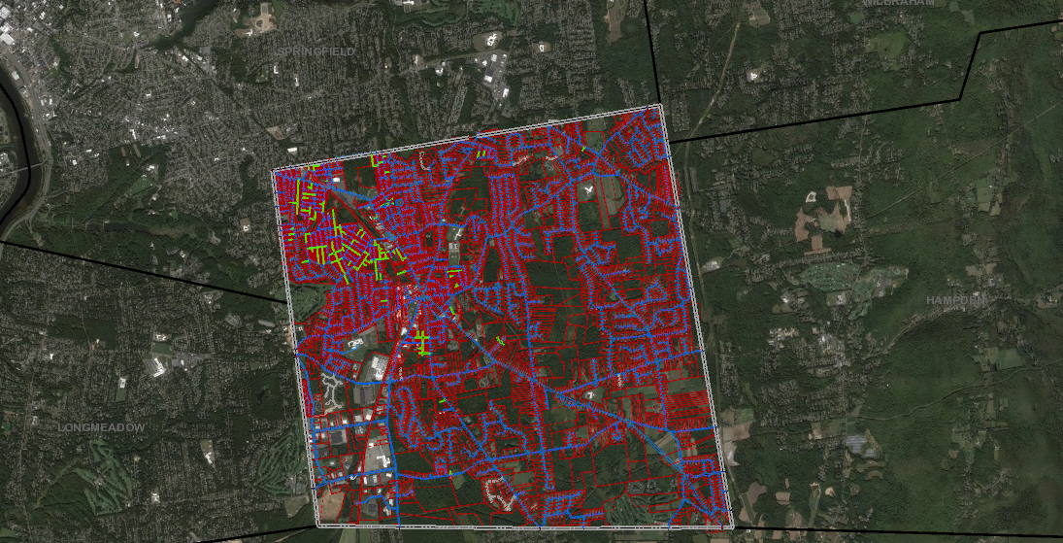
Research Your Property Find your Deed, Order of Conditions, Subdivision Plan, Mortgage and other Public Records by following these steps!

Slide 2
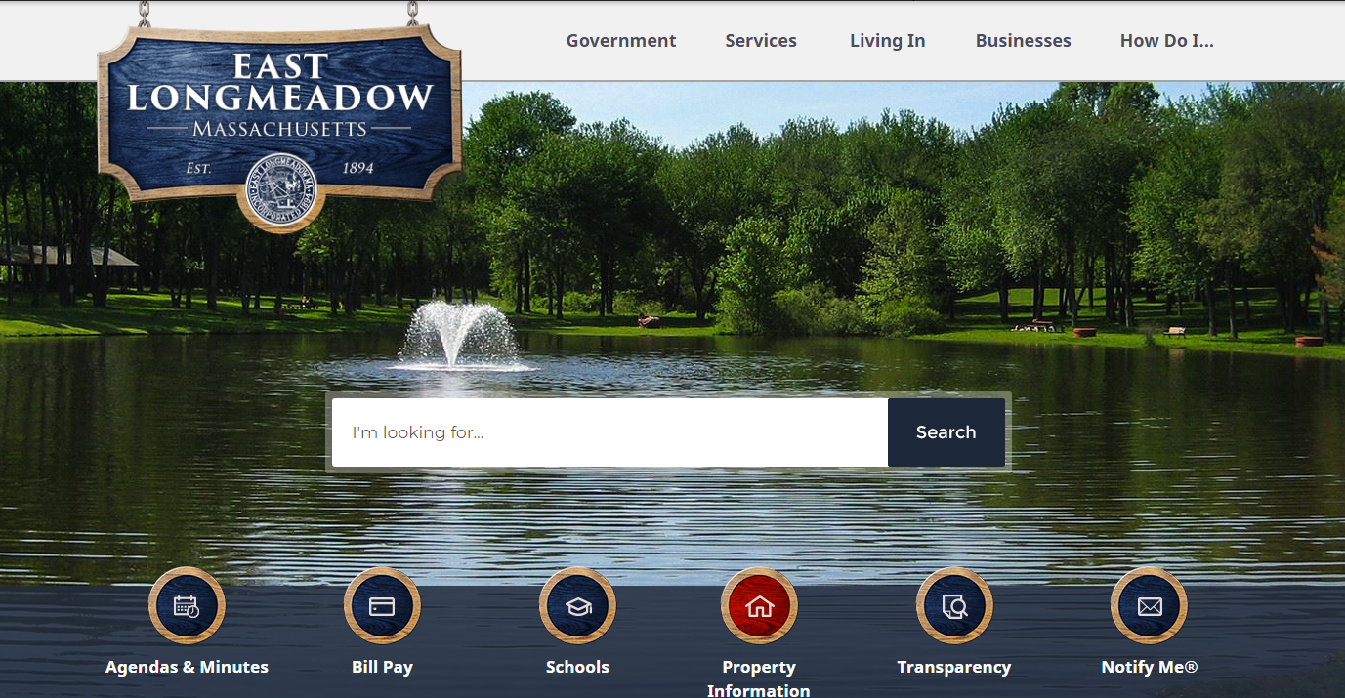
Step 1. Start your research off by clicking on Property Information on the front page of the East Longmeadow website: https://www.eastlongmeadowma.gov/

Slide 3
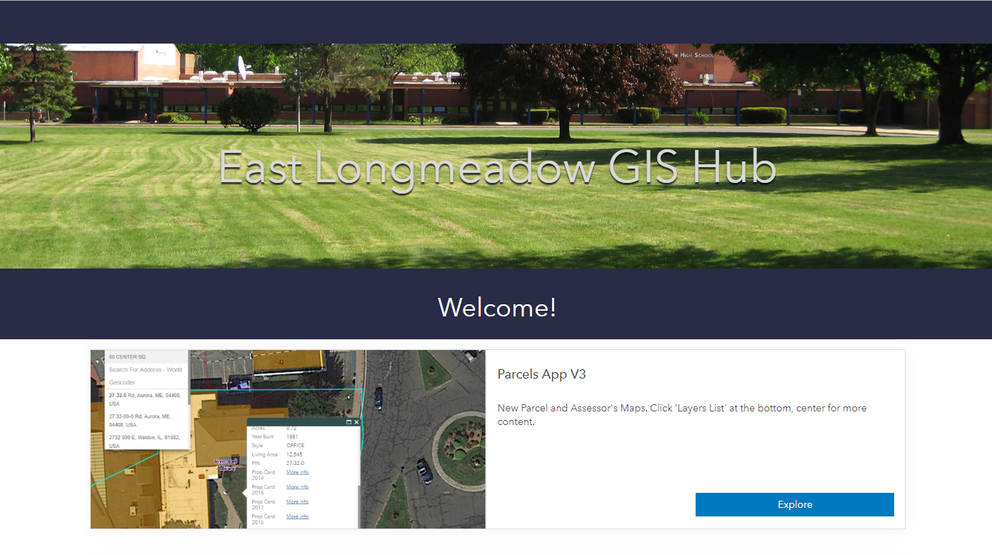
Step 2: Click “explore” on the option for “New Parcel and Assessor's Maps.

Slide 4
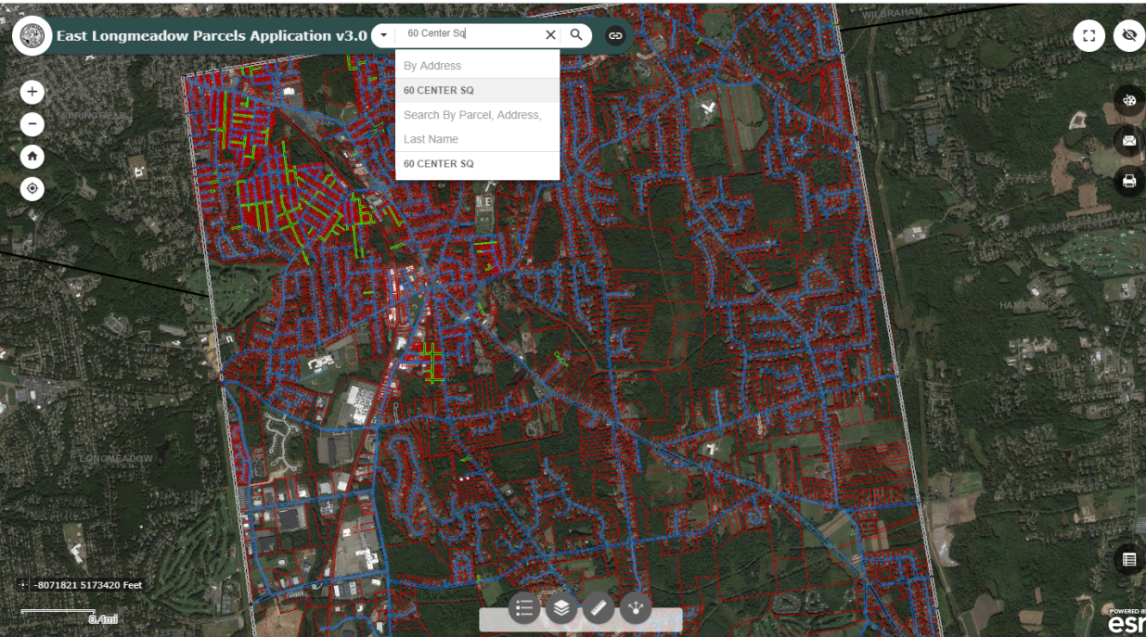
Step 3. Enter your address/last name into the search bar

Slide 5
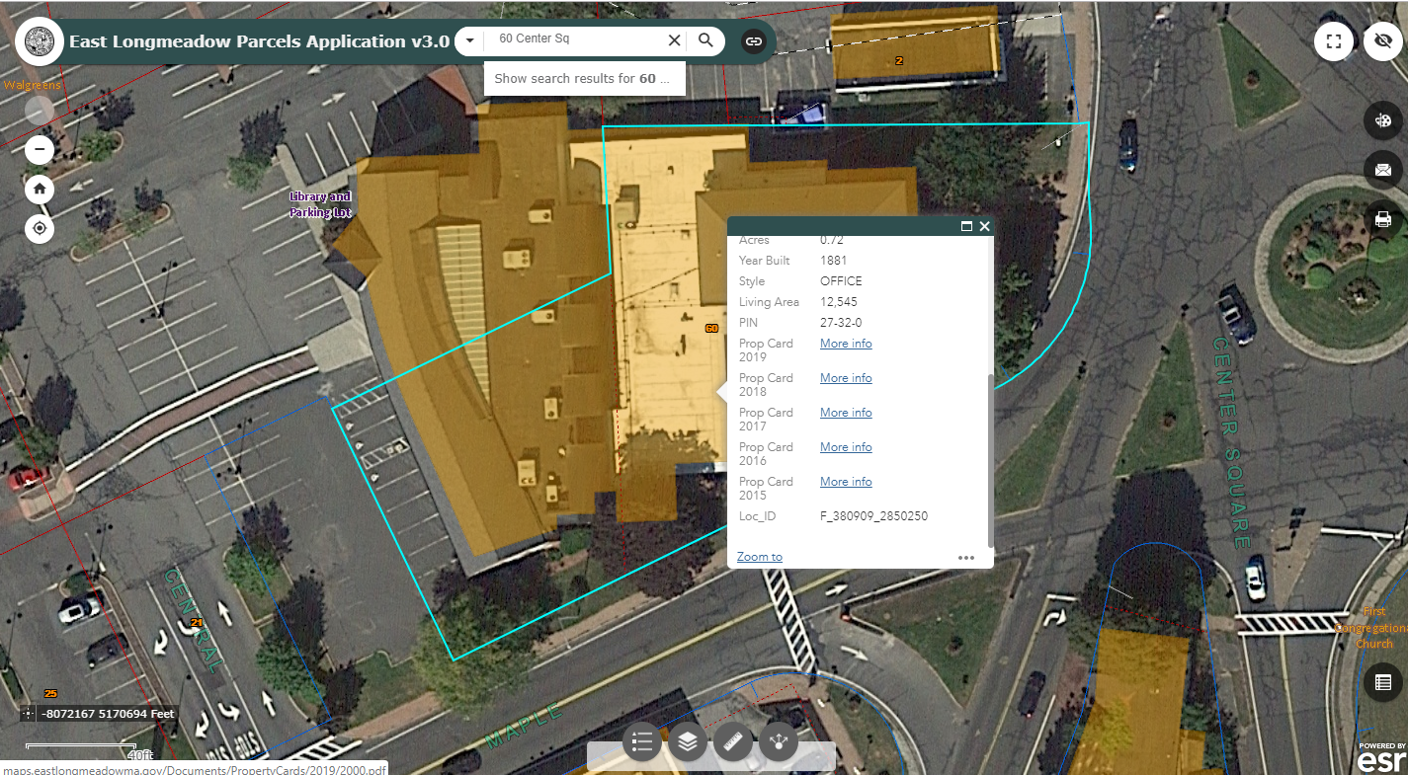
Step 4. A window will pop up with basic information for the property you searched. Scroll all the way down on the pop up and click on “more info” next to “ Prop(erty) Card 2019”

Slide 6
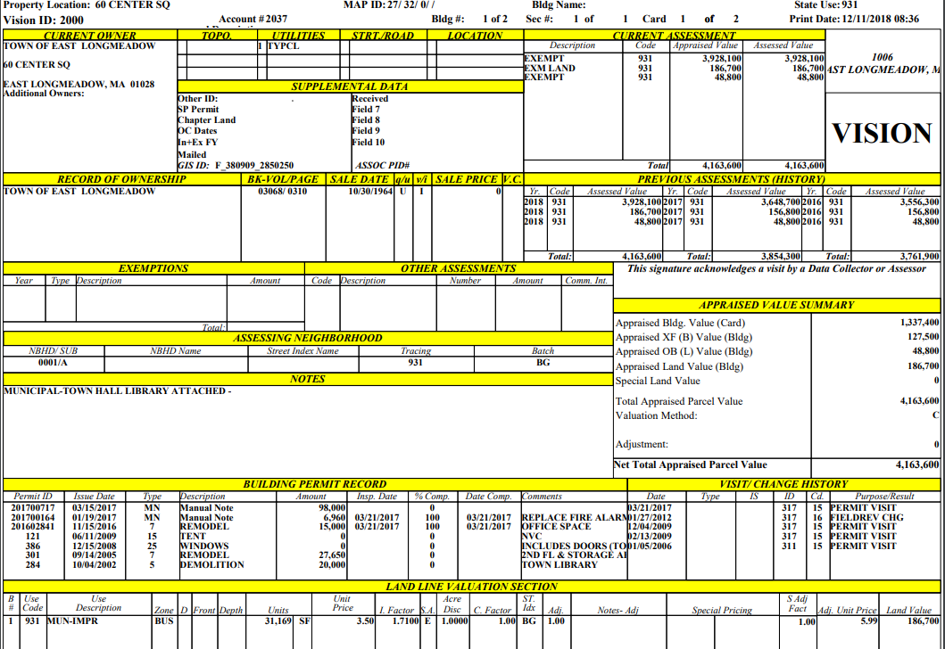
Step 5. This will open a new window showing the entire property card. Important details to note:
Your Parcel ID is located at the top center of the document “MAP ID: ##/##/#“ (The last digit is the lot number)
Under BK-VOL/PAGE you will find the Book and Page of the current deed and any previous deeds for the property

Slide 7
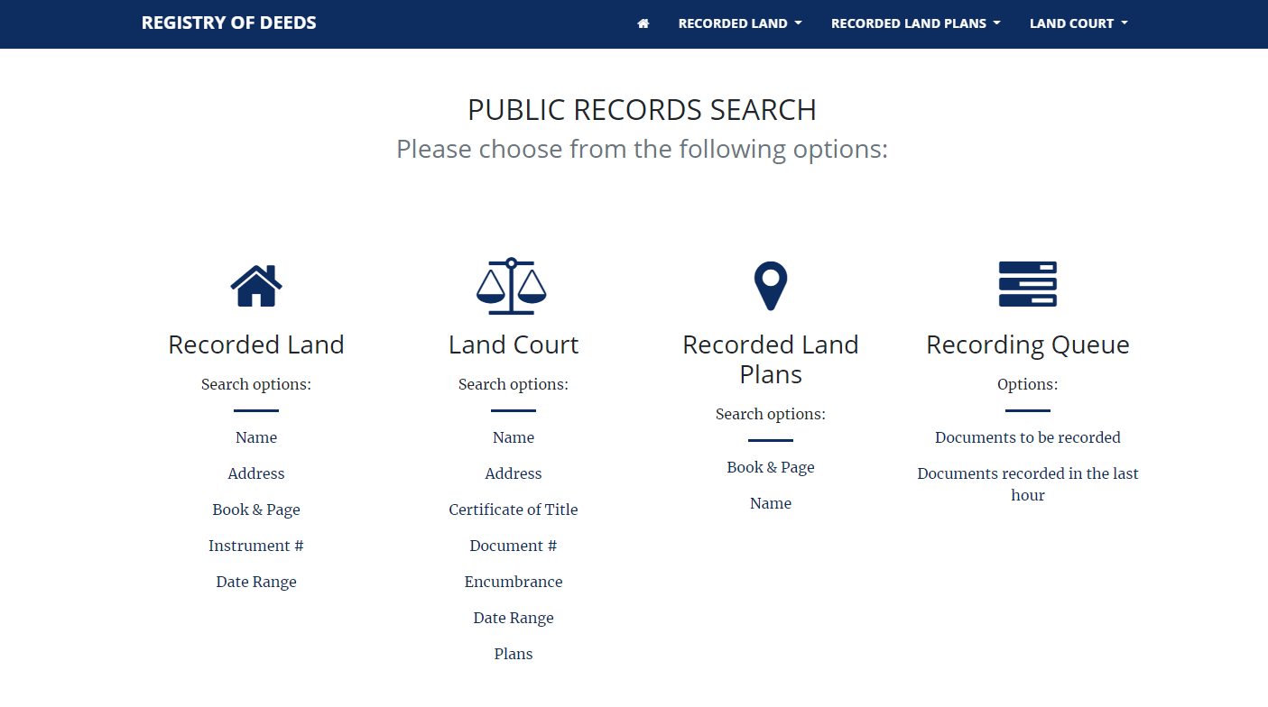
Step 6. To search for more information on your property use the Book and Page numbers by going to the Hampden Registry of Deeds website: https://search.hampdendeeds.com/html/Hampden/V3/search.html

Slide 8
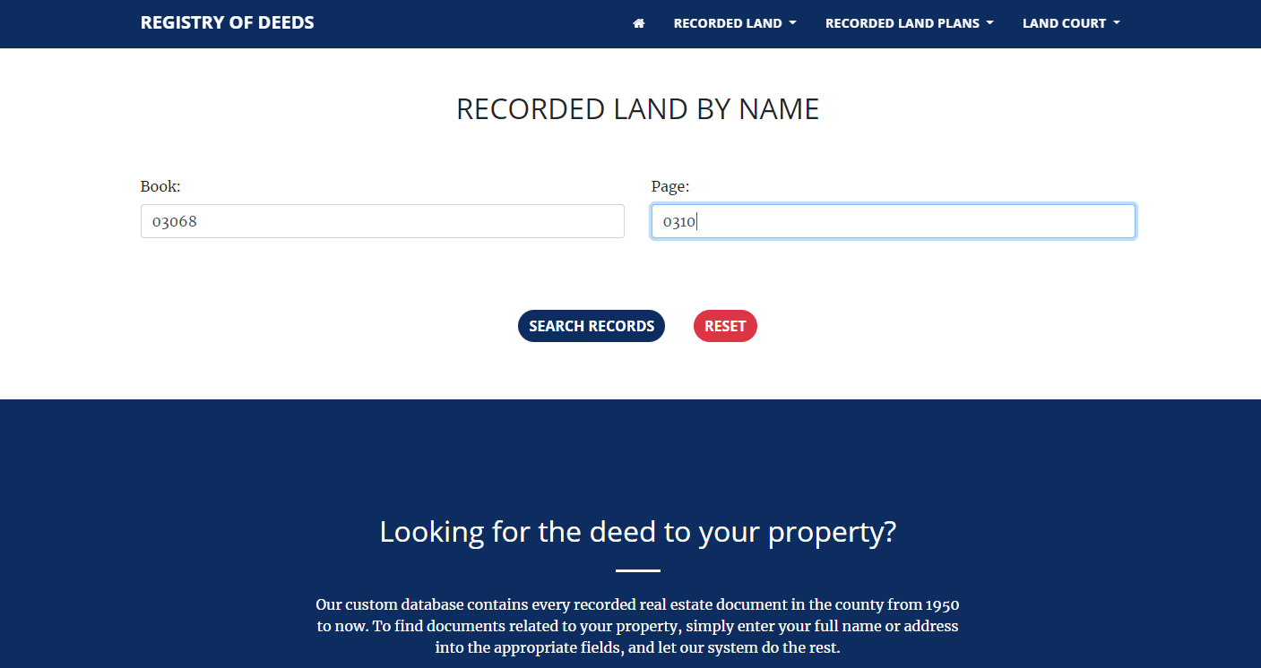
7. Under Recorded Land click on Book & Page and then enter the Book and Page number you found on the property card.

Slide 9
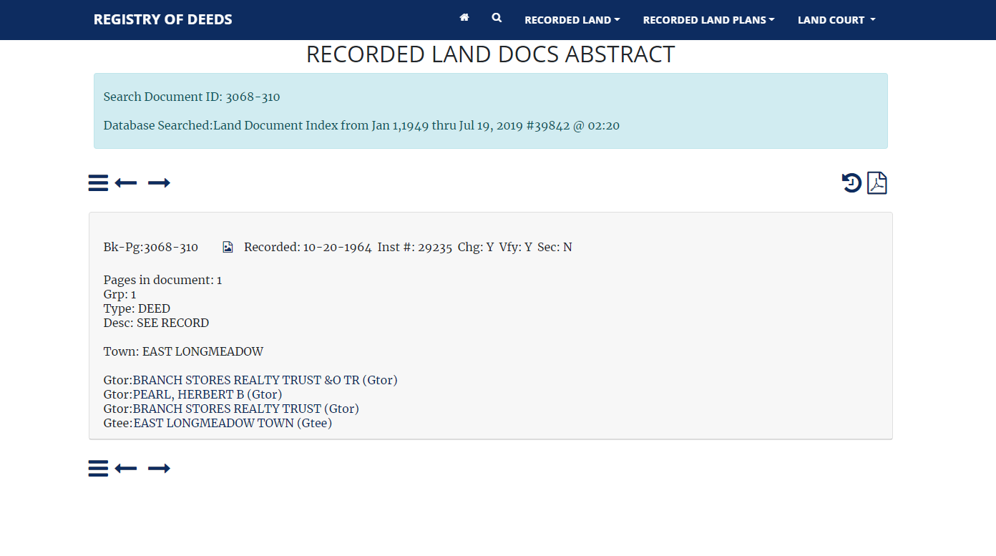
Step 7 Cont.

Slide 10
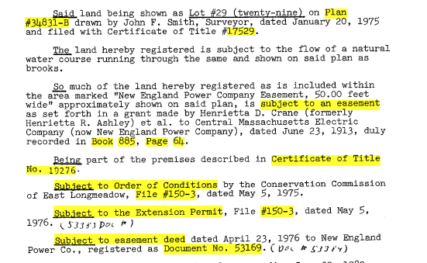
Step 8. The deed should mention if the property is subject to any other conditions /restrictions etc. Look for Book and Page numbers mentioned in the deed to continue your research as needed as.
See highlighted information in the example below:

Slide 11

HELPFUL TIPS
If you are having trouble locating the document you seek, despite having the address or book and page information, try searching under the subdivision name or original owner of the subdivision which would be mentioned in the deed (probably in an earlier deed so go back to your property card and look up the book and page under the earliest date listed then repeat steps 5 & 6.)
Please keep in mind that these documents were created by humans who may have made errors at some point in the creation and process of recording the documents. Typos may have occurred and older documents may not have been recorded properly or, recorded at all.
Tired? Confused? Lost?

Slide 12
Please do not hesitate to contact the Planning and Community Development Department for further guidance.
Town of East Longmeadow
Department of Planning and Community Development
60 Center Square
East Longmeadow, Massachusetts 01028
(413) 525-5400 - ext. 1700
Bethany.Yeo@eastlongmeadowma.gov
Thank you and--Enjoy!

